Slide 1
Solutions
Mr. Mesiouris

Slide 2
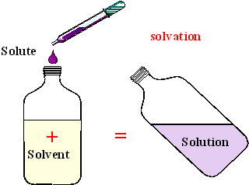
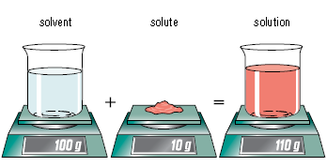
What is a solution?
A solution is a homogenous mixture made up of two or more substances combined in a single phase. It is a physical mixture, and not a chemical reaction.
The solute is dissolved in the solvent
Solute – the substance dissolved in solution
Solvent – the dissolving medium
Notice: the volume doesn’t change, but mass does.

Slide 3
Types of Solutions
Solute | Solvent | Example
Gas | Gas | The air.
Gas | Liquid | soda
Liquid | Gas | Fog
Liquid | Liquid
Liquid | Solid
Solid | Liquid | Salt water
Solid | Solid | Alloys
* There is ALWAYS a greater amount of solvent in g/g , g/l , l/l solutions.

Slide 4
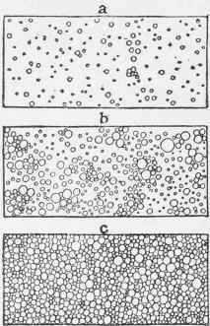
Suspensions vs. Solutions
Suspension – occurs when the solute particles are so large that they will settle to the bottom of the container if left alone
Think about milk….

Slide 5
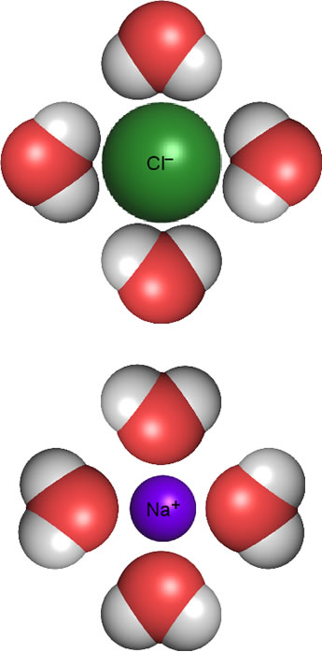
Dissolving / Hydrating
When you put certain things in water, they will ‘disappear’
This is because of the water molecules surrounding the other molecules and dispersing them throughout the water.
A molecule or ion that is surrounded by water molecules is ‘hydrated’ and chemists describe this using the subscript (aq) much like (s) , (l) , and (g)

Slide 6
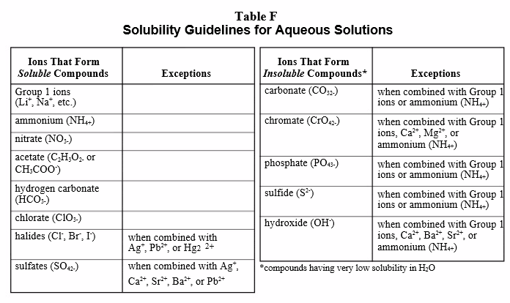
Solubility
Solubility Rules (Table F) – Help you to determine whether or not a compound is soluble in water.

Slide 7


Concept Check
Is the following compound soluble:
NaNO₃
No
Yes

Slide 8
Concept Check
Is the following compound soluble:
NaNO₃
No
Yes

Slide 9
Concept Check
Is the following compound soluble:
FeCl₂
No
Yes

Slide 10
Concept Check
Is the following compound soluble:
FeCl₂
No
Yes

Slide 11
Concept Check
Is the following compound soluble:
AlPO₄
No
Yes

Slide 12
Concept Check
Is the following compound soluble:
AlPO₄
No
Yes

Slide 13
Concept Check
Is the following compound soluble:
Ba(OH)₂
No
Yes

Slide 14
Concept Check
Is the following compound soluble:
Ba(OH)₂
No
Yes

Slide 15
Concept Check
Is the following compound soluble:
AgCl
No
Yes

Slide 16
Concept Check
Is the following compound soluble:
AgCl
No
Yes

Slide 17
Concept Check
REGENTS
QUESTION
Based on the full Reference Table F, which of the following saturated solutions would be the least concentrated?
1.
2.
3.
4.
sodium sulfate potassium sulfate copper (II) sulfate barium sulfate

Slide 18
Concept Check
REGENTS
QUESTION
Based on the full Reference Table F, which of the following saturated solutions would be the least concentrated?
1.
2.
3.
4.
sodium sulfate potassium sulfate copper (II) sulfate barium sulfate

Slide 19
Solutions of Different Proportions
Solutions have proportions that are variable, to an extent. Saline solution and sea water are the same solution, but have different proportions of salt.
We have 4 terms that we use to generally describe the proportions of solutions:
Unsaturated Saturated Supersaturated Saturated with Extra
What do those mean?
Lets draw them out

Slide 20
Solutions of Different Proportions
Unsaturated
Solvent is not holding the maximum amount of solute.
Homogenous mixture
Saturated
Solvent is holding the maximum amount of solute
Homogenous mixture
Supersaturated
Solvent is holding more than the maximum amount of solute
Homogenous mixture
Saturated with Extra
Solvent is holding the maximum amount of solute, with any extra solute at the bottom
Heterogeneous mixture

Slide 21
Using Table G
Table G shows us the solubility of a number of compounds.
If we are given the temperature, mass of the solute, and the volume of the solvent (it MUST be water), we can determine if the solution is saturated, unsaturated, or supersaturated.
Any value below the line is unsaturated
Any value above the line is either supersaturated or saturated with extra
Any value on the line is saturated.
Example: How much ammonium chloride would we need to saturate 100 ml of water at 70ºC ?

Slide 22
Concept Check
At what temperature is a solution of 52 g of HCl in 100 ml of water saturated?
1.
2.
3.
70ºC
80ºC
90ºC

Slide 23
Concept Check
At what temperature is a solution of 52 g of HCl in 100 ml of water saturated?
1.
2.
3.
70ºC
80ºC
90ºC

Slide 24
Concept Check
You make a solution of ammonia, using 50 g of solute and 100 g of solvent. At what temperature is the solution saturated?
1.
2.
3.
20ºC
25ºC
30ºC

Slide 25
Concept Check
You make a solution of ammonia, using 50 g of solute and 100 g of solvent. At what temperature is the solution saturated?
1.
2.
3.
20ºC
25ºC
30ºC

Slide 26
Concept Check
You make a solution of sodium nitrate, at 35ºC using 100 g of solute and 200 g of solvent. Is the solution saturated?
No
Yes

Slide 27
Concept Check
You make a solution of sodium nitrate, at 35ºC using 100 g of solute and 200 g of solvent. Is the solution saturated?
No
Yes

Slide 28
Concept Check
REGENTS
QUESTION
According to Reference Table G, which compound’s solubility decreases most rapidly as the temperature changes from 10ºC to 70ºC?
1.
2.
3.
4.
NH₄Cl NH₃ HCl KCl

Slide 29
Concept Check
REGENTS
QUESTION
According to Reference Table G, which compound’s solubility decreases most rapidly as the temperature changes from 10ºC to 70ºC?
1.
2.
3.
4.
NH₄Cl NH₃ HCl KCl

Slide 30
Solute / Solvent Interactions
“Like Dissolves Like”
A polar solvent will dissolve a polar solute, and vice versa.
Example: Oil (a non polar molecule) wont dissolve in water, but ethanol (a polar molecule) will.
SPECIAL Vocab: in a l / l solution, if the solute is able to dissolve, it is ‘miscible’ (ethanol and water are miscible), if the solute is unable to dissolve, the two substances are ‘immiscible’ (oil and water are immiscible)

Slide 31
Factors That Effect Solubility
Surface Area of Solute – If you increase the surface area of the solute, you allow the solvent to interact with more of it, increasing its solubility.
Agitation – If you stir the solution, you mix the solute, forcing it to collide with solvent particles, increasing its solubility (though it may be temporary)
Amount dissolved – The more solute already dissolved in a solution, the harder it will be to dissolve more.
Temperature – If you increase the temperature, you increase the rate that solute and solvent particles collide, which makes them interact, and increases the solubility of the solute

Slide 32
Rate of Solution vs Solubility
Two very different ideas.
Rate of solution refers ONLY to how quickly a substance is dissolving.
Solubility is the measure of how well the substance dissolves.
To describe a solution, you should use both.
Ex – The powder has a high solubility, and a high rate of solution in the warm water.
Ex – The large chunk of solid has a high solubility, but a low rate of solution in the cold water

Slide 33
Concept Check
You put 2 kg of a solid into a beaker containing 500 ml of water. You check back every day for a week. At the end of the week you can see no more solid. Which is true about the solution?
1.
2.
3.
It has high solubility but a low rate of solution
It has a low solubility but a high rate of solution
It has a high solubility and a high rate of solution

Slide 34
Concept Check
You put 2 kg of a solid into a beaker containing 500 ml of water. You check back every day for a week. At the end of the week you can see no more solid. Which is true about the solution?
1.
2.
3.
It has high solubility but a low rate of solution
It has a low solubility but a high rate of solution
It has a high solubility and a high rate of solution

Slide 35
Concept Check
How would you NOT increase the rate of solution of a salt in water?
1.
2.
3.
Stir the solution
Add salt to the solution
Increase the surface area of the salt

Slide 36
Concept Check
How would you NOT increase the rate of solution of a salt in water?
1.
2.
3.
Stir the solution
Add salt to the solution
Increase the surface area of the salt

Slide 37
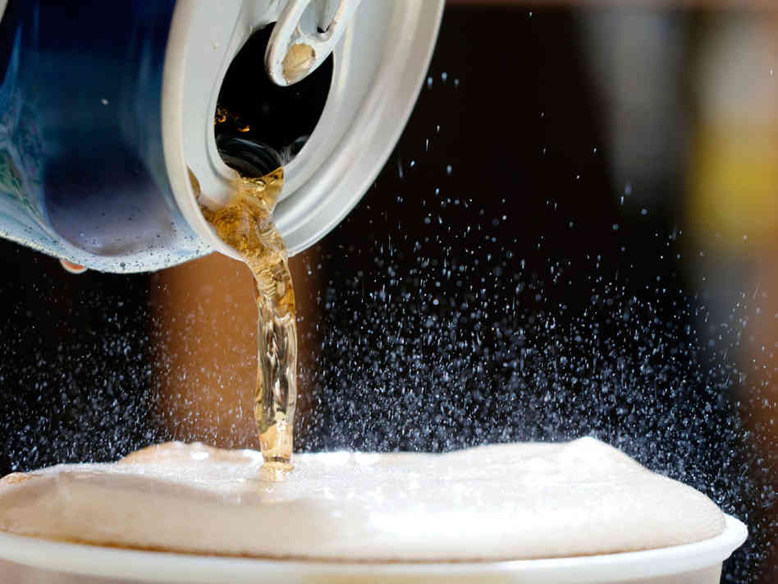
Special Factors That Effect Gas Solubility
Agitation – What happens to the gas (solute) in a soda when you shake it?
Pressure – Doesn’t have an effect on other solutes, but it changes the solubility of gases. Gas creates an equilibrium in the container with the solution:
Temperature – When you heat a gas / liquid solution, it helps the gas escape the solution. Increasing the temperature lowers the solubility of a gas
Effervescence – The rapid escape of a gas from a liquid (fizzing, foaming)

Slide 38
Concept Check
You are trying to make soda, and you are carbonating the liquid too much. What could you do to lower the amount of carbon dioxide in your soda?
1.
2.
3.
Increase the pressure that the liquid is under
Carbonate the soda at a lower temperature
Lower the pressure in the bottles of soda

Slide 39
Concept Check
You are trying to make soda, and you are carbonating the liquid too much. What could you do to lower the amount of carbon dioxide in your soda?
1.
2.
3.
Increase the pressure that the liquid is under
Carbonate the soda at a lower temperature
Lower the pressure in the bottles of soda

Slide 40
Concentration
We need a more precise way to measure the amount of solute in a solution. Saturated, unsaturated and supersaturated are not good enough.
The good news is that we have 3 different methods to calculate concentration.
Molarity parts per million % by mass

Slide 41
Molarity (M)
Moles solute
Liter of solution
Examples:
What is the molarity of 80 g of sodium hydroxide in 500 ml of solution?
How many moles of solute are in a 2 L sample of 6 molar hydrochloric acid?

Slide 42
Parts per million
On the reference table, in Table T
*You can use any unit, as long as they remain the same for the solute and the solution*
Examples
There is one atom of gold for every 500 g of water in Cayuga lake, what is the gold concentration in parts per million?
What is the concentration of a solution, in parts per million, if 0.02 gram of Na₃PO₄ is dissolved in 1 L of water?
A chemical analysis shows that a sample contains 250.0 micrograms of Uranium in 4.00 x 10⁴ grams of water.
Mass of solute
Mass of solution
X 1 000 000

Slide 43
% by mass
Mass solute
Mass solution
Examples:
What is the percent by mass of 80 g of sodium hydroxide in 500 ml of water?
How many grams of solute are in 800 grams of a 25 % by mass solution?
How much water would be needed to make 85 grams of solute into a 40% by mass solution?
X 100

Slide 44
Concept Check
REGENTS
QUESTION
What is the concentration of a solution of 10 moles of copper (II) nitrate in 5 L of solution?
1.
2.
3.
4.
0.50 M 2.0 M 5.0 M 10 M

Slide 45
Concept Check
REGENTS
QUESTION
What is the concentration of a solution of 10 moles of copper (II) nitrate in 5 L of solution?
1.
2.
3.
4.
0.50 M 2.0 M 5.0 M 10 M

