Slide 1
Bonding
Mr. Mesiouris

Slide 2
The Name is Bond, Chemical Bond.
A chemical bond is formed when the nucleus of one atom pulls on the electrons of another.
The bond is formed by the transferring or sharing of electrons. There are 3 types of bonds:
Ionic, Covalent, and metallic
The type of bond is determined by a value called the electronegativity difference

Slide 3
Electronegativity Difference
We have already talked about electronegativity before, during our discussion of atomic trends.
What is electronegativity?
What is the electronegativity difference between two atoms?

Slide 4
Electronegativity Difference
If the electronegativity difference (END) is 2 or more, then the bond is ionic. If the END is less than 2, then the bond is covalent
We will start off with ionic bonds and substances, then move on to covalent bonds and substances.

Slide 5
Ionic Bonds (metal + nonmetal)
When the END of the atoms is 2 or more, the bond is considered ionic. This means that the electrons are transferred between the atoms and not shared.
In a substance like FrF, fluorine steals the electron away from francium.
Now F has a negative charge (because of the extra electron)
And Fr has a positive charge (because of the missing electron)
The two atoms now bond to each other because of these charges. Like magnets.

Slide 6
Properties of Ionic Substances
Ionic substances have a number of properties that can help distinguish them from other substances.
They are:
Hard
Good conductors of heat and electricity in their liquid or aqueous forms
High melting and boiling points

Slide 7
Anions and Cations
There are two types of ions: Positive and negative, depending on whether the atoms gain or lose electrons.
An anion is negative, most of the elements on the right side of the periodic table form anions.
CATions are PAWsitive. Most of the elements on the left side of the periodic table form cations.
Thinking back to FrF, which is the cation, which is the anion?

Slide 8
The Lewis Structures of Ionic Compounds
Draw the Lewis structure of F, and the Lewis structure of Fr.
Based on what we said before (F steals the electron from Fr) draw what you think you would see happen to each of these atoms’ valence shells.

Slide 9
Naming Ionic Compounds
We’ll start with an example: NaCl, table salt.
The FIRST ion is ALWAYS POSITIVE, the SECOND ion is ALWAYS NEGATIVE
The positive ion keeps its name: Sodium
The negative ion keeps the start of its name, then has the end replaced with –ide: Chlorine → Chloride

Slide 10
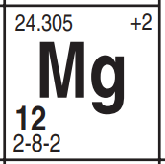
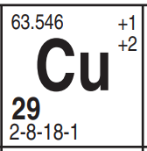
Atoms with Multiple Oxidation States
On the reference table, there is a number on the upper right of each periodic table cell.
That is the oxidation state, it tells you how many electrons that atom can gain or lose.
Transition metals have more than one, due to the way their electrons are placed.
How do we tell the difference between Cu⁺¹ and Cu⁺²?

Slide 11
Atoms with Multiple Oxidation States
On the reference table, there is a number on the upper right of each periodic table cell.
That is the oxidation state, it tells you how many electrons that atom can gain or lose.
Transition metals have more than one, due to the way their electrons are placed.
How do we tell the difference between Cu⁺¹ and Cu⁺²?
Roman numerals! When we talk about CuCl₂, we say copper (II) chloride.
To find the correct roman numeral we use the “criss cross” method. Watch closely….

Slide 12
Atoms with Multiple Oxidation States
Steps CuCl CuCl₂
Assign 1s
Criss Cross
Assign Charge
Check P.T
Name

Slide 13
Practice
Name the following compounds:
CaS
MnO₂
BeCl₂
Ra₃P₂
Li₂O
BaBr₂
CsI
LiH
H₂S
FeS
MgO
CrO₃

Slide 14
Practice
Name the following compounds:
CaS Calcium sulfide
MnO₂ Manganese (IV) oxide
BeCl₂ Beryllium chloride
Ra₃P₂ Radium phosphide
Li₂O lithium oxide
BaBr₂ barium bromide
CsI Cesium iodide
LiH lithium hydride
H₂S hydrogen sulfide
FeS iron (II) sulfide
MgO Magnesium oxide
CrO₃ Chromium (VI) oxide

Slide 15
More Practice
CoO
NiCl₃
PdO₂
Mn₂S₇
NbI₅
TiS₂
TlP

Slide 16
More Practice
CoO Cobalt (II) Oxide
NiCl₃ Nickel (III) chloride
PdO₂ Palladium (IV) oxide
Mn₂S₇ manganese (VII) sulfide
NbI₅ niobium (V) iodide
TiS₂ titanium (IV) sulfide
TlP thallium (III) phosphide

Slide 17
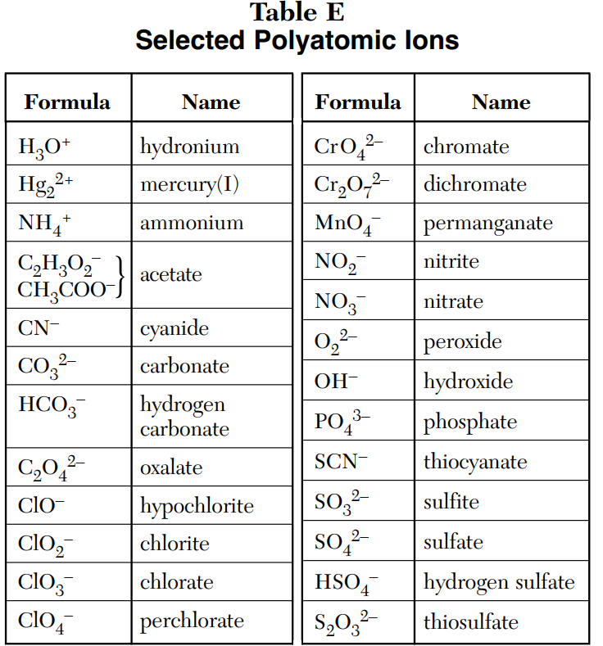
Polyatomic Ions
Polyatomic ions are listed on Table E in your reference table.
They are treated as a unit and are usually not broken up into their elements.
When they are in an ionic compound, you don’t change their name, you leave them as they are.
Ex. LiNO₃ is lithium nitrate

Slide 18
Compounds with Polyatomic Ions
How do polyatomic ions change the way we name compounds and do the criss cross method?
Steps Fr₂C₂O₄ Mg₃(PO₄)₂ FeCO₃
Assign 1s
Criss Cross
Assign Charge
Check P.T
Name

Slide 19
Practice
KNO₃
Rb₂CO₃
Ca(ClO₃)₂
Cu(NO₃)₂
Li₂SO₄
Na₃PO₄
Al(OH)₃
NH₄OH
FeSO₄
Ni(OH)₃

Slide 20
Practice
KNO₃ Potassium nitrate
Rb₂CO₃ rubidium carbonate
Ca(ClO₃)₂ calcium chlorate
Cu(NO₃)₂ copper (II) nitrate
Li₂SO₄ lithium sulfate
Na₃PO₄ sodium phosphate
Al(OH)₃ aluminum hydroxide
NH₄OH ammonium hydroxide
FeSO₄ iron (II) sulfate
Ni(OH)₃ nickel (III) hydroxide

Slide 21
Going Backwards!!
How do we reverse the criss cross method to get a formula from a name?
Steps calcium bromide iron (III) nitrate barium sulfide aluminum phosphate
Assign 1s
Criss Cross
Assign Charge
Check P.T
Name

Slide 22
Going Backwards!!
How do we reverse the criss cross method to get a formula from a name?
Steps calcium bromide iron (III) nitrate barium sulfide aluminum phosphate
Name
Check PT
Assign Charge
Criss Cross
Assign 1s

Slide 23
Going Backwards!!
How do we reverse the criss cross method to get a formula from a name?
Steps calcium bromide iron (III) nitrate barium sulfide aluminum phosphate
Find Ions
Check PT
Assign Charge
Criss Cross
Reduce

Slide 24
Going Backwards!!
Lithium chloride
Beryllium sulfide
Boron chloride
Copper (II) Nitrate
Lead (IV) iodide
Aluminum oxide
Chromium (VI) phosphide
Tin (IV) oxide
Iron (II) bromide
Sodium bromide
Aluminum fluoride
Copper (II) oxide
Manganese (IV) sulfide
Iron (III) sulfate
Sodium fluoride
Copper (II) chloride

Slide 25
Going Backwards!!
Lithium chloride LiCl
Beryllium sulfide BeS
Boron chloride BCl₃
Copper (II) Nitrate Cu(NO₃)₂
Lead (IV) iodide PbI₄
Aluminum oxide Al₂O₃
Chromium (VI) phosphide CrP₂
Tin (IV) oxide SnO₂
Iron (II) bromide FeBr₂
Sodium bromide NaBr
Aluminum fluoride AlF₃
Copper (II) oxide CuO
Manganese (IV) sulfide MnS₂
Iron (III) sulfate Fe₂(SO₄)₃
Sodium fluoride NaF
Copper (II) chloride CuCl₂

Slide 26
Covalent bonds (nonmetal + nonmetal)
When the electronegativity difference is less than 2, that means that the bond is covalent. The atoms share the electrons between them, and DON’T become ions
Some common chemicals are covalently bonded:
H₂O CH₄ NH₃

Slide 27
Properties of Covalent Compounds
When a covalent compound is made, it gains new properties, because it is a new substance.
Many covalent substances have these properties:
Soft
Low melting/boiling points
Poor conductors of heat and electricity

Slide 28
Dot Structures of Covalent Compounds
NH₃
HCl
H₂O
CH₄
Draw the lewis dot structure of each atom in the molecule
(for example, NH₃ has 1 N and 3 H’s)
Then, find how the atoms would fit together to make each one look like a noble gas
(N wants 8 electrons surrounding it, H wants 2 electrons surrounding it)

Slide 29
Dot Structures of Covalent Compounds
NH₃
HCl
H₂O
CH₄

Slide 30
Drawing Practice!
CH₂Br₂
H₂S
C₂H₆
CClBrFI (C , Cl, Br, F, then I)
CH₂O

Slide 31
Double and Triple Bonds
C₂H₄
C₂H₂
N₂
O₂
C₃H₄ (There are 2 correct answers here!)
CO₂

Slide 32
Network Solids
These form when atoms are covalently bonded in one big network.
The substances don’t have separate particles, they are one big molecule.
For example, diamond is a network solid, made of carbon atoms all bonded to each other. Each diamond is one molecule.

Slide 33
Types of Covalent Bonds
Non-polar covalent – electrons between the atoms are shared equally
  Common non-polar covalent molecules (the diatomic molecules): Br₂ I₂ N₂ Cl₂ H₂ O₂ F₂
Polar covalent – electrons between the atoms are NOT shared equally.
  Almost everything else has bonds that are slightly polar

Slide 34


Concept Check
Does the following molecule have polar or non polar bonds?
NH₃
Polar
Non-polar

Slide 35
Concept Check
Does the following molecule have polar or non polar bonds?
NH₃
Polar
Non-polar

Slide 36
Concept Check
Does the following molecule have polar or non polar bonds?
CH₄
Polar
Non-polar

Slide 37
Concept Check
Does the following molecule have polar or non polar bonds?
CH₄
Polar
Non-polar

Slide 38
Concept Check
Does the following molecule have polar or non polar bonds?
CH₃Cl
Polar
Non-polar

Slide 39
Concept Check
Does the following molecule have polar or non polar bonds?
CH₃Cl
Polar
Non-polar

Slide 40
Concept Check
Does the following molecule have polar or non polar bonds?
H₂
Polar
Non-polar

Slide 41
Concept Check
Does the following molecule have polar or non polar bonds?
H₂
Polar
Non-polar

Slide 42
Concept Check
Does the following molecule have polar or non polar bonds?
HCl
Polar
Non-polar

Slide 43
Concept Check
Does the following molecule have polar or non polar bonds?
HCl
Polar
Non-polar

Slide 44
Polar Molecules
Entire molecules can be polar or non polar too.
If the spread of electrons in a molecule is not even, then the molecule is polar. We can tell if the electrons are evenly spread or not by the bonding in the molecule.
A symmetrical molecule is non polar. CO₂
An asymmetrical molecule is polar. H₂O

Slide 45
Concept Check
Is the following molecule polar or non-polar
NH₃
Polar
Non-polar

Slide 46
Concept Check
Is the following molecule polar or non-polar
NH₃
Polar
Non-polar

Slide 47
Concept Check
Is the following molecule polar or non-polar
CH₄
Polar
Non-polar

Slide 48
Concept Check
Is the following molecule polar or non-polar
CH₄
Polar
Non-polar

Slide 49
Concept Check
Is the following molecule polar or non-polar
CH₃Cl
Polar
Non-polar

Slide 50
Concept Check
Is the following molecule polar or non-polar
CH₃Cl
Polar
Non-polar

Slide 51
Concept Check
Is the following molecule polar or non-polar
H₂
Polar
Non-polar

Slide 52
Concept Check
Is the following molecule polar or non-polar
H₂
Polar
Non-polar

Slide 53
Concept Check
Is the following molecule polar or non-polar
HCl
Polar
Non-polar

Slide 54
Concept Check
Is the following molecule polar or non-polar
HCl
Polar
Non-polar

Slide 55
BOND
MOLECULE
NON
POLAR
POLAR

Slide 56
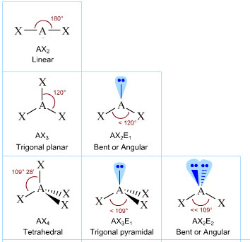
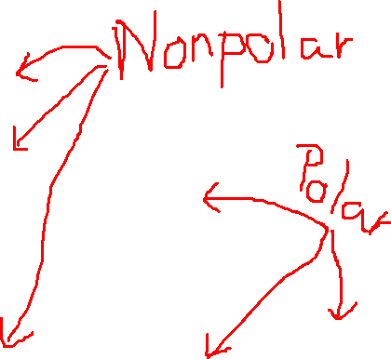
Molecular Shapes
The nuclei of atoms want to be as far away from each other as possible (because like charges repel)
Depending on the number of atoms that are bonded together, and the number of lone pairs of electrons, there are a few different shapes that can occur to make the molecule as stable as possible

Slide 57
Intermolecular Forces
Bonds exist inside the molecules; they are intramolecular forces.
BETWEEN two molecules, we have intermolecular forces. The forces that hold molecules together.
There are three types:
  Dispersion forces
  Dipole-Dipole forces
  Hydrogen bonding
  Every molecule has at least one type of intermolecular force.

Slide 58
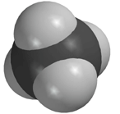
Dispersion Forces
Lowest strength intermolecular force
Nonpolar molecules have ONLY dispersion forces
Strength increases as the size and mass of the molecules increase.

Slide 59
Concept Check
REGENTS
QUESTION
The strongest dispersion forces exist between molecules of …
1.
2.
3.
4.
F₂ I₂ Cl₂ Br₂

Slide 60
Concept Check
REGENTS
QUESTION
The strongest dispersion forces exist between molecules of …
1.
2.
3.
4.
F₂ I₂ Cl₂ Br₂

Slide 61
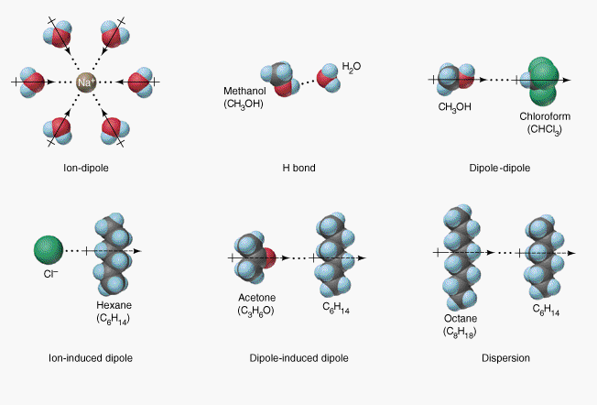
Dipole-Dipole Forces
Medium strength intermolecular force
A dipole is made when a polar bond exists in a molecule
The unequal sharing causes slight positives and slight negatives, which are attracted to each other.

Slide 62
Hydrogen Bonding
The strongest intermolecular force
NOT ACTUALLY A BOND!
It happens when a polar molecule has H bonded to F, O, or N. (the three most polar bonds)

Slide 63
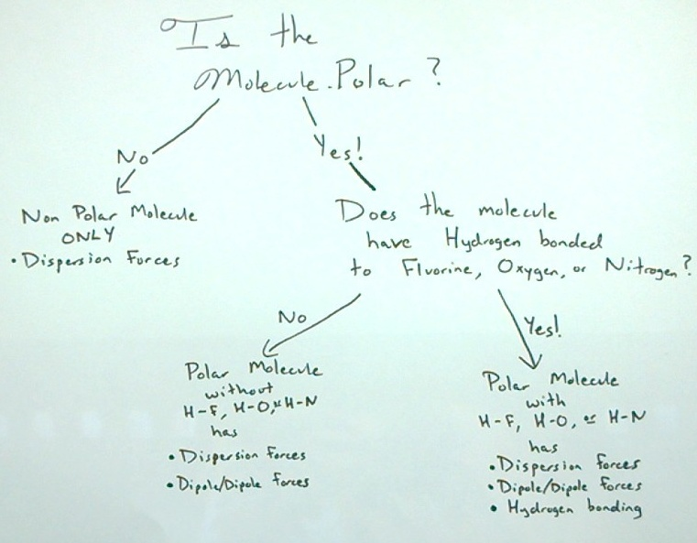

Slide 68
Concept Check
Which molecule has only dispersion forces?
1.
2.
3.
HF
CH₄
CH₂O

Slide 69
Concept Check
Which molecule has only dispersion forces?
1.
2.
3.
HF
CH₄
CH₂O

Slide 70
Concept Check
Which molecule has dipole-dipole interactions?
1.
2.
3.
F₂
CH₄
CH₃CH₂OH

Slide 71
Concept Check
Which molecule has dipole-dipole interactions?
1.
2.
3.
F₂
CH₄
CH₃CH₂OH

Slide 72
Concept Check
Which molecule has hydrogen bonding?
1.
2.
3.
HF
CH₄
CH₂O

Slide 73
Concept Check
Which molecule has hydrogen bonding?
1.
2.
3.
HF
CH₄
CH₂O

Slide 74
Connecting Intermolecular Forces
A substance with strong intermolecular forces will have a higher melting point, a higher boiling point, and a lower vapor pressure….
A substance with weak intermolecular forces will have a lower melting point, a lower boiling point, and a higher vapor pressure….

Slide 75
Connecting Intermolecular Forces
A substance with strong intermolecular forces will have a higher melting point, a higher boiling point, and a lower vapor pressure….
Because it takes more energy to force the molecules apart if they have strong intermolecular forces
A substance with weak intermolecular forces will have a lower melting point, a lower boiling point, and a higher vapor pressure….
Because it takes less energy to force the molecules apart if they have weak intermolecular forces

Slide 76
Concept Check
REGENTS
QUESTION
Which pair of elements has the most ionic character?
1.
2.
3.
4.
HF NaCl NaI CsN

Slide 77
Concept Check
REGENTS
QUESTION
Ionic character refers to electronegativity difference!
Which pair of elements has the most ionic character?
4.0-2.2 3.2-0.9 2.7-0.9 3.0-0.8
1.8 2.3 1.8 2.2
1.
2.
3.
4.
HF NaCl NaI CsN

Slide 78
Concept Check
REGENTS
QUESTION
Which of the following exhibits both ionic and covalent bonds?
1.
2.
3.
4.
MgO C₃H₅OH NH₄⁺ NaNO₃

Slide 79
Concept Check
REGENTS
QUESTION
Which of the following exhibits both ionic and covalent bonds?
1.
2.
3.
4.
MgO C₃H₅OH NH₄⁺ NaNO₃

Slide 80
Metallic Bonding (metal + metal)
When metals form solids, they have a special type of bond.
In a metallic bond, the nuclei of the atoms are held in place by repelling forces (positive nuclei around each other).
The electrons though, can move freely around those nuclei. We often call this phenomenon the “sea of electrons”
This metallic bonding is what allows metals to be malleable, ductile, and good conductors

Slide 81
Metallic Bonding (metal + metal)
In a metallic bond, the nuclei of the atoms are held in place by repelling forces (positive nuclei around each other).
The electrons though, can move freely around those nuclei. We often call this phenomenon the “sea of electrons”

Slide 82
Reaction Types
In chemistry, there are five types of reactions that you should be able to recognize.
Synthesis/Combination – A + B → AB
Decomposition - CD → C + D
Single Replacement - Q + RS → R + QS
Double replacement – FG + LM → FM + LG
Combustion - C_{x}H_{y} + O₂ → H₂O + CO₂

Slide 83
Concept Check
REGENTS
QUESTION
What type of chemical reaction is
2 H₂O → 2 H₂ + O₂
Zn + 2 HCl → ZnCl₂ +H₂
2 Mg + O₂ → 2 MgO
1.
2.
3.
4.
synthesis decomposition single rep. double rep.

Slide 84
Concept Check
REGENTS
QUESTION
What type of chemical reaction is
2 H₂O → 2 H₂ + O₂
Zn + 2 HCl → ZnCl₂ +H₂
2 Mg + O₂ → 2 MgO
Decomposition
Single rep.
Synthesis
1.
2.
3.
4.
synthesis decomposition single rep. double rep.

Slide 85
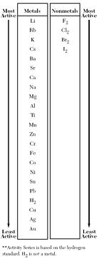
The Activity Series
(Reference Table J)
In a single replacement reaction, the activity series shows which elements will successfully replace other elements.
If an element is higher on the Activity series than the one it is trying to replace, the reaction will go forward.
If an element is lower on the activity series than the one it is trying to replace, the reaction will NOT go forward.

Slide 86
Concept Check
Will the following reaction proceed:
Zn_{(s)} + HCl_{(aq)}
No
Yes

Slide 87
Concept Check
Will the following reaction proceed:
Zn_{(s)} + HCl_{(aq)}
No
Yes

Slide 88
Concept Check
Will the following reaction proceed:
Cu_{(s)} + HCl_{(aq)}
No
Yes

Slide 89
Concept Check
Will the following reaction proceed:
Cu_{(s)} + HCl_{(aq)}
No
Yes

Slide 90
Concept Check
Will the following reaction proceed:
Fe_{(s)} + ZnSO_{4(aq)}
No
Yes

Slide 91
Concept Check
Will the following reaction proceed:
Fe_{(s)} + ZnSO_{4(aq)}
No
Yes

Slide 92
Concept Check
Will the following reaction proceed:
Mg_{(s)} + ZnSO_{4(aq)}
No
Yes

Slide 93
Concept Check
Will the following reaction proceed:
Mg_{(s)} + ZnSO_{4(aq)}
No
Yes

Slide 94
Concept Check
Will the following reaction proceed:
F_{2(g)} + HBr_{(aq)}
No
Yes

Slide 95
Concept Check
Will the following reaction proceed:
F_{2(g)} + HBr_{(aq)}
No
Yes

Slide 96
Concept Check
Will the following reaction proceed:
Cl_{2(g)} + KBr_{(aq)}
No
Yes

Slide 97
Concept Check
Will the following reaction proceed:
Cl_{2(g)} + KBr_{(aq)}
No
Yes

Slide 98
Concept Check
Will the following reaction proceed:
Br_{2(l)} + KCl_{(aq)}
No
Yes

Slide 99
Concept Check
Will the following reaction proceed:
Br_{2(l)} + KCl_{(aq)}
No
Yes

