Slide 1
The Atom:
Structure and History
Mr. Mesiouris

Slide 2
The Law of Conservation of Mass
As scientific instruments improved, scientists could take more accurate measurements.
They found that mass is never gained or lost in a chemical reaction, it remains constant.
Mass is neither created nor destroyed during ordinary chemical reactions or physical changes

Slide 3
The History of the Atom
Ancient Greeks theorized that elements were the most basic substances and could not be broken down into something simpler.
The idea stuck for hundreds of years, and scientists expanded on it with various experiments that led to the creation of scientific laws

Slide 4
The Atomic Theory
1. All matter is composed of extremely small particles called atoms
2. Atoms of an element are identical in size, mass, and other properties; atoms of different elements differ in size, mass, and other properties.
3. Atoms can not be subdivided, created, or destroyed.
4. Atoms of different elements combine in whole number ratios to form compounds.
5. In chemical reactions atoms are combined, separated, or rearranged.

Slide 5
The Evolution of the Structure of the Atom
When the atomic theory was written, people didn’t know what atoms looked like.
JJ Thompson did experiments with a cathode ray tube (a glass tube that contains very little gas in a vacuum) and found that the beams created when electricity runs through the tube can be affected by magnetic forces, and that the beam was negatively charged.
He created the plum pudding model of the atom. (electrons in a positive pudding)

Slide 6
The Evolution of the Structure of the Atom
As time went on, other scientists kept experimenting trying to learn more about the atom.
Ernest Rutherford bombarded a thin piece of gold foil with alpha particles (helium atoms) and saw some interesting things happen
He said that an atom is mostly ________ ____________ and that there is a ________ _________ in the atom.

Slide 7
The Evolution of the Structure of the Atom
As time went on, other scientists kept experimenting trying to learn more about the atom.
Ernest Rutherford bombarded a thin piece of gold foil with alpha particles (helium atoms) and saw some interesting things happen
He said that an atom is mostly __empty_ ____space____ and that there is a _dense__ __nucleus_ in the atom.

Slide 8
Bohr’s Model
Niels Bohr spent time experimenting with hydrogen, and observing what happened when energy was applied to hydrogen atoms and released from hydrogen atoms.
He found that hydrogen released energy at a very specific wavelength. He tested this discovery against other elements and found that each element releases energy at specific wavelengths.
He did some calculations, and came up with the theory that electrons orbit the nucleus at fixed distances.

Slide 9
Quantum Mechanical Model
As time went on and science became more advanced, scientists discovered that Bohr’s model wasn’t perfect.
His ideas were all correct, except for his placement of the electrons. They do exist at specific distances from the nucleus, but they do NOT orbit like planets, like his model hints at.

Slide 10
How do we use this information today?
 | Mass | Charge
protons (p)
neutrons (n)
electrons (e⁻)
The number of protons is always equal to its atomic number
The number of protons and neutrons together equal the mass number
An atom of an element exists with an equal number of protons and electrons, which keeps it neutral, but the number of electrons change to create a charge.

Slide 11
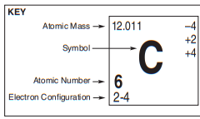
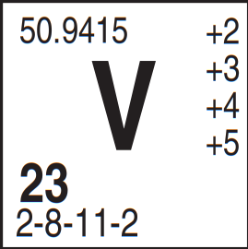
How do we use this information today?
X
42
0
20

Slide 12
Concept Check
REGENTS
QUESTION
Compared to the charge of a proton, the charge of an electron has
1.
2.
3.
4.
greater magnitude the same magnitude the same magnitude greater magnitude
and the same sign and the opposite sign and the same sign and the opposite sign

Slide 13
Concept Check
REGENTS
QUESTION
Compared to the charge of a proton, the charge of an electron has
1.
2.
3.
4.
greater magnitude the same magnitude the same magnitude greater magnitude
and the same sign and the opposite sign and the same sign and the opposite sign

Slide 14
Atomic symbol | Atomic number | Protons | Neutrons | Electrons | Mass Number | Atomic Mass
No |  |  |  |  | 261
Tm |  |  |  |  | 170
 |  | 106 | 159
 |  |  |  |  | 22 | 20.2
 |  |  |  | 19 | 39
 | 2 |  | 2
Ti |  |  |  |  | 49
 |  |  | 30 |  |  | 55.8
 |  | 4 | 5
 |  |  |  | 16 | 32
V |  |  | 28

Slide 15
Atomic symbol | Atomic number | Protons | Neutrons | Electrons | Mass Number | Atomic Mass
No | 102 | 102 | 159 | 102 | 261 | 259
Tm | 69 | 69 | 101 | 69 | 170 | 169
Sg | 106 | 106 | 159 | 106 | 265 | 263
Ne | 10 | 10 | 12 | 10 | 22 | 20.2
K | 19 | 19 | 20 | 19 | 39 | 39.1
He | 2 | 2 | 2 | 2 | 4 | 4.00
Ti | 22 | 22 | 27 | 22 | 49 | 47.9
Fe | 26 | 26 | 30 | 26 | 56 | 55.8
Be | 4 | 4 | 5 | 4 | 9 | 9.01
S | 16 | 16 | 16 | 16 | 32 | 32.1
V | 23 | 23 | 28 | 23 | 51 | 50.9

Slide 16
Practice
Atomic symbol | Atomic number | Protons | Neutrons | Electrons | Mass Number | Atomic Mass
B |  |  | 6
 | 11 |  |  |  | 24
 |  | 31 | 37
 |  |  |  | 39 | 89
 |  |  | 35 |  |  | 63.5
 |  | 43 |  |  | 100
Pb |  |  |  |  | 207
 |  |  | 102 | 70
 |  |  |  |  | 225 | 227
Mo |  |  | 53
 | 81 |  |  |  | 206
 | 100 |  | 159

Slide 17
Practice
Atomic symbol | Atomic number | Protons | Neutrons | Electrons | Mass Number | Atomic Mass
B | 5 | 5 | 6 | 5 | 11 | 10.8
Na | 11 | 11 | 13 | 11 | 24 | 23.0
Ga | 31 | 31 | 37 | 31 | 68 | 69.7
Y | 39 | 39 | 50 | 39 | 89 | 88.9
Cu | 29 | 29 | 35 | 29 | 64 | 63.5
Tc | 43 | 43 | 57 | 43 | 100 | (98)
Pb | 82 | 82 | 125 | 82 | 207 | 207
Yb | 70 | 70 | 102 | 70 | 172 | 173
Ac | 89 | 89 | 136 | 89 | 225 | 227
Mo | 42 | 42 | 53 | 42 | 95 | 95.9
Tl | 81 | 81 | 125 | 81 | 206 | 204.4
Fm | 100 | 100 | 159 | 100 | 259 | 257

Slide 18
Elements vs Isotopes
Elements are the basic building blocks of everything. An element is a material made up of only one type of atom (each atom has the same number of protons).
Isotopes are variations of elements that have different weights, because they have different numbers of neutrons.
For example, lets look at carbon 12, 13, & 14

Slide 19
Concept Check
REGENTS
QUESTION
Which symbols represent atoms that are isotopes of each other
1.
2.
3.
4.
¹⁴C and ¹⁴N ¹⁶O and ¹⁸O ¹³¹I and ¹³¹I ²²²Rn and ²²²Rn

Slide 20
Concept Check
REGENTS
QUESTION
Which symbols represent atoms that are isotopes of each other
1.
2.
3.
4.
¹⁴C and ¹⁴N ¹⁶O and ¹⁸O ¹³¹I and ¹³¹I ²²²Rn and ²²²Rn

Slide 21
Average Atomic Mass
Since there are isotopes for every atom, the mass for each element that is reported on the periodic table is the weighted average of each isotope for each element.
(mass x abundance)+(mass x abundance)+… / 100
or
(mass x decimal abundance)+(mass x decimal abundance)+…
How do we do this? Let's do some examples.

Slide 22
Average Atomic Mass
mass number | exact weight | % abundance
12 | 12.000000 | 98.90
13 | 13.003355 | 1.10
mass number | exact weight | % abundance
14 | 14.003074 | 99.63
15 | 15.000108 | 0.37

Slide 23
Average Atomic Mass
mass number | exact weight | % abundance |  | mass number | exact weight | % abundance
35 | 34.968852 | 75.77 |  | 28 | 27.976927 | 92.23
37 | 36.965903 | 24.23 |  | 29 | 28.976495 | 4.67
 |  |  |  | 30 | 29.973770 | 3.10

Slide 24
Concept Check
REGENTS
QUESTION
The atomic mass of an element is defined as the weighted average mass of that element’s
1.
2.
3.
4.
most abundant least abundant naturally occurring radioactive
isotope isotope isotopes isotopes

Slide 25
Concept Check
REGENTS
QUESTION
The atomic mass of an element is defined as the weighted average mass of that element’s
1.
2.
3.
4.
most abundant least abundant naturally occurring radioactive
isotope isotope isotopes isotopes

Slide 26
Back to Bohr’s Model
Remember in the Bohr model of the atom, how he said that electrons only existed at specific distances from the nucleus?
Well, we can use those specific distances to talk about how electrons are arranged in the atom.
We call the methods we’re going to talk about now electron configurations.

Slide 27
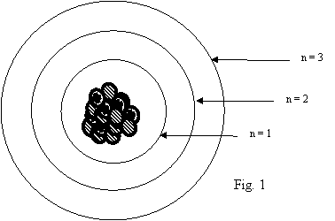
Shell Model
Electrons orbit the nucleus in shells, or Principal energy levels. These shells are at the most stable distances from each other and the nucleus.
Each shell can only hold a limited number of electrons
Steps:
Determine the number of electrons
Start from n=1 and fill the entire shell, moving upwards by one shell at a time.

Slide 28
Shell Model

Slide 29
Practice
Use the shell model to fill in the electron configurations of:
Be Si As

Slide 30


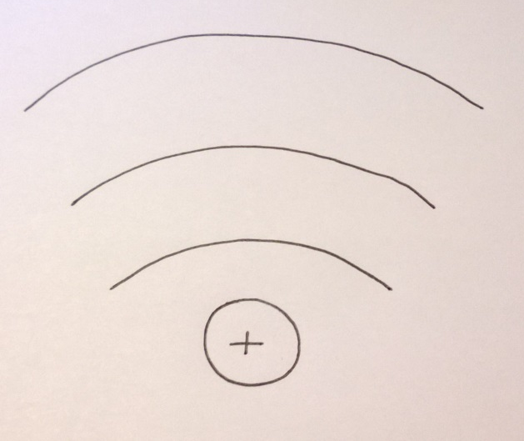
Concept Check
0
4
6
2
2
2

Slide 31
Concept Check
0
4
6
2
2
2

Slide 32
Concept Check
4
3
2
3

Slide 33
Concept Check
4
3
2
3

Slide 34
Concept Check
1
0
7
8
2
2

Slide 35
Concept Check
1
0
7
8
2
2

Slide 36
Back to Bohr’s Model
How did Bohr discover that there were energy levels?
Electrons can be “excited” and given energy. This energy makes them jump to a higher shell (principal energy level). When they lose that energy, they fall back down to their original energy level.
But energy can’t be created or destroyed, so where does it go?

Slide 37
Excited and Ground State

Slide 38
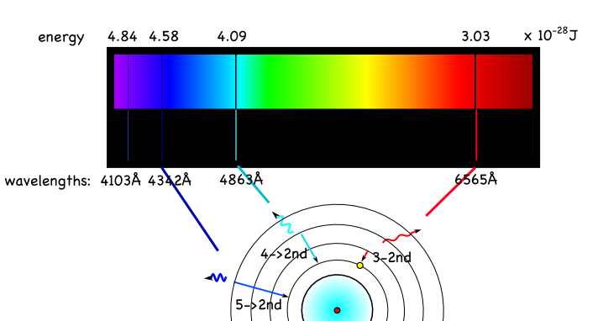
Emission Spectra

Slide 39
Emission Spectra
A
B
C
D
MIXTURE

Slide 40
Concept Check
REGENTS
QUESTION
Which electron configuration represents an atom in an excited state?
1.
2.
3.
4.
2-8-2 2-8-1 2-8 2-7-1

Slide 41
Concept Check
REGENTS
QUESTION
Which electron configuration represents an atom in an excited state?
1.
2.
3.
4.
2-8-2 2-8-1 2-8 2-7-1

Slide 42
The Mole
What is a dozen? How do you know?
A mole is a chemistry dozen. It is the same as saying 6.02 x 10²³ atoms (or molecules) of a substance.
Avogadro found this number by determining how many atoms were needed to take an atom’s mass in amu, and make it the same number of grams. Why is that so cool?

Slide 43
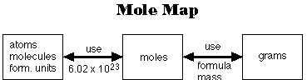
Mole Conversions
Divide by 6.02x10²³
Mult. by atomic mass
Mult. by 6.02x10²³
Divide by atomic mass

Slide 44
Concept Check
How many atoms are in 1 molecule of NH₃?
1.
2.
3.
3 atoms
1 atom
4 atoms

Slide 45
Concept Check
How many atoms are in 1 molecule of NH₃?
1.
2.
3.
3 atoms
1 atom
4 atoms

Slide 46
Concept Check
How many moles of atoms are in 1 mole of NH₃
1.
2.
3.
1 mole
4 moles
2 moles

Slide 47
Concept Check
How many moles of atoms are in 1 mole of NH₃
1.
2.
3.
1 mole
4 moles
2 moles

Slide 48
Concept Check
½ a mole of carbon has a mass of…..
1.
2.
3.
12 g
6 g
24 g

Slide 49
Concept Check
½ a mole of carbon has a mass of…..
1.
2.
3.
12 g
6 g
24 g

Slide 50
Concept Check
2 moles of H₂O has a mass of …...
1.
2.
3.
18 g
9 g
36 g

Slide 51
Concept Check
2 moles of H₂O has a mass of …...
1.
2.
3.
18 g
9 g
36 g

Slide 52
Testwizard HW #7 Due Sunday at 11:59
  Usernames and passwords are in the comments of the Individual Chat Room assignment
  You can see what you got right and wrong by clicking “View Detailed Report” in My Grades
Lab 9 due Friday at 11:59
  Please remember I need to grade every short answer by hand!
  Lab 4,5, and 8 have no due dates until June, do them on your own time!
  Read the lab headings carefully, there are often explanations and clues there.
  Please make up any lab you missed!
    Losing 1 pt for submitting late is WAY better than having a 0 in your average
Please put your name in the chat for attendance!
  What was one thing you would like to make this class better?

