Slide 1
Acids, Bases, pH, and Titration
Mr. Mesiouris

Slide 2
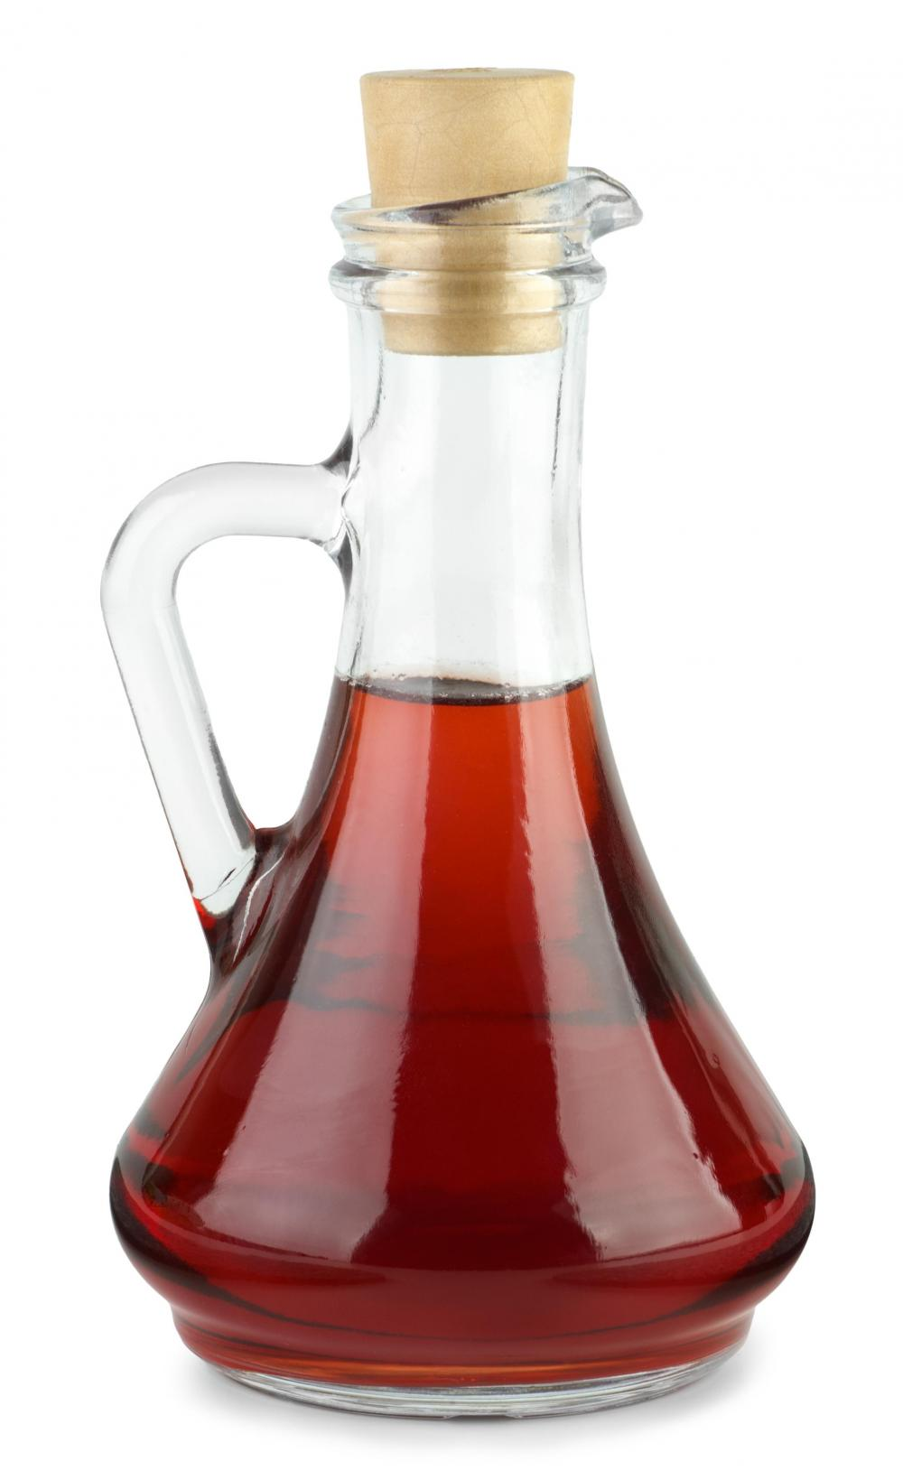
Properties of Acids
React with bases to create a salt and water
Sour tasting
Changes the color of indicators (Table M)
Conduct electricity (electrolytes)
Some react with metals to produce hydrogen gas
pH less than 7

Slide 3
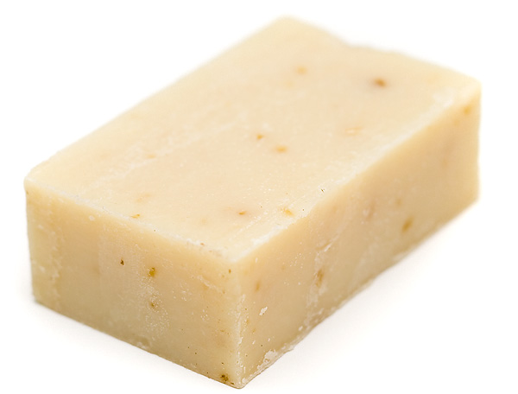
Properties of Bases
React with acids to create a salt and water
Bitter tasting
Feel slippery
Changes the color of indicators (Table M)
Conduct electricity (electrolytes)
Referred to as ‘alkaline’
Emulsifies fats and oils
pH above 7

Slide 4
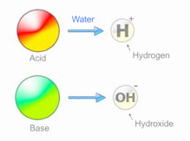
Arrhenius Theory
Svante Arrhenius created a theory for the classification of acids and bases.
He noticed that all acids and bases conduct electricity, so he theorized:
Acids – substances that produce H⁺ ions in solution as the only positive ion
Bases – substances that produce OH⁻ ions in solution as the only negative ion

Slide 5
Alternate (Brønsted-Lowry) Theory
In 1923 two chemists got together and expanded the Arrhenius theory
They redefined acids as ‘proton donors’ and bases as ‘proton acceptors’
Let’s look at a reaction:
HCl + NH₃ → NH₄⁺ + Cl⁻
The HCl ‘donates’ its proton to the NH₃
Would NH₃ be considered a base using Arrhenius’ theory?

Slide 6
Concept Check
Which is the Bronsted-Lowry Acid in the following equation:
HNO_{3 (aq)} + H₂O NO₃⁻_{(aq)} + H₃O⁺_{(aq)}
1.
2.
3.
H₃O⁺_{(aq)}
HNO_{3 (aq)}
H₂O

Slide 7
Concept Check
Which is the Bronsted-Lowry Acid in the following equation:
HNO_{3 (aq)} + H₂O NO₃⁻_{(aq)} + H₃O⁺_{(aq)}
1.
2.
3.
H₃O⁺_{(aq)}
HNO_{3 (aq)}
H₂O

Slide 8
Concept Check
Is HCl an Arrhenius acid, a Bronsted-Lowry acid, or both?
1.
2.
3.
Arrhenius
Both
Bronsted-Lowry

Slide 9
Concept Check
Is HCl an Arrhenius acid, a Bronsted-Lowry acid, or both?
1.
2.
3.
Arrhenius
Both
Bronsted-Lowry

Slide 10
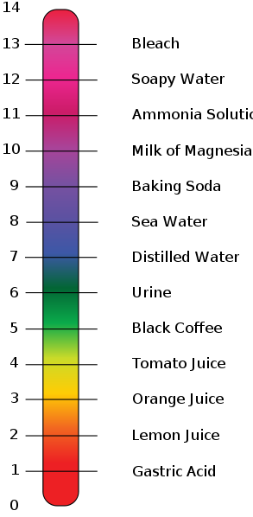
The pH Scale
Ranges from 0 to 14
7 is neutral, below 7 is acidic, above 7 is basic
pH is defined as the negative log of the H₃O⁺ concentration, or:
pH = -log[H₃O⁺]
BUT, there is a shortcut:
[H₃O⁺](H⁺ concentration) = 1 x 10^{-pH}

Slide 11
Concept Check
What is the pH of the following solution:
1x10⁻⁶ M HCl
1.
2.
3.
pH = 6
pH = -6
pH = 8

Slide 12
Concept Check
What is the pH of the following solution:
1x10⁻⁶ M HCl
1.
2.
3.
pH = 6
pH = -6
pH = 8

Slide 13
Concept Check
REGENTS
QUESTION
What is the pH of a 0.001 M HNO₃ solution?
1.
2.
3.
4.
1 2 3 11

Slide 14
Concept Check
REGENTS
QUESTION
What is the pH of a 0.001 M HNO₃ solution?
1.
2.
3.
4.
1 2 3 11

Slide 15
Indicators
Indicators are compounds that are color sensitive to pH
They act similarly to weak acids, existing in equilibrium between two forms, each a different color
As the pH shifts, so does the equilibrium, changing the color of the solution
The pH range that an indicator changes color in is called the transition interval

Slide 16
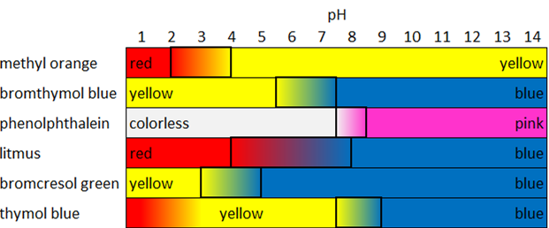
Table M

Slide 17
Concept Check
REGENTS
QUESTION
Which 0.1 M solution will turn phenolphthalein pink?
1.
2.
3.
4.
HBr_{(aq)} CO_{2(aq)} LiOH_{(aq)} CH₃OH_{(aq)}

Slide 18
Concept Check
REGENTS
QUESTION
Which 0.1 M solution will turn phenolphthalein pink?
1.
2.
3.
4.
HBr_{(aq)} CO_{2(aq)} LiOH_{(aq)} CH₃OH_{(aq)}

Slide 19
Neutralization
When you combine an equal number of moles of H⁺ and OH⁻, you have neutralized the two substances.
For example, 1 mole of NaOH will neutralize 1 mole of HCl
Equal molar quantities of strong monoprotic acids and strong bases will neutralize each other, the same goes for weak acids and weak bases
The key idea is that the moles of H⁺ and the moles of OH⁻ must be equal.

Slide 20
Concept Check
How many moles of HNO₃ are needed to neutralize half a liter of a 4 molar solution of sodium hydroxide?
1.
2.
3.
4 moles
2 moles
1 mole

Slide 21
Concept Check
How many moles of HNO₃ are needed to neutralize half a liter of a 4 molar solution of sodium hydroxide?
1.
2.
3.
4 moles
2 moles
1 mole

Slide 22
Concept Check
How many liters of a 2 molar solution of H₂SO₄ are needed to neutralize 160 grams of NaOH?
1.
2.
3.
4 Liters
1 Liter
2 Liters

Slide 23
Concept Check
How many liters of a 2 molar solution of H₂SO₄ are needed to neutralize 160 grams of NaOH?
1.
2.
3.
4 Liters
1 Liter
2 Liters

Slide 24
Concept Check
What is the concentration of a monoprotic acid if 2 moles of LiOH neutralized .75 L of solution?
1.
2.
3.
.75 M
2 M
2.66 M

Slide 25
Concept Check
What is the concentration of a monoprotic acid if 2 moles of LiOH neutralized .75 L of solution?
1.
2.
3.
.75 M
2 M
2.66 M

Slide 26
Concept Check
REGENTS
QUESTION
What is the net ionic equation for a neutralization reaction?
1.
2.
3.
4.
H⁺ + H₂O → H₃O⁺ H⁺ + NH₃ → NH₄⁺ 2H⁺ + 2O⁻² → 2 OH⁻ H⁺ + OH⁻ → H₂O

Slide 27
Concept Check
REGENTS
QUESTION
What is the net ionic equation for a neutralization reaction?
1.
2.
3.
4.
H⁺ + H₂O → H₃O⁺ H⁺ + NH₃ → NH₄⁺ 2H⁺ + 2O⁻² → 2 OH⁻ H⁺ + OH⁻ → H₂O

Slide 28
Titration
When you don’t know the concentration of a known volume of acid/base, you can titrate it to determine the concentration
Titration is the controlled neutralization of an unknown acid/base
The goal of a titration is to get as close to the neutralization of the unknown as possible, this is also known as the equivalence point of the titration
M_{A}V_{A}=M_{B}V_{B}

Slide 29
Titration - Process
First, fill your burette. Fill it a little bit over the 0 line, and then slowly release the solution into a waste beaker until the bottom of the meniscus is on the line.
Next, dispense a measured amount of the unknown solution in an Erlenmeyer flask, and add 3 drops of indicator
Slowly add the known solution, swirling the Erlenmeyer as you go, watch for color changes from the indicator.
When the indicator’s color change persists for a few seconds before leaving, add the known solution drop by drop from the burette until the color change remains constantly.

Slide 30
Titration - Calculations
After the titration is complete and all of the numbers have been recorded, calculations can be done.
First, determine how many moles of the known substance you used, using the concentration and the volume added.
Next, determine the molarity of the unknown, using the moles from the previous calculation, and the original volume

Slide 31
Concept Check
60 mL of 1 M NaOH is used to titrate 1 L of a strong acid to its end point,
what is the concentration of the acid?
1.
2.
3.
0.06 M
0.006 M
0.6 M

Slide 32
Concept Check
60 mL of 1 M NaOH is used to titrate 1 L of a strong acid to its end point,
what is the concentration of the acid?
1.
2.
3.
0.06 M
0.006 M
0.6 M

Slide 33
Concept Check
What volume of 2 M HCl is needed to titrate .25 L of 4 M LiOH to its end point?
1.
2.
3.
500 mL
1 L
2 L

Slide 34
Concept Check
What volume of 2 M HCl is needed to titrate .25 L of 4 M LiOH to its end point?
1.
2.
3.
500 mL
1 L
2 L

Slide 35
Concept Check
500 mL of 1 M H₂SO₄ is used to titrate 1 L of a strong base to its end point,
what is the concentration of the base?
1.
2.
3.
0.5 M
2 M
1 M

Slide 36
Concept Check
500 mL of 1 M H₂SO₄ is used to titrate 1 L of a strong base to its end point,
what is the concentration of the base?
1.
2.
3.
0.5 M
2 M
1 M

Slide 37
Concept Check
REGENTS
QUESTION
If 20 mL of 1.0 M HCl was used to completely neutralize 40 mL of an NaOH solution, what was the molarity of the NaOH solution?
1.
2.
3.
4.
0.50 M 2.0 M 1.5 M 4.0 M

Slide 38
Concept Check
REGENTS
QUESTION
If 20 mL of 1.0 M HCl was used to completely neutralize 40 mL of an NaOH solution, what was the molarity of the NaOH solution?
1.
2.
3.
4.
0.50 M 2.0 M 1.5 M 4.0 M

