Slide 1
Electrochemistry (Oxidation & Reduction)
Mr. Mesiouris

Slide 2
What is an oxidation state?
Oxidation states play a very large role in this unit. They are the basis for everything we do when we talk about oxidation and reduction.
An oxidation state is a possible ion that an element can become.
Some elements have multiple oxidation states, which means they can become one of many different ions.
Some elements have one oxidation state, which means they will always form the same ion.

Slide 3
Finding the oxidation state
An element’s possible oxidation states are listed on the periodic table, in the reference table, in the upper right hand side of each cell. The oxidation state of a pure element is 0
A polyatomic ion’s charge is listed on reference table E. The individual oxidation states of the elements in a polyatomic ion must add up to the polyatomic ion’s charge.
For example CO₃⁻² (carbonate) has a total charge of -2. Each oxygen has a charge of -2, and the carbon has a charge of +4.

Slide 4
Finding the oxidation state
The total charge of a compound (the sum of all the oxidation states) will always be 0.
Finding the oxidation state of each element in a compound can be done in different ways. We can use the criss-cross method, like we did to write the formulas for ionic compounds, or we can treat it like a puzzle.
If all the pieces need to add up to 0, and we know one or two of the oxidation states for sure (oxygen is always -2, Na is always +1, etc), then we can puzzle out the rest of the oxidation states.
Example: CaSO₄

Slide 5
Concept Check
Give the oxidation states of each element in each compound:
FeCl₂
MgO
Mn₂S₇
NaNO₃
H₃PO₄
MgCO₃
Ca(OH)₂

Slide 6
Concept Check
Give the oxidation states of each element in each compound:
FeCl₂ Fe: +2 Cl: -1
MgO Mg: +2 O: -2
Mn₂S₇ Mn: +7 S: -2
NaNO₃ Na: +1 N: +5 O: -2
H₃PO₄ H: +1 P: +5 O: -2
MgCO₃ Mg: +2 C: +4 O: -2
Ca(OH)₂ Ca: +2 O: -2 H: +1

Slide 7
Concept Check
REGENTS
QUESTION
The oxidation state of the nitrogen in N₂O is
1.
2.
3.
4.
+1 +2 -1 -2

Slide 8
Concept Check
REGENTS
QUESTION
The oxidation state of the nitrogen in N₂O is
1.
2.
3.
4.
+1 +2 -1 -2

Slide 9
Oxidation & Reduction
When we know the oxidation state, we know whether the element has gained electrons or lost electrons.
Oxidation is losing electrons, Reduction is gaining electrons
We can remember this easily using: Oil Rig
An element that has been oxidized has a positive oxidation state, it is the reducing agent.
An element that has been reduced has a negative oxidation state, it is the oxidizing agent.
(Think of the elements as ‘double agents’ they do the opposite of what agent they are)

Slide 10
Oxidation & Reduction
What does it look like when an element gains or loses electrons?
Write the reaction of sulfur (S) being reduced.
Write the reaction of sodium (Na) being oxidized.
Use “e-” as the chemical symbol for an electron
(Later on in this unit, we’ll call reactions like these ‘half reactions’)

Slide 11
Oxidation & Reduction
What does it look like when an element gains or loses electrons?
Write the reaction of sulfur (S) being reduced. S + 2 e⁻ → S⁻²
Write the reaction of sodium (Na) being oxidized. Na → Na⁺ + 1 e⁻
Use “e⁻” as the chemical symbol for an electron
(Later on in this unit, we’ll call reactions like these ‘half reactions’)

Slide 12
Concept Check
Was each element oxidized or reduced?
Cu → Cu⁺² + 2 e⁻
Sn⁺⁴ + 2 e⁻ → Sn⁺²
Cu⁺¹ + e⁻ → Cu
Zn → Zn⁺² + 2 e⁻
2 O⁻² → O₂ + 4 e⁻
Fe⁺³ + e⁻ → Fe⁺²
S⁻² → S + 2 e⁻
Sn → Sn⁺² + 2 e⁻

Slide 13
Concept Check
Was each element oxidized or reduced?
Cu → Cu⁺² + 2 e⁻
Sn⁺⁴ + 2 e⁻ → Sn⁺²
Cu⁺¹ + e⁻ → Cu
Zn → Zn⁺² + 2 e⁻
2 O⁻² → O₂ + 4 e⁻
Fe⁺³ + e⁻ → Fe⁺²
S⁻² → S + 2 e⁻
Sn → Sn⁺² + 2 e⁻
Oxidized
Reduced
Reduced
Oxidized
Oxidized
Reduced
Oxidized
Oxidized

Slide 14
Concept Check
Write the following reactions:
Sc is oxidized
Cl₂ is reduced
H₂ is oxidized
H₂ is reduced
Al is oxidized
Mg is oxidized
Mn⁺⁴ is oxidized
Ca⁺² is reduced

Slide 15
Concept Check
Write the following reactions:
Sc is oxidized
Cl₂ is reduced
H₂ is oxidized
H₂ is reduced
Al is oxidized
Mg is oxidized
Mn⁺⁴ is oxidized
Ca⁺² is reduced
Sc → Sc⁺³ + 3e⁻
Cl₂ + 2 e⁻ → 2 Cl⁻
H₂ → 2H⁺ + 2 e⁻
H₂ + 2 e⁻ → 2 H⁻
Al → Al⁺³ + 3 e⁻
Mg → Mg⁺² + 2 e⁻
Mn⁺⁴ → Mn⁺⁷ + 3 e⁻
Ca⁺² + 2 e⁻ → Ca
We will never make a polyatomic ion through reduction or oxidation. If an element is diatomic, we must break it apart like the 2nd 3rd and 4th examples

Slide 16
Reduction/Oxidation (Redox) Reactions
A redox reaction is a reaction where the reactants have been oxidized and reduced, meaning that electrons were moved around.
An easy way to spot a redox reaction is to look for a change in oxidation state:
2 Na + Cl₂ → 2 NaCl
What are the oxidation states of every element in the reaction?
Did they change from left to right?

Slide 17
Reduction/Oxidation (Redox) Reactions
A redox reaction is a reaction where the reactants have been oxidized and reduced, meaning that electrons were moved around.
An easy way to spot a redox reaction is to look for a change in oxidation state:
2 Na + Cl₂ → 2 NaCl
0 0 +1 -1
What are the oxidation states of every element in the reaction?
Did they change from left to right? Yes
This is a redox reaction.

Slide 18


Concept Check
Is this a redox reaction:
2 H₂O → 2 H₂ + O₂
No
Yes

Slide 19
Concept Check
Is this a redox reaction:
2 H₂O → 2 H₂ + O₂
No
Yes

Slide 20
Concept Check
Is this a redox reaction:
NaOH + HCl → H₂O + NaCl
No
Yes

Slide 21
Concept Check
Is this a redox reaction:
NaOH + HCl → H₂O + NaCl
No
Yes

Slide 22
Concept Check
Is this a redox reaction:
Mg + 2 HCl → H₂ + MgCl₂
No
Yes

Slide 23
Concept Check
Is this a redox reaction:
Mg + 2 HCl → H₂ + MgCl₂
No
Yes

Slide 24
Concept Check
REGENTS
QUESTION
In the reaction: 2 Al + 3 Cu⁺² → 2 Al⁺³ + 3 Cu, the Al…
1.
2.
3.
4.
Gains protons loses protons gains electrons loses electrons

Slide 25
Concept Check
REGENTS
QUESTION
In the reaction: 2 Al + 3 Cu⁺² → 2 Al⁺³ + 3 Cu, the Al…
1.
2.
3.
4.
Gains protons loses protons gains electrons loses electrons

Slide 26
Balancing Redox Reactions
When you balance any reaction, you need to conserve matter (no matter created, no matter destroyed).
You also need to conserve charge though. If you look back in your notes, no reaction ever created charge or lost charge. Total charge on the left and the right was always equal.
In a redox reaction, the electrons lost by the oxidized element has to be equal to the electrons gained by the reduced element.
You can write each half reaction, make the electrons equal, then add them back together for one whole redox reaction

Slide 27
Concept Check
Is this equation balanced:
3 Fe⁺³ + Al → 3 Fe⁺² + Al⁺³
No
Yes

Slide 28
Concept Check
Is this equation balanced:
3 Fe⁺³ + Al → 3 Fe⁺² + Al⁺³
No
Yes

Slide 29
Concept Check
REGENTS
QUESTION
Given the reaction: __Mg + __Cr⁺³ → __Mg⁺² + __Cr
When the equation is properly balanced, using the smallest whole numbers, the sum of the coefficients will be
1.
2.
3.
4.
10 7 5 4

Slide 30
Concept Check
REGENTS
QUESTION
Given the reaction: 3 Mg + 2 Cr⁺³ → 3 Mg⁺² + 2 Cr
When the equation is properly balanced, using the smallest whole numbers, the sum of the coefficients will be
1.
2.
3.
4.
10 7 5 4

Slide 31
Concept Check
What is the total number of moles of electrons needed to completely reduce 6 moles of Ni⁺² ions?
1.
2.
3.
4.
6 8 10 12

Slide 32
Concept Check
What is the total number of moles of electrons needed to completely reduce 6 moles of Ni⁺² ions?
1.
2.
3.
4.
6 8 10 12

Slide 33
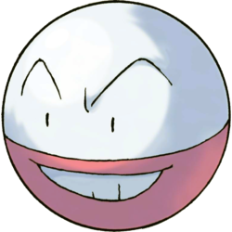
Electrochemical Cells
There are two types: Voltaic & Electrolytic
Both types of cells use small strips of metal, called electrodes to allow for the changing of a pure element into an ion (ex. Na → Na⁺ + e⁻)
The electrodes are labeled:
The electrode where oxidation happens is the anode. (AN OX)
The electrode where reduction happens is the cathode. (RED CAT)
Voltaic cells are spontaneous if Table J agrees

Slide 34
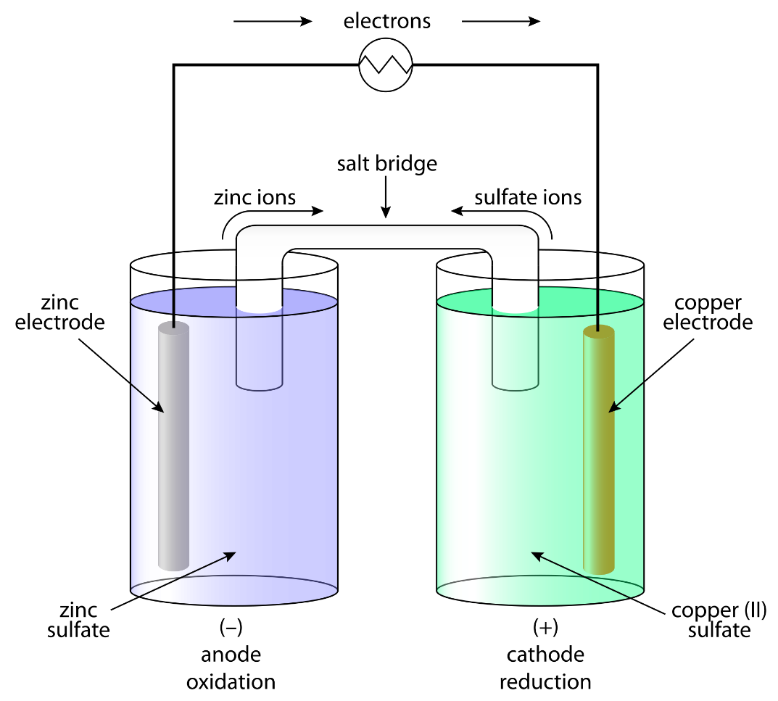
Voltaic Cells
Use a salt bridge to allow for the flow of ions and create a circuit.
Change chemical energy to electrical energy
Electrons flow from the anode to the cathode. Why? What happens at the anode? What happens at the cathode? What are the half reactions in each cell?
Voltaic cells are spontaneous, if the loser of electrons (the thing that is oxidized, the anode) is above the gainer of electrons (the thing that is reduced, the cathode) on Table J
The anode is negative, the cathode is positive

Slide 35
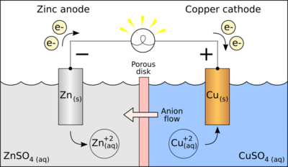
Voltaic Cells
Zn → Zn⁺² + 2 e⁻
Oxidation at the anode Reduction at the cathode
Cu⁺² + 2 e⁻ → Cu
Use a salt bridge to allow for the flow of ions and create a circuit.
Electrons flow from the anode to the cathode. Why? What happens at the anode? What happens at the cathode?
What are the half reactions in each cell?
Voltaic cells are spontaneous, if the loser of electrons (the thing that is oxidized, the anode) is above the gainer of electrons (the thing that is reduced, the cathode) on Table J
The anode is negative, the cathode is positive

Slide 36
Voltaic Cell
electrical
current
anode (-)
cathode (+)
salt bridge
e-
Zn
Zn
Zn²⁺
Cu
Cu
e-
Cu²⁺
Cu
Zn
e-
Cu
Cu
Zn
Zn²⁺
e-
Cu²⁺
Cu
e-
NO₃⁻
NO₃⁻
NO₃⁻
NO₃⁻
NO₃⁻
Cu
Zn
Zn
NO₃⁻
NO₃⁻
NO₃⁻
NO₃⁻
NO₃⁻
Cu
e-
Zn²⁺
Na⁺
Cu²⁺
Cu
e-
Na⁺
Na⁺
Na⁺
Na⁺
Na⁺
Na⁺
Na⁺
Na⁺
Na⁺
Cu
Zn
Zn
Zn²⁺
Cu
e-
Cu²⁺
Cu
e-
Zn
Zn
Zn²⁺
Cu
e-
Cu²⁺
Cu
Cu

Slide 37
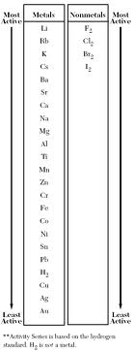
The Activity Series
(Reference Table J)
The activity series shows which elements will successfully replace other elements.
If a metal is higher on the Activity series, it is trying to lose electrons, meaning it is better at being oxidized than the metals under it.
If a nonmetal is higher on the activity series, it is trying to gain electrons, meaning it is better at being reduced than the nonmetals under it.

Slide 38
Fill in:
Anode / Cathode
Oxidized / Reduced
Half Reactions (Anode and Cathode)
Direction of electron flow
Full Balanced Reaction
Ba
Fe
Ag
Sn
Ba⁺
Fe⁺³
Ag⁺
Sn⁺⁴

Slide 39
Fill in:
Anode / Cathode
Oxidized / Reduced
Half Reactions (Anode and Cathode)
Direction of electron flow
Full Balanced Reaction
Ni
K
Mg
Pb
Ni⁺³
K⁺
Mg⁺²
Pb⁺²

Slide 40
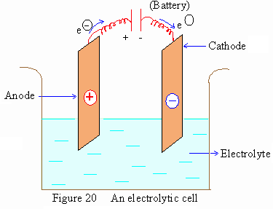
Electrolytic Cells
Use a battery to force a reaction to happen.
Change electrical energy to chemical energy
In an electrolytic cell, the anode and the cathode have reversed charges. The anode is positive and the cathode is negative. By filling the cathode with electrons, it attracts the positive ions to be reduced.
These electrolytic cells are used for metal plating. For car bumpers and spoons and jewelry.

Slide 41
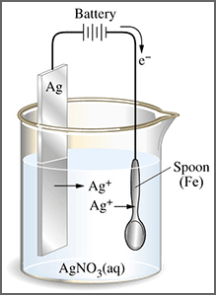
Electrolytic Cells
Use a battery to force a reaction to happen.
In an electrolytic cell, the anode and the cathode have reversed charges. The anode is positive and the cathode is negative.
By filling the cathode with electrons, it attracts the positive ions to be reduced.
These electrolytic cells are used for metal plating. For car bumpers and spoons and jewelry.

