Slide 1
Organic Chemistry
Mr. Mesiouris

Slide 2
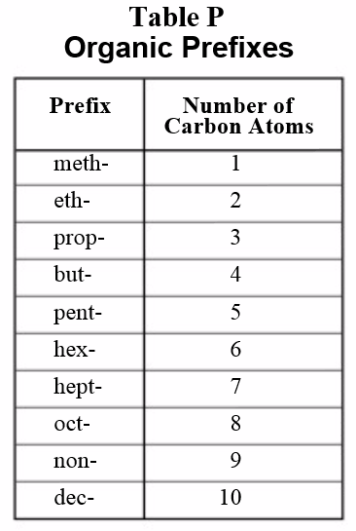
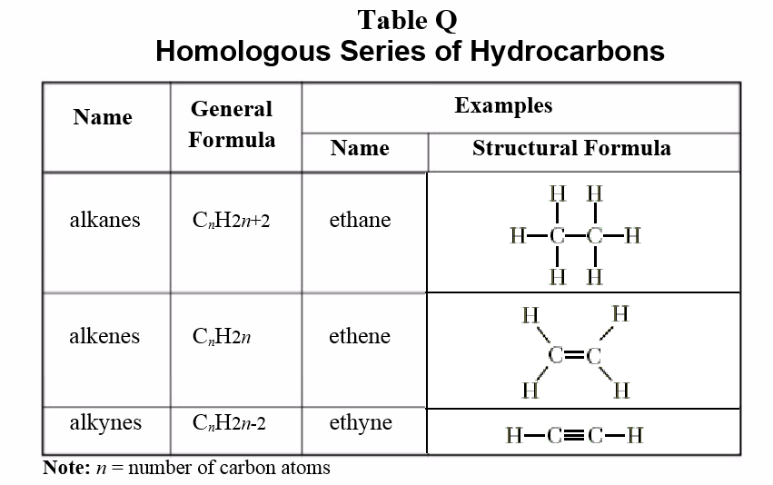
Simple Organic Molecules

Slide 3
Simple Organic Molecules
Before we can do anything with organic chemistry, we have to talk about the way that organic compounds are named (This is actually the biggest part of the chapter).
Organic molecules start out as one of three different ‘carbon chains’ (long strings of carbons linked together, with hydrogens filling out the bonds)
The prefix (Table P) tells us the number of carbons in the chain. The suffix (Table Q) tells us the type of chain (single bonds, a double bond, a triple bond).
The number in front of the name tells us which carbon to put the double or triple bond on (Its actually pretty straight-forward ).
Ex. 3-hexene, 4-pentyne

Slide 4
Concept Check
Draw the following simple organic molecules:
butane
4-nonyne
1-propene
heptane
3-octene
2-decyne
1-hexyne
2-pentene

Slide 5
Making Simple Molecules More Complex
Not all carbon chains exist in a straight line, some of them have branches.
Remember isomers? (compounds with the same chemical formula, but different structures)
We can use the prefixes (Table P) and the ending –yl to name the branches.
Ex: 3-ethylpentane and heptane
Ex: 4-methylhexane

Slide 6
Concept Check
Draw the following branched organic molecules:
3-propyl-3-octene
7-ethyl-2-decyne
3-methyl-2-pentene
2-ethylheptane
2-methyl-1-propene
6-methyl-4-nonyne
1-methylbutane
4-ethyl-3-methyl-1-hexyne

Slide 7
The Parent Chain
The ‘parent chain’ or the most basic piece of the organic molecule, must have the smallest number possible.
What is the difference between 1-pentyne and 4-pentyne ?
Draw them both. They are the same molecule, except the 4-pentyne looks upside-down.
4-pentyne does not exist, we will always call it 1-pentyne because it has a smaller number

Slide 8

Naming a Molecule
When we work backwards to name a molecule, we always want the simplest name.
We wont name something 1 methyl butane, because there is a simpler name: pentane.
To make sure the name is the simplest it can possibly be, we need to use the longest continuous chain of carbons as the parent chain.
Lets practice….

Slide 9
Naming a Molecule
When we work backwards to name a molecule, we always want the simplest name.
We wont name something 1 methyl butane, because there is a simpler name: pentane.
To make sure the name is the simplest it can possibly be, we need to use the longest continuous chain of carbons as the parent chain.
Lets practice….

Slide 10
Condensed structural formulas
If we write the formula for a compound to be: C₆H₁₄, it doesn’t tell us much about what the compound looks like.
Instead, I can write a formula in a way that gives me more information, for example I can write C₆H₁₄ as:
CH₃CH₂CH₂CH₂CH₂CH₃ or CH₃CHC₂H₅CH₂CH₃
Both of these formulas are C₆H₁₄, but they are two different compounds.
The first compound is hexane, the second is 2-ethylbutane
In organic chemistry we use these condensed structural formulas to give us more information about the compounds we use

Slide 11
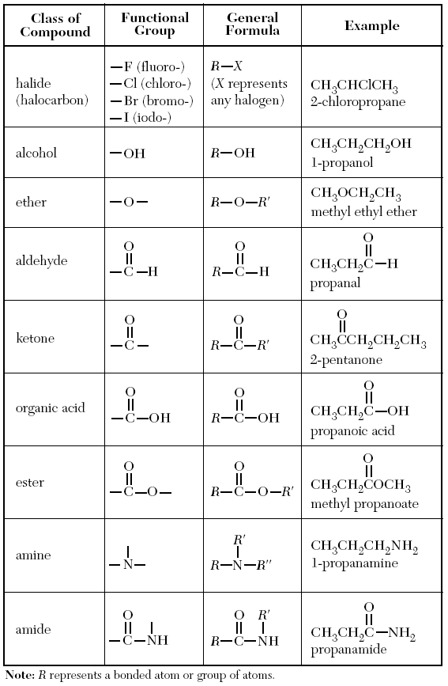
Making Molecules Even More Complex
On top of the fact that we can add branches to carbon chains, we can add ‘functional groups’ (Table R)
These are extra add-ons that change the structure of the compounds and the naming.
They follow all of the same straight-forward rules as before, but with new names for each type of functional group.

Slide 12
Functional Groups
Halides, alcohols, aldehydes, ketones, and organic acids are straightforward, using the same rules that we used for the simple chains and branched chains.
2-chloropentane is exactly what you’d think: a pentane with a chlorine on the second carbon.
Ethers, esters, amines, and amides are not as simple

Slide 13
Ethers & Esters
For ethers and esters you need to name the substances on either side of the functional group.
For ethers, it is the name of the chain on each side of the oxygen, followed by ‘ether’
Ex. methyl ethyl ether, diethyl ether, methyl propyl ether
For esters, (for example ethyl propanoate) the chain containing the –oate contains the double bond O.
Ex. methyl hexanoate, pentyl propanoate, ethyl butanoate

Slide 14
Amines & Amides
To name an amine or amide, you drop the final ‘e’ from the hydrocarbon and add amine or amide.
An amine is a nitrogen bonded into the chain.
Ex. Pentanamine, methanamine, butanamine
An amide has a double bonded oxygen connected to a carbon, and a nitrogen right next to it.
The carbon in the amide counts as one of the carbons in the chain
Ex. Hexanamide, ethanamide, propanamide

Slide 15
Effects of Funct. Groups on Chemical Properties
Boiling and melting points:
Alcohols and organic acids have higher melting/boiling points than the parent chain alone.
Amines have a higher melting/boiling point than the parent chain alone (but lower than same carbon acids/alcohols)
Halides have a higher melting/boiling point than the parent chain alone (but lower than same carbon amines)
Why? Draw ethanoic acid, ethanamine, chloroethane, and ethane. What causes these differences?

Slide 16
Effects of Funct. Groups on Chemical Properties
Ethane is a hydrocarbon with weak dispersion forces, making it easy to boil/melt
Chloroethane is polar, giving it dipole dipole forces (stronger than dispersion forces), making it slightly harder to boil/melt
Ethanamine has N hydrogen bonding, which are stronger than dipole dipole forces, making it hard to boil/melt
Ethanoic acid has O hydrogen bonding, giving it the strongest intermolecular forces, making it hardest to boil/melt

Slide 17
Effects of Funct. Groups on Chemical Properties
Solubility:
Small alcohols/acids are more soluble than large alcohols/acids.
Small ethers/aldehydes/ketones are more soluble than large ethers/aldehydes/ketones.
Hydrocarbons (chains with nothing fancy) are not soluble
Why?

Slide 18
Effects of Funct. Groups on Chemical Properties
Solubility:
Small alcohols/acids are more soluble than large alcohols/acids.
Small ethers/aldehydes/ketones are more soluble than large ethers/aldehydes/ketones.
Hydrocarbons (chains with nothing fancy) are not soluble
Why?
The bigger the chains get, the less polar the substance becomes. The less polar the substance is, the less soluble it is.

Slide 19
Organic Reactions
Substitution – only in alkanes. Replaces one atom/group with another atom/group.
Ex. propane + chlorine → chloropropane + HCl
Addition – only in alkenes/alkynes. Adds an atom/group at a double or triple bond.
Ex. 1-propene + chlorine → 1,2 dichloropropane
Fermentation – the process that breaks glucose into ethanol (alcohol) and CO₂
C₆H₁₂O₆ → 2 C₂H₅OH + 2 CO₂
Combustion – the reaction of a hydrocarbon and oxygen to produce H₂O and CO₂
Ex. 2 C₂H₆ + 7 O₂ → 4 CO₂ + 6 H₂O

Slide 20
Organic Reactions
Esterification – makes an ester from the combination of an acid and an alcohol.
Ex: propanol + butanoic acid → propyl butanoate + H₂O
Alcohol + organic acid → ester + water
Saponification – makes an alcohol and an organic acid from an ester
Ethyl hexanoate → ethanol + hexanoic acid
ester → Alcohol + organic acid
Polymerization – makes a larger molecule out of smaller molecules (remember from living environment?)
Amino acid + amino acid + amino acid → protein

Slide 21
Finding a Missing Piece to a Reaction
Its just like solving a puzzle!
We need to make sure mass is conserved, so we automatically know how many of each element we need. We just have to check the differences between the left side of the equation and the right side of the equation.
Ex. What is missing from the following reaction:
_____ + 8 O₂ → 5 CO₂ + 6 H₂O

Slide 22
Finding a Missing Piece to a Reaction
Its just like solving a puzzle!
We need to make sure mass is conserved, so we automatically know how many of each element we need. We just have to check the differences between the left side of the equation and the right side of the equation.
Ex. What is missing from the following reaction:
C₅H₁₂ + 8 O₂ → 5 CO₂ + 6 H₂O

Slide 23
Concept Check
What is missing from the following reaction:
2 C₄H₁₀ + 13 O₂ → 8 CO₂ + ______
1.
2.
3.
10 H₂O
5 H₂O
H₂₀O₁₀

Slide 24
Concept Check
What is missing from the following reaction:
2 C₄H₁₀ + 13 O₂ → 8 CO₂ + ______
1.
2.
3.
10 H₂O
5 H₂O
H₂₀O₁₀

Slide 25
Concept Check
REGENTS
QUESTION
Given the incomplete reaction:
CH₃CH₂CH₂COOH + x → CH₃CH₂CH₂COOCH₂CH₃ + H₂O
Which compound is represented by 'x’ ?
1.
2.
3.
4.
CH₃CH₂OH CH₃COH CH₃OCH₂CH₃ CH₃COCH₃

Slide 26
Concept Check
REGENTS
QUESTION
Given the incomplete reaction:
CH₃CH₂CH₂COOH + x → CH₃CH₂CH₂COOCH₂CH₃ + H₂O
Which compound is represented by 'x’ ?
1.
2.
3.
4.
CH₃CH₂OH CH₃COH CH₃OCH₂CH₃ CH₃COCH₃

