Slide 1
Reaction Kinetics & Equilibrium
Mr. Mesiouris

Slide 2
Collision Theory
This unit is all about reactions: how they happen, why they happen, and what makes them happen.
The collision theory explains reactions:
In order for a reaction to occur, the particles need to collide with enough energy at the best angles so the reaction can go forward.

Slide 3
Changing Reaction Rates
There are 5 factors that affect the rate of reaction:
Concentration – increasing concentration increases the amount of collisions
Temperature – increasing the average kinetic energy increases the amount of collisions
Surface area – increasing the surface area increases the amount of collisions
Nature of reactant – something that has a lot of bonds to rearrange takes longer to react (ions vs molecules)
Catalysts – these lower the activation energy to make a reaction start easier (this will make sense in a few slides)

Slide 4
Concept Check
REGENTS
QUESTION
As the number of effective collisions between the reactant particles in a chemical reaction decreases, the rate of the reaction…
1.
2.
3.
decreases increases remains the same

Slide 5
Concept Check
REGENTS
QUESTION
As the number of effective collisions between the reactant particles in a chemical reaction decreases, the rate of the reaction…
1.
2.
3.
decreases increases remains the same

Slide 6
A Quick Refresher (and some new stuff)
Endothermic reactions are reactions that ( release / take in ) energy.
  The products have (higher / lower) potential energy than the reactants.
Exothermic reactions are reactions that ( release / take in ) energy.
  The products have (higher / lower) potential energy than the reactants

Slide 7
A Quick Refresher (and some new stuff)
Endothermic reactions are reactions that ( take in ) energy.
  The products have (higher) potential energy than the reactants.
Exothermic reactions are reactions that ( release ) energy.
  The products have (lower) potential energy than the reactants

Slide 8
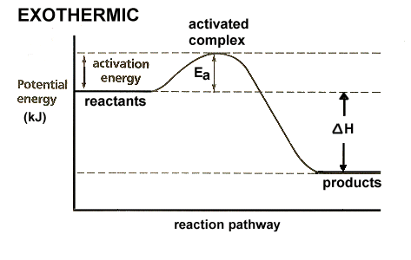
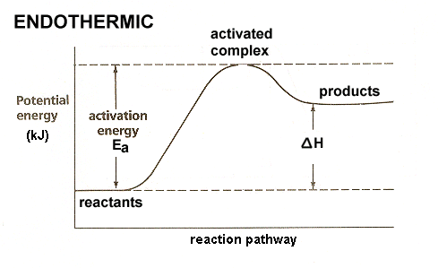
Potential Energy Diagrams
We can take the things we just talked about and put them into a diagram.

Slide 9
Activation Energy
Activation energy is the smallest amount of energy required to start a reaction.
A match has potential energy, and it will burn, but it won’t burn until energy is added.
Some reactions have a high activation energy, some have a low activation energy.
Catalysts lower the activation energy, allowing the reaction to start sooner than it usually would.

Slide 10
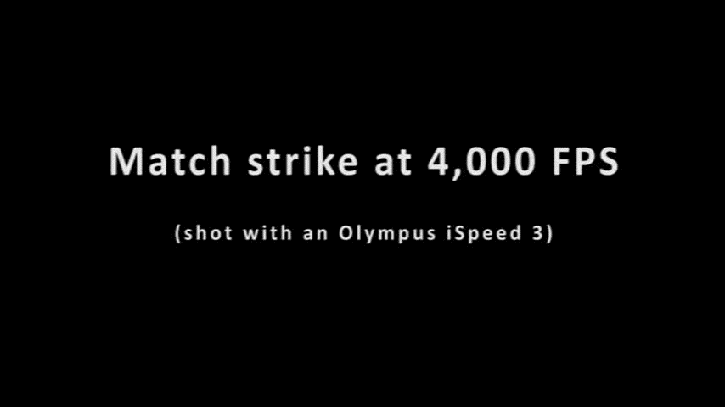
Activation Energy Explained through Video

Slide 11
Activation Energy Explained through Video
As the match is dragged across the strike pad energy is being added. This is the activation energy.
As the match starts to catch fire the energy added is almost equal to the activation energy.
When the match is removed from the pad, the reaction continues on its own, because the activation energy has been put in.
Draw the potential energy diagram for an exothermic reaction, and follow along as the video plays again.

Slide 12
Concept Check
Draw the potential energy diagram of….
An endothermic reaction with a high activation energy
An endothermic reaction with a low activation energy
An exothermic reaction with a high activation energy
An exothermic reaction with a low activation energy

Slide 13
The Heat of Reaction
  Δ H = H_{products} - H_{reactants}
The heat of reaction is the difference in potential energies of the reactants and the products, which we can find on the potential energy diagrams.
If Δ H is positive, energy was absorbed. The reaction is endothermic.
If Δ H is negative, energy was released. The reaction is exothermic.
Does this match the potential energy diagrams we just drew?

Slide 14
Reference Table I
Table I gives you a list of reactions and their Δ H values.
Remember that a negative Δ H means an exothermic reaction, and a positive ΔH means an endothermic reaction.
The regents will ask you if a reaction is endo or exothermic based on Table I, it can also ask you to manipulate the equations and values given like this:
How much energy is produced when 2 moles of NaOH dissolve in water?

Slide 15
Reference Table I
Table I gives you a list of reactions and their Δ H values.
Remember that a negative Δ H means an exothermic reaction, and a positive ΔH means an endothermic reaction.
The regents will ask you if a reaction is endo or exothermic based on Table I, it can also ask you to manipulate the equations and values given like this:
How much energy is produced when 2 moles of NaOH dissolve in water? 89.02 kJ

Slide 16
Concept Check
According to Reference Table I, how much energy is released when aluminum and oxygen react to create aluminum oxide?
1.
2.
3.
-1675.5 kJ
-393.5 kJ
-3351 kJ

Slide 17
Concept Check
According to Reference Table I, how much energy is released when aluminum and oxygen react to create aluminum oxide?
1.
2.
3.
-1675.5 kJ
-393.5 kJ
-3351 kJ

Slide 18
Concept Check
According to Reference Table I, how much energy is released when hydrogen and oxygen react to create liquid water?
1.
2.
3.
-571.6 kJ
-483.6 kJ
-55.8 kJ

Slide 19
Concept Check
According to Reference Table I, how much energy is released when hydrogen and oxygen react to create liquid water?
1.
2.
3.
-571.6 kJ
-483.6 kJ
-55.8 kJ

Slide 20
Concept Check
According to Reference Table I, how much energy is absorbed when 1 mole of HI is created?
1.
2.
3.
53 kJ
- 26.5 kJ
26.5 kJ

Slide 21
Concept Check
According to Reference Table I, how much energy is absorbed when 1 mole of HI is created?
1.
2.
3.
53 kJ
- 26.5 kJ
26.5 kJ

Slide 22
Concept Check
According to Reference Table I, how much energy is released when 2 moles of CO₂ are created from carbon and oxygen?
1.
2.
3.
- 787 kJ
- 393.5 kJ
-1452 kJ

Slide 23
Concept Check
According to Reference Table I, how much energy is released when 2 moles of CO₂ are created from carbon and oxygen?
1.
2.
3.
- 787 kJ
- 393.5 kJ
-1452 kJ

Slide 24
Spontaneous Reactions
Some reactions occur instantly (remember the sodium in the water?).
In order for this to happen, the products need to have:
Lower potential energy and/or Higher entropy
Entropy is the chemistry term used to describe chaos or randomness.
What kind of phase changes will have a higher entropy?

Slide 25
Spontaneous Reactions
Some reactions occur instantly (remember the sodium in the water?).
In order for this to happen, the product need to have:
Lower potential energy and/or Higher entropy
Entropy is the chemistry term used to describe chaos or randomness.
What kind of phase changes will have a higher entropy? Melting , boiling, subliming

Slide 26
Concept Check
REGENTS
QUESTION
Which change represents an increase of entropy?
1.
2.
3.
4.
I_{2(s)}→I_{2(g)} I_{2(g)}→I_{2(l)} H₂O_{(g)}→H₂O_{(l)} H₂O_{(l)}→H₂O_{(s)}

Slide 27
Concept Check
REGENTS
QUESTION
Which change represents an increase of entropy?
1.
2.
3.
4.
I_{2(s)}→I_{2(g)} I_{2(g)}→I_{2(l)} H₂O_{(g)}→H₂O_{(l)} H₂O_{(l)}→H₂O_{(s)}

Slide 28
Equilibrium
In an equilibrium, the rate of the forward reaction is equal to the rate of the reverse reaction.
The RATES are equal, but the AMOUNTS do not have to be.
There are three kinds of equilibrium:
Phase equilibrium
Solution equilibrium
Chemical equilibrium

Slide 29
Phase & Solution Equilibrium
These are physical equilibria. There are no chemical changes happening.
Phase equilibrium exists at a substances melting or boiling point.
What phase is water at exactly 0ºC ? What phase is water at exactly 100ºC ?
Solution equilibrium exists when there is extra solid in a saturated solution.
(This should be review from the last unit)

Slide 30
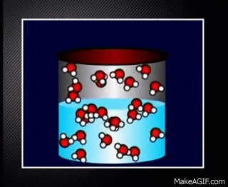

Slide 31
Concept Check
REGENTS
QUESTION
A solution in which the crystallizing rate of the solute equals the dissolving rate of the solute must be
1.
2.
3.
4.
saturated unsaturated concentrated dilute

Slide 32
Concept Check
REGENTS
QUESTION
A solution in which the crystallizing rate of the solute equals the dissolving rate of the solute must be
1.
2.
3.
4.
saturated unsaturated concentrated dilute

Slide 33
Concept Check
REGENTS
QUESTION
At which point do a liquid and a solid exist at equilibrium?
1.
2.
3.
4.
sublimation pt vaporization pt boiling pt melting pt

Slide 34
Concept Check
REGENTS
QUESTION
At which point do a liquid and a solid exist at equilibrium?
1.
2.
3.
4.
sublimation pt vaporization pt boiling pt melting pt

Slide 35
Chemical Equilibrium
A chemical equilibrium exists when the products of a reaction can break down easily into the reactants again.
Again, it must be stressed that RATES are equal, but AMOUNTS do not have to be.
Create a possible potential energy diagram for a chemical equilibrium. Focus on the activation energy value and heat of reaction (Δ H) value.
Does it make sense that this reaction can occur both forwards and backwards? Why?

Slide 36
Chemical Equilibrium
A chemical equilibrium exists when the products of a reaction can break down easily into the reactants again.
Again, it must be stressed that RATES are equal, but AMOUNTS do not have to be.
Create a possible potential energy diagram for a chemical equilibrium. Focus on the activation energy value and heat of reaction (Δ H) value.
These typically have a small activation energy and heat of reaction (Δ H)
Does it make sense that this reaction can occur both forwards and backwards? Why?

Slide 37
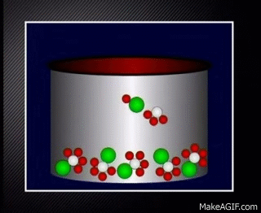

Slide 38
LeChatelier’s Principle
LeChatelier studied equilibria and tried to learn how they work.
During his studies he found that if he made changes to the equilibrium, it would shift to maintain a balance.
He found three changes that caused an equilibrium to shift:
Concentration
Temperature
Pressure

Slide 39
What is a ‘shift’ ?
We have established that in an equilibrium the rate of the forward reaction and the reverse reaction are equal.
Equilibria only exist at very specific conditions though, any change will cause either the forward or reverse reaction to become dominant (the rates will not be equal anymore)
When the rates aren’t equal, the equilibrium has SHIFTED to favor one side (left or right), depending on how the conditions were changed.

Slide 40
Change in Concentration
In an equilibrium, if the concentration of one chemical increases, the equilibrium will shift towards the opposite side to relieve the stress.
Why does this happen? Think about concentration and the reaction rate.
N₂ + 3 H₂ ↔ 2 NH₃
If I increase the concentration of N₂, the reaction will shift towards …
When this is done with equilibria containing ions, it is called the “common ion effect”

Slide 41
Change in Concentration
In an equilibrium, if the concentration of one chemical increases, the equilibrium will shift towards the opposite side to relieve the stress.
Why does this happen? Think about concentration and the reaction rate.
N₂ + 3 H₂ ↔ 2 NH₃
If I increase the concentration of N₂, the reaction will shift towards the right, because the reaction rate has increased.
When this is done with equilibria containing ions, it is called the “common ion effect”

Slide 42
Concept Check
Given the system at equilibrium:
CaO_{(s)} + CO_{2(g)} ↔ CaCO_{3(s)} ΔH= -179 kJ
What will happen if the concentration of CaCO₃ is increased?
1.
2.
3.
Decrease CaO
Increase CO₂
Decrease CO₂

Slide 43
Concept Check
Given the system at equilibrium:
CaO_{(s)} + CO_{2(g)} ↔ CaCO_{3(s)} ΔH= -179 kJ
What will happen if the concentration of CaCO₃ is increased?
1.
2.
3.
Decrease CaO
Increase CO₂
Decrease CO₂

Slide 44
Concept Check
Given the system at equilibrium:
CaO_{(s)} + CO_{2(g)} ↔ CaCO_{3(s)} ΔH= -179 kJ
What will happen if the concentration of CaO is increased?
1.
2.
3.
Decrease CaCO₃
Increase CO₂
Decrease CO₂

Slide 45
Concept Check
Given the system at equilibrium:
CaO_{(s)} + CO_{2(g)} ↔ CaCO_{3(s)} ΔH= -179 kJ
What will happen if the concentration of CaO is increased?
1.
2.
3.
Decrease CaCO₃
Increase CO₂
Decrease CO₂

Slide 46
Change in Temperature
Changing the temperature acts very similarly to changing the concentration.
Rewrite this equation to include the energy as either a reactant or product:
NH₃ + H₂O ↔ NH₄OH Δ H = -75 kJ
If I increase temperature, where does the reaction shift?
If I decrease temperature, where does the reaction shift?

Slide 47
Change in Temperature
Changing the temperature acts very similarly to changing the concentration.
Rewrite this equation to include the energy as either a reactant or product:
NH₃ + H₂O ↔ NH₄OH Δ H = -75 kJ
NH₃ + H₂O ↔ NH₄OH + 75 kJ
If I increase temperature, where does the reaction shift?
If I decrease temperature, where does the reaction shift?

Slide 48
Change in Temperature
Changing the temperature acts very similarly to changing the concentration.
Rewrite this equation to include the energy as either a reactant or product:
NH₃ + H₂O ↔ NH₄OH Δ H = -75 kJ
NH₃ + H₂O ↔ NH₄OH + 75 kJ
If I increase temperature, where does the reaction shift? left
If I decrease temperature, where does the reaction shift? right

Slide 49
Concept Check
Given the system at equilibrium:
2 NO_{2(g)} ↔ N_{2(g)} +2 O_{2(g)} ΔH= -43 kJ
What will happen if the temperature is increased?
1.
2.
3.
Increase energy
Decrease O₂
Decrease NO₂

Slide 50
Concept Check
Given the system at equilibrium:
2 NO_{2(g)} ↔ N_{2(g)} +2 O_{2(g)} ΔH= -43 kJ
What will happen if the temperature is increased?
1.
2.
3.
Increase energy
Decrease O₂
Decrease NO₂

Slide 51
Concept Check
Given the system at equilibrium:
H₂O_{(l)} ↔ H⁺_{(aq)} + OH⁻_{(aq)} ΔH= 55.8 kJ
What will happen if the temperature is increased?
1.
2.
3.
Increase H₂O
Increase H⁺
Decrease OH-

Slide 52
Concept Check
Given the system at equilibrium:
H₂O_{(l)} ↔ H⁺_{(aq)} + OH⁻_{(aq)} ΔH= 55.8 kJ
What will happen if the temperature is increased?
1.
2.
3.
Increase H₂O
Increase H⁺
Decrease OH-

Slide 53
Change in Pressure
Changing the pressure makes us look at a different part of the reaction: the number of moles of gas.
N_{2(g)} + 3 H_{2(g)} ↔ 2 NH_{3(g)}
In this equilibrium, all of the reactants and all of the products are gas.
If I increase the pressure on this equilibrium as a whole, will it shift toward the side with more moles of gas or less moles of gas? Why?

Slide 54
Change in Pressure
Changing the pressure makes us look at a different part of the reaction: the number of moles of gas.
N_{2(g)} + 3 H_{2(g)} ↔ 2 NH_{3(g)}
In this equilibrium, all of the reactants and all of the products are gas.
If I increase the pressure on this equilibrium as a whole, will it shift toward the side with more moles of gas or less moles of gas? Why?
When pressure is increased on an equilibrium, the equilibrium will shift to the side with FEWER moles of gas.

Slide 55
Concept Check
Given the system at equilibrium:
N_{2(s)} + 3 H_{2(g)} ↔ 2 NH_{3(s)} ΔH= -29 kJ
What will happen if the pressure is increased?
1.
2.
3.
Increase NH₃
Increase H₂
Decrease energy

Slide 56
Concept Check
Given the system at equilibrium:
N_{2(s)} + 3 H_{2(g)} ↔ 2 NH_{3(s)} ΔH= -29 kJ
What will happen if the pressure is increased?
1.
2.
3.
Increase NH₃
Increase H₂
Decrease energy

Slide 57
Concept Check
Given the system at equilibrium:
CaO_{(s)} + CO_{2(g)} ↔ CaCO_{3(s)} ΔH= -179 kJ
What will happen if the pressure is decreased?
1.
2.
3.
Increase CaCO₃
Increase CaO
Decrease CO₂

Slide 58
Concept Check
Given the system at equilibrium:
CaO_{(s)} + CO_{2(g)} ↔ CaCO_{3(s)} ΔH= -179 kJ
What will happen if the pressure is decreased?
1.
2.
3.
Increase CaCO₃
Increase CaO
Decrease CO₂

Slide 59
N_{2(g)} + 3 H_{2(g)} ↔ 2 NH_{3(g)}
Stress | Shift | NH₃ | N₂ | H₂
Increase H₂ concentration
Decrease NH₃ concentration
Decrease pressure
Increase NH₃ concentration
Decrease N₂ concentration
Increase pressure

Slide 60
N_{2(g)} + 3 H_{2(g)} ↔ 2 NH_{3(g)}
Stress | Shift | NH₃ | N₂ | H₂
Increase H₂ concentration
Decrease NH₃ concentration
Decrease pressure
Increase NH₃ concentration
Decrease N₂ concentration
Increase pressure

Slide 61
2 NO_{2(g)} ↔ N_{2(g)} + O_{2(g)} Δ H = 33 kJ
Stress | Shift | NO₂ | N₂ | O₂
Increase temperature
Decrease NO₂ concentration
Increase pressure
Decrease N₂ concentration
Increase O₂ concentration
Decrease temperature

Slide 62
2 NO_{2(g)} ↔ N_{2(g)} + O_{2(g)} Δ H = 33 kJ
Stress | Shift | NO₂ | N₂ | O₂
Increase temperature
Decrease NO₂ concentration
Increase pressure | NO CHANGE
Decrease N₂ concentration
Increase O₂ concentration
Decrease temperature

Slide 63
H_{2(g)} + Cl_{2(g)}↔ 2 HCl_{(g)} Δ H = -87 kJ
Stress | Shift | HCl | H₂ | Cl₂
Increase H₂ concentration
Increase temperature
Increase pressure
Decrease HCl concentration
Decrease Cl₂ concentration
Decrease temperature

Slide 64
H_{2(g)} + Cl_{2(g)}↔ 2 HCl_{(g)} Δ H = -87 kJ
Stress | Shift | HCl | H₂ | Cl₂
Increase H₂ concentration
Increase temperature
Increase pressure | NO CHANGE
Decrease HCl concentration
Decrease Cl₂ concentration
Decrease temperature

