Slide 1
Nuclear Chemistry
Mr. Mesiouris

Slide 2
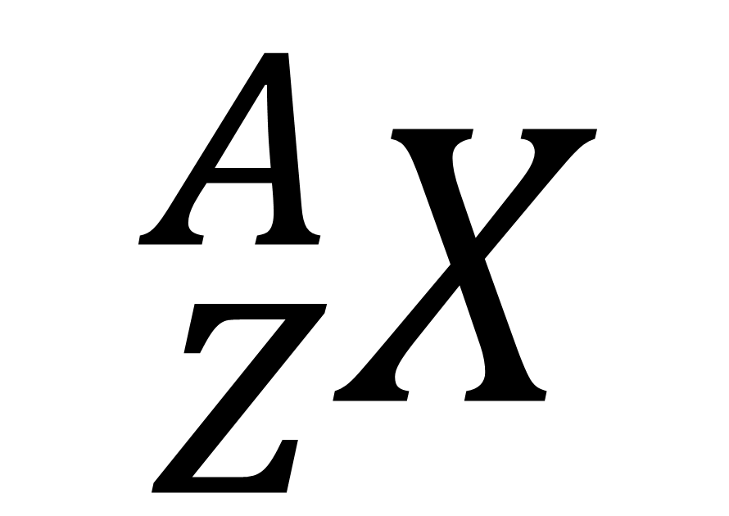
A Quick Review
In this notation:
X represents any element, taking the symbol from the periodic table.
A represents the mass number, the sum of the protons and neutrons in the nucleus of the element.
Z represents the atomic number, the number of protons in the nucleus of the element
$${}_{Z}^{A}X$$

Slide 3
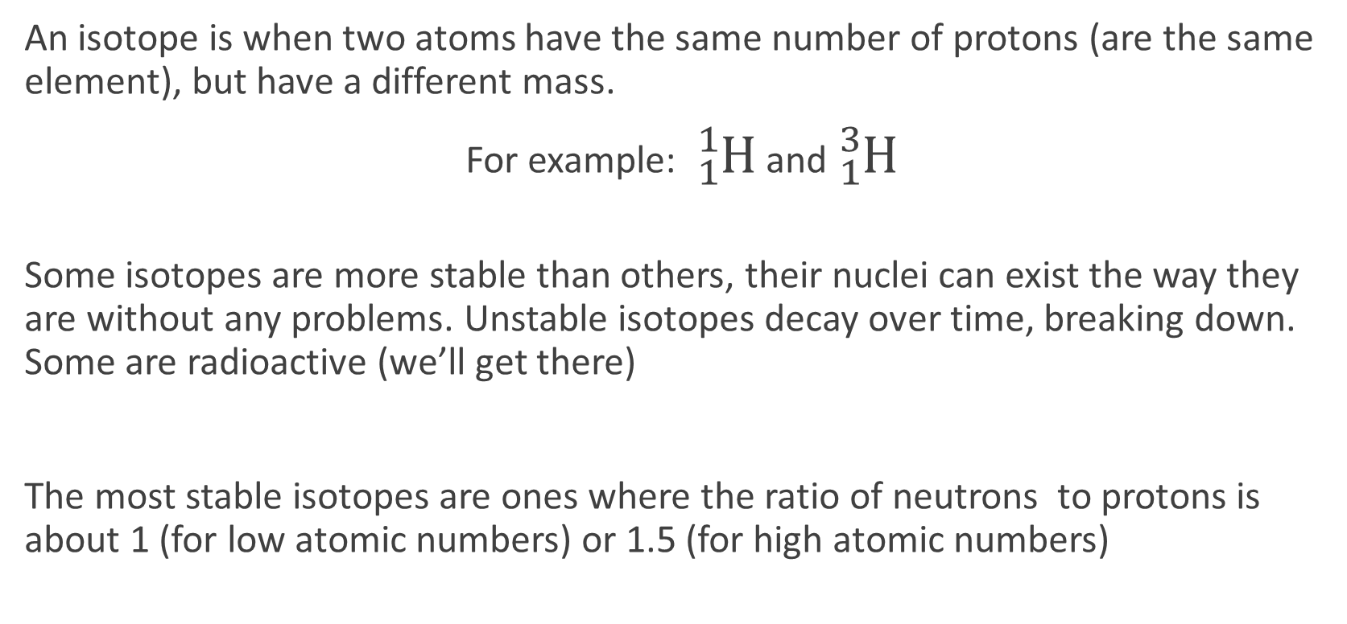
Stable Isotopes
An isotope is when two atoms have the same number of protons (are the same element), but have a different mass.
For example: ${}_{1}^{1}H$ and ${}_{1}^{3}H$
Some isotopes are more stable than others, their nuclei can exist the way they are without any problems. Unstable isotopes decay over time, breaking down. Some are radioactive (we’ll get there)
The most stable isotopes are ones where the ratio of neutrons to protons is about 1 (for low atomic numbers) or 1.5 (for high atomic numbers)

Slide 4
Half (½) Life
The half life of a substance is the amount of time that has to pass before half of the mass of the substance has degraded.
For example, an unstable isotope of carbon has a half life of exactly 2 years. How much time must pass before 1.25 grams of a 20 gram sample remain?
The half life of certain isotopes are listed on Table N

Slide 5
Half (½) Life
The half life of a substance is the amount of time that has to pass before half of the mass of the substance has degraded.
For example, an unstable isotope of carbon has a half life of exactly 2 years. How much time must pass before 1.25 grams of a 20 gram sample remain?
20 → 10 → 5 → 2.5 → 1.25 4 half lives, or 8 years.
The half life of certain isotopes are listed on Table N

Slide 6
Concept Check
If 2 grams of a 128 gram sample remain after 48 years, what is the half life of the sample?
1.
2.
3.
4.
12 years 8 years 6 years 4 years

Slide 7
Concept Check
If 2 grams of a 128 gram sample remain after 48 years, what is the half life of the sample?
1.
2.
3.
4.
12 years 8 years 6 years 4 years

Slide 8
Concept Check
REGENTS
QUESTION
Which substance has chemical properties similar to those of radioactive ${}_{}^{235}U$?
1.
2.
3.
4.
${}_{}^{235}{Pa}$ ${}_{}^{233}{Pa}$ ${}_{}^{233}U$ ${}_{}^{206}{Pb}$

Slide 9
Concept Check
REGENTS
QUESTION
Which substance has chemical properties similar to those of radioactive ${}_{}^{235}U$?
1.
2.
3.
4.
${}_{}^{235}{Pa}$ ${}_{}^{233}{Pa}$ ${}_{}^{233}U$ ${}_{}^{206}{Pb}$

Slide 10
Decay and Table O
We have always said that the nucleus of an atom is what gives it an identity.
Carbon is carbon because it has 6 protons in its nucleus.
Some radioactive elements decay over time, shooting out particles from their nuclei in an attempt to become more stable.
The types of particles that can be released through decay are listed on Table O

Slide 11
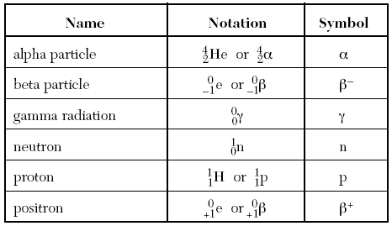
Table O
Two protons and two neutrons, it has a charge of +2 and a low penetrating power
An electron. It has a mass of zero, a charge of negative 1, and medium penetrating power
Pure energy. It has no charge and no mass, but a high penetrating power
A positron is just a positive charge. It has no mass and a charge of positive 1

Slide 12
Table O
An alpha particle is a helium atom, two protons and two neutrons, it has a charge of +2 and a low penetrating power (they don’t penetrate many things)
A beta particle is an electron. It has a mass of zero and a charge of negative 1. Beta particles have medium penetrating power (they can penetrate some materials)
Gamma radiation is pure energy. It has no charge and no mass, but a high penetrating power
A positron is just a positive charge. The opposite of an electron, it has no mass and a charge of positive 1

Slide 13
Concept Check
REGENTS
QUESTION
Which emanation has no mass and no charge?
1.
2.
3.
4.
alpha beta gamma neutron

Slide 14
Concept Check
REGENTS
QUESTION
Which emanation has no mass and no charge?
1.
2.
3.
4.
alpha beta gamma neutron

Slide 15
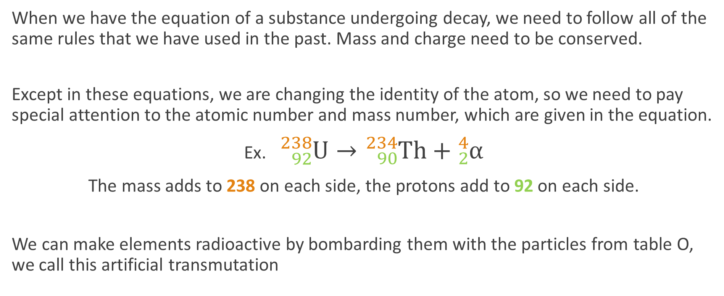
Transmutation Equations
When we have the equation of a substance undergoing decay, we need to follow all of the same rules that we have used in the past. Mass and charge need to be conserved.
Except in these equations, we are changing the identity of the atom, so we need to pay special attention to the atomic number and mass number, which are given in the equation.
Ex. ${}_{92}^{238}U→{}_{90}^{234}{Th}+{}_{2}^{4}α$
The mass adds to 238 on each side, the protons add to 92 on each side.
We can make elements radioactive by bombarding them with the particles from table O, we call this artificial transmutation

Slide 16
Concept Check
REGENTS
QUESTION
In the equation ${}_{90}^{234}{Th}→{}_{91}^{234}{Pa}+X$ , the symbol X represents
1.
2.
3.
4.
${}_{+1}^{0}e$ ${}_{−1}^{0}e$ ${}_{0}^{1}n$ ${}_{1}^{1}H$

Slide 17
Concept Check
REGENTS
QUESTION
In the equation ${}_{90}^{234}{Th}→{}_{91}^{234}{Pa}+X$ , the symbol X represents
1.
2.
3.
4.
${}_{+1}^{0}e$ ${}_{−1}^{0}e$ ${}_{0}^{1}n$ ${}_{1}^{1}H$

Slide 18
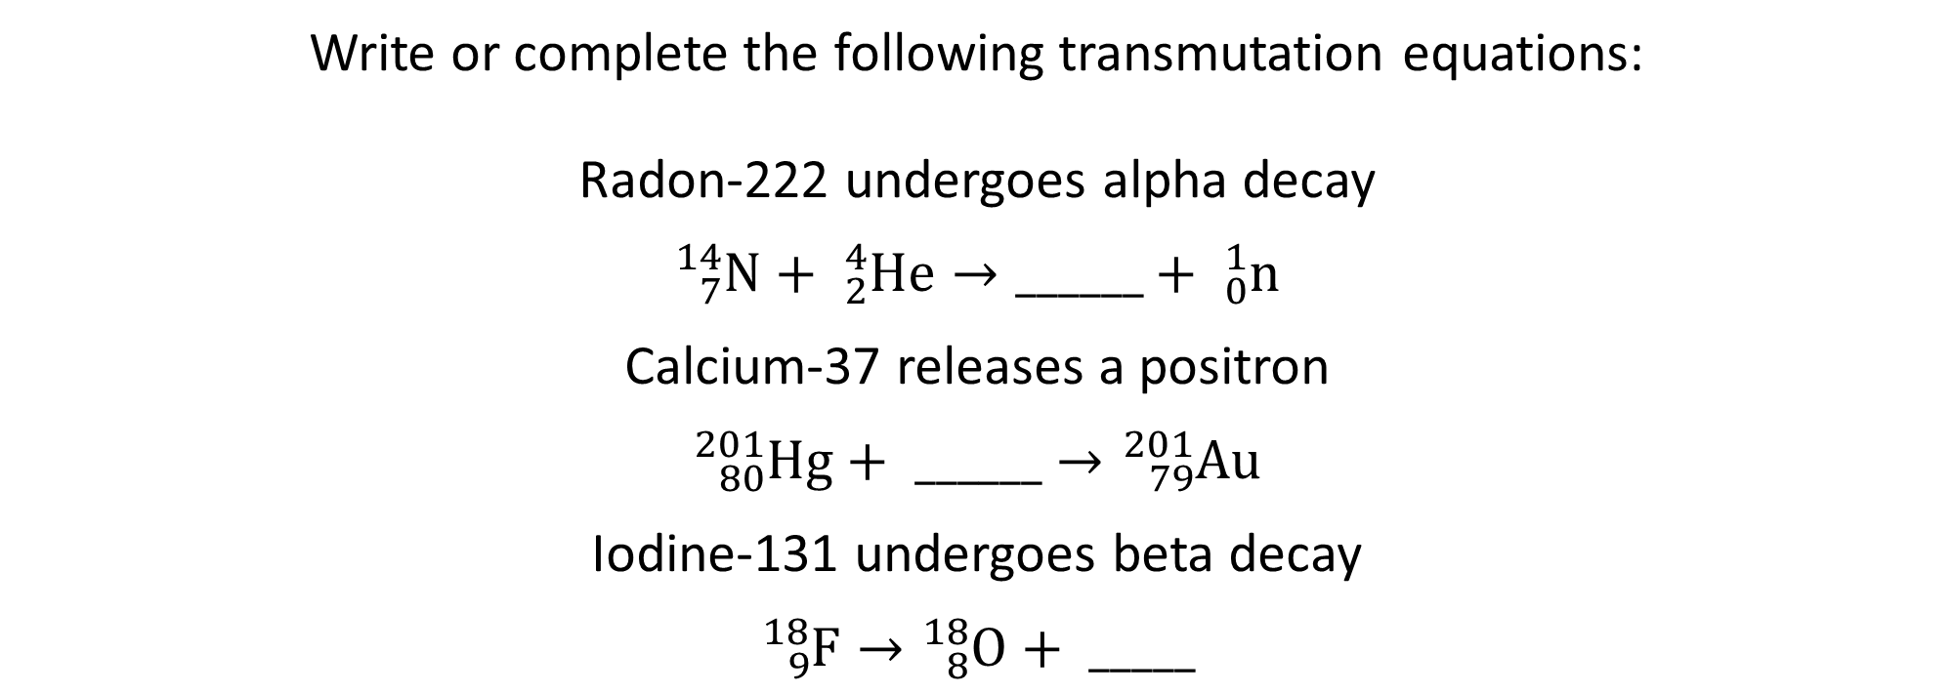
Concept Check
Write or complete the following transmutation equations:
Radon-222 undergoes alpha decay
$${}_{7}^{14}N+ {}_{2}^{4}{He}→______+ {}_{0}^{1}n$$
Calcium-37 releases a positron
$${}_{80}^{201}{Hg}+ ______→{}_{79}^{201}{Au}$$
Iodine-131 undergoes beta decay
$${}_{9}^{18}F→{}_{8}^{18}O+ _____$$

Slide 19

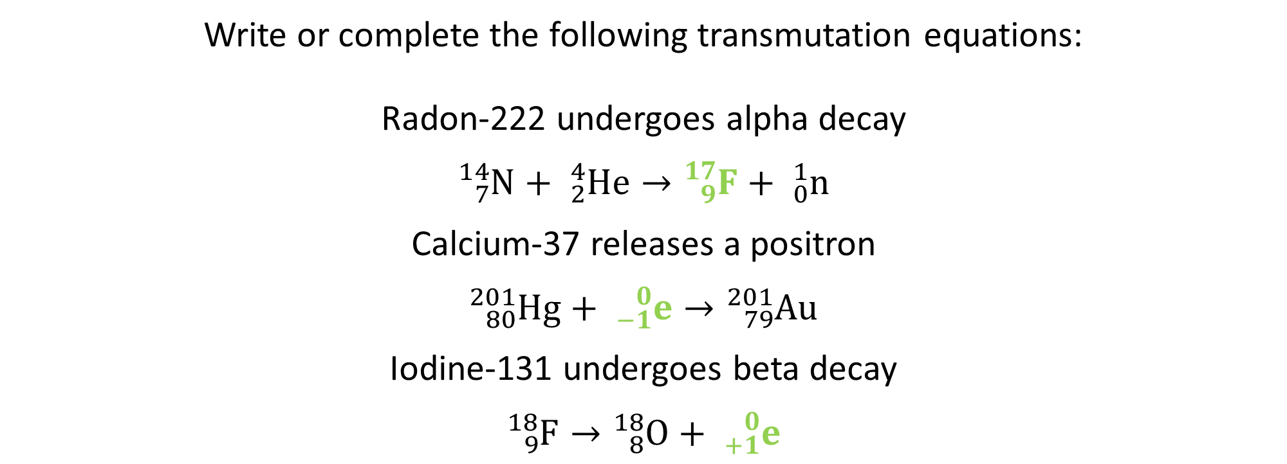


Concept Check
Write or complete the following transmutation equations:
Radon-222 undergoes alpha decay
$${}_{7}^{14}N+ {}_{2}^{4}{He}→{}_{9}^{17}F+ {}_{0}^{1}n$$
Calcium-37 releases a positron
$${}_{80}^{201}{Hg}+ {}_{−1}^{0}e→{}_{79}^{201}{Au}$$
Iodine-131 undergoes beta decay
$${}_{9}^{18}F→{}_{8}^{18}O+ {}_{+1}^{0}e$$
$${}_{86}^{222}{Rn} →{}_{84}^{218}{Po}+{}_{2}^{4}{He}$$
$${}_{20}^{37}{Ca} →{}_{19}^{37}K+{}_{+1}^{0}e$$
$${}_{53}^{131}I →{}_{54}^{131}{Xe}+{}_{−1}^{0}e$$

Slide 20
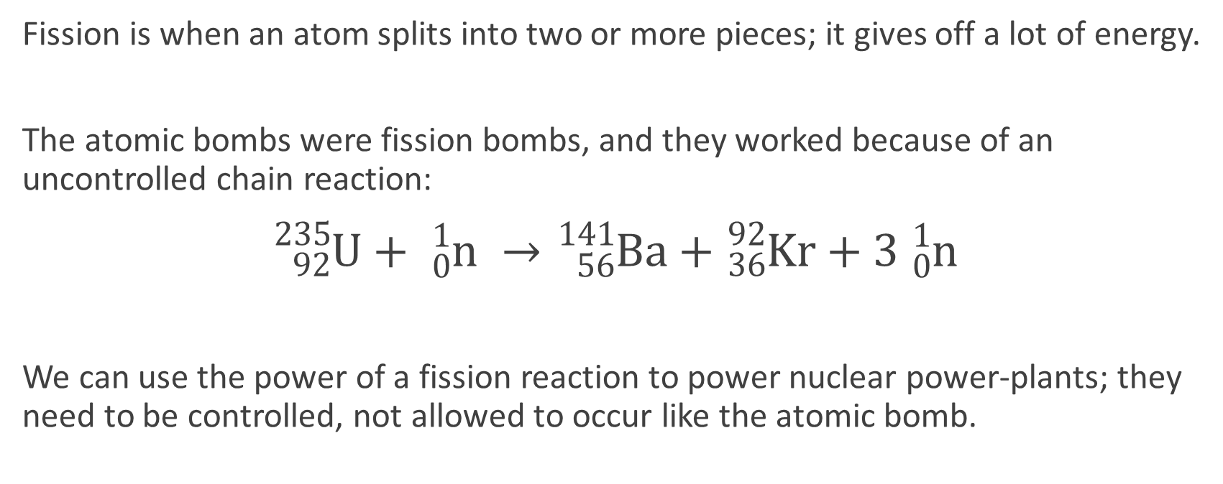
Fission
Fission is when an atom splits into two or more pieces; it gives off a lot of energy.
The atomic bombs were fission bombs, and they worked because of an uncontrolled chain reaction:
${}_{92}^{235}U+ {}_{0}^{1}n →{}_{56}^{141}{Ba}+{}_{36}^{92}{Kr}+3 {}_{0}^{1}n$
We can use the power of a fission reaction to power nuclear power-plants; they need to be controlled, not allowed to occur like the atomic bomb.

Slide 21
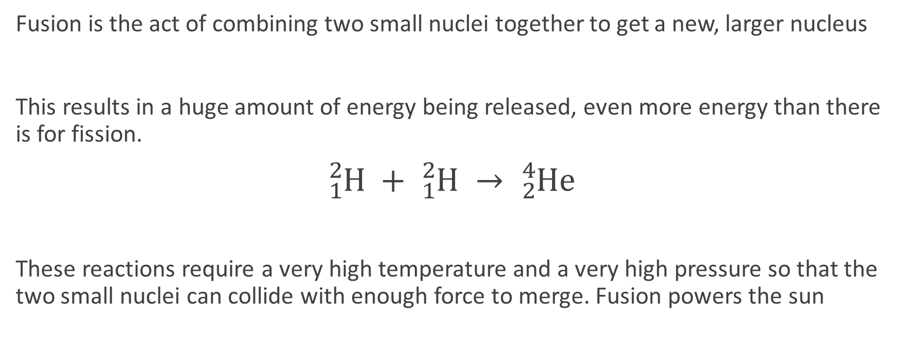
Fusion
Fusion is the act of combining two small nuclei together to get a new, larger nucleus
This results in a huge amount of energy being released, even more energy than there is for fission.
${}_{1}^{2}H + {}_{1}^{2}H → {}_{2}^{4}{He}$
These reactions require a very high temperature and a very high pressure so that the two small nuclei can collide with enough force to merge. Fusion powers the sun

Slide 22
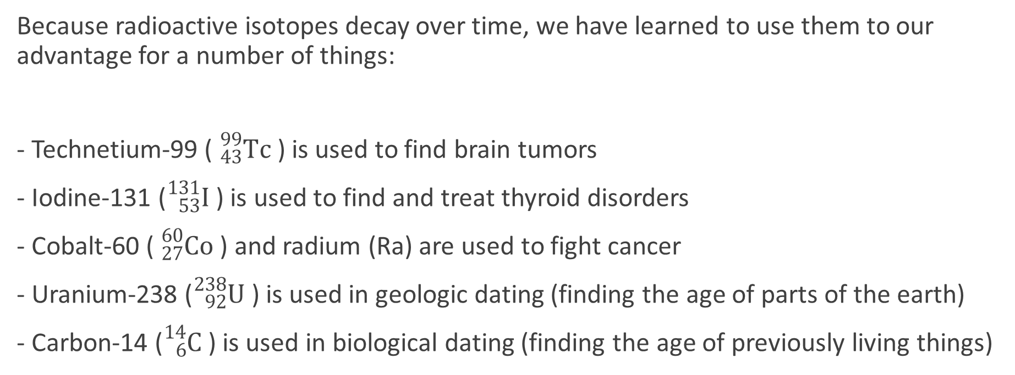
Radioisotopes
Because radioactive isotopes decay over time, we have learned to use them to our advantage for a number of things:
- Technetium-99 ( ${}_{43}^{99}{Tc}$ ) is used to find brain tumors
- Iodine-131 (${}_{53}^{131}I$ ) is used to find and treat thyroid disorders
- Cobalt-60 ( ${}_{27}^{60}{Co}$ ) and radium (Ra) are used to fight cancer
- Uranium-238 (${}_{92}^{238}U$ ) is used in geologic dating (finding the age of parts of the earth)
- Carbon-14 (${}_{6}^{14}C$ ) is used in biological dating (finding the age of previously living things)

