Slide 1
Digestion
Mr. Mesiouris

Slide 2
Nutrients
Your body needs certain things in order to remain healthy. We’ve learned about some of these things but not others:
Water
Carbohydrates
Fats
Proteins
Vitamins
Minerals

Slide 3
Vitamins and Minerals
Vitamins are organic compounds that our bodies use to help in different processes.
Minerals are inorganic substances, usually elements, that the body needs to use in different processes.
Both vitamins and minerals are necessary to keep us healthy, but we can’t make many of the vitamins and minerals that we need, so we have to get them in our food.

Slide 4
Balanced Diet
What makes a balanced diet important?

Slide 5
Balanced Diet
What makes a balanced diet important?
A balanced diet provides our bodies with the right amount of all the nutrients needed to keep it running.
Nutritionists created the food pyramid to help people understand what a balanced diet should look like

Slide 6
The Food Pyramid
The original food pyramid showed:
Carbs should be eaten the most,
Fruits, veggies, dairy, and proteins should be eaten second most,
Fats and oils should be eaten the least

Slide 7
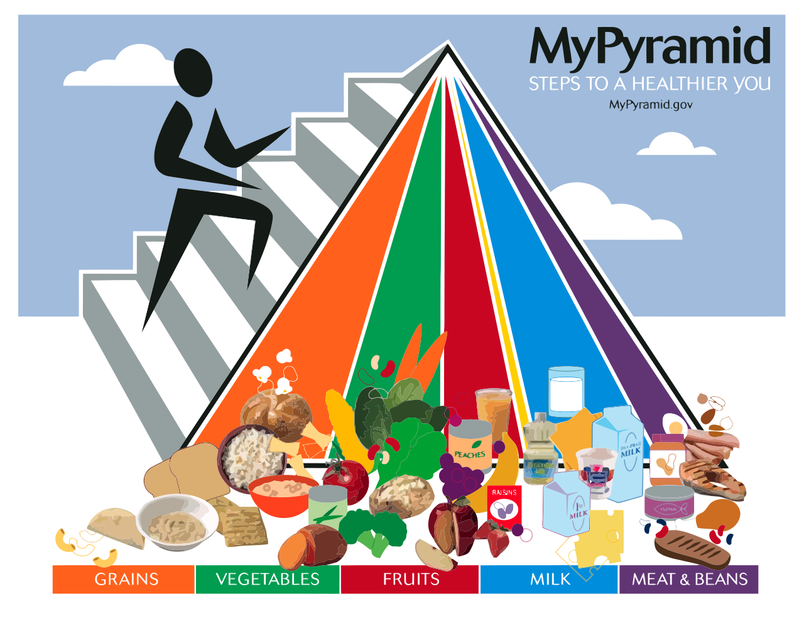
The Food Pyramid
A newer, updated food pyramid showed:
All groups should be eaten in about the same proportions, except for sweets, which aren’t on the pyramid anymore

Slide 8
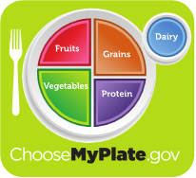
The Food Pyramid
The latest idea is the ‘healthy plate’:
Each meal should be about half fruits/veggies, half grains and proteins, with a glass of dairy

Slide 9
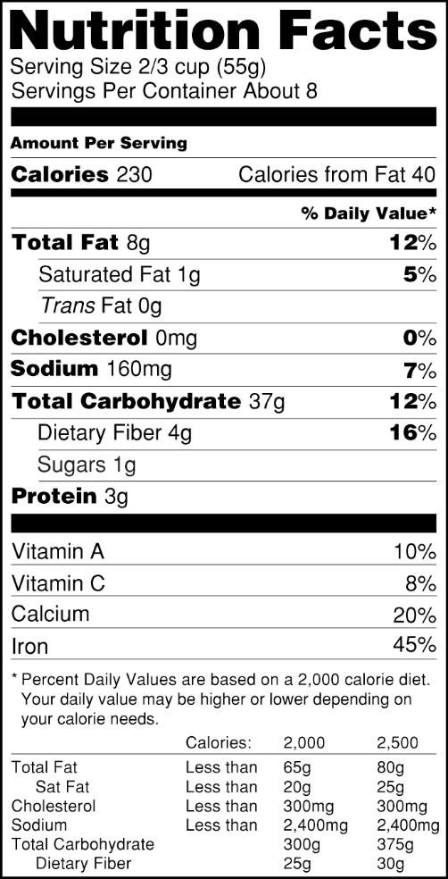
The Food Pyramid
Nutrition Fact labels are created by nutritionists with the same ideas as the food pyramids.
The percentages are the ‘daily recommended values’ for healthy living
The label tells you the size of a serving and breaks down the nutrients present in each serving

Slide 10
The Digestive System
There are 5 parts to the digestive system:
The mouth, the esophagus, the stomach, the small intestine, the large intestine
Each piece of the digestive system works to break down the food that you eat and then get the molecules into your bloodstream.
There is mechanical digestion and chemical digestion.

Slide 11
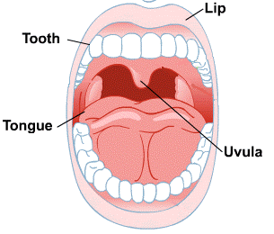
The Mouth
In the mouth, mechanical and chemical digestion start.
The teeth break food into smaller pieces by chewing (mechanical digestion)
Saliva starts to chemically break down food as you chew
What happens to the surface area of food as you chew?

Slide 12
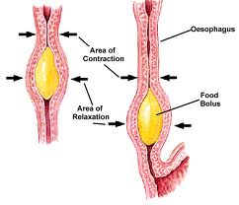
The Esophagus
When you swallow, you push food out of your mouth and into your esophagus.
At the back of your throat, a small flap of skin called the epiglottis makes sure the food goes into your throat and not your windpipe
The food moves to your stomach through peristalsis
The muscles in your esophagus relax and contract to push the food.
This is why you can swallow lying down

Slide 13
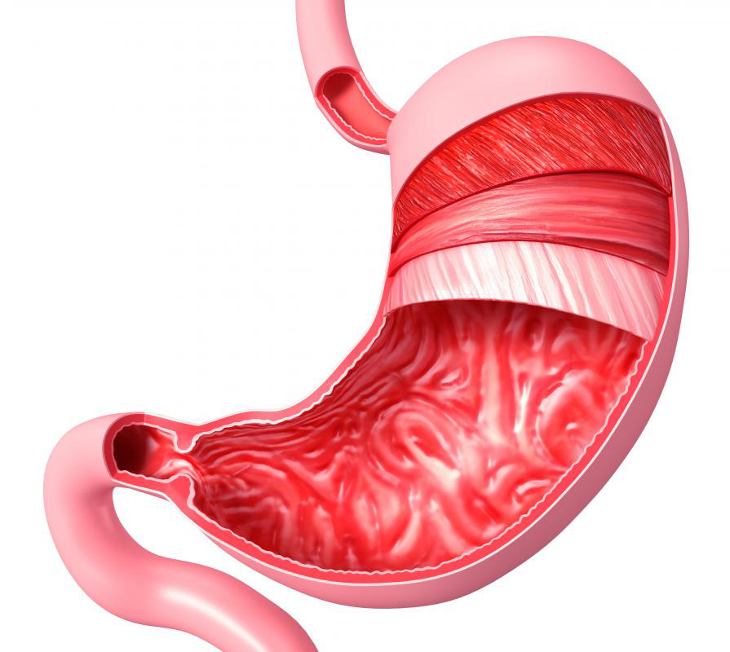
The Stomach
The stomach constantly moves to mix the food you eat with the digestive chemicals that are inside.
The chemicals in your stomach (including hydrochloric acid)
break down the food that you ate even more, making the
big molecules smaller and smaller.
People often think that stomach acid causes ulcers (small holes in the stomach lining), but they are actually caused by a special bacteria in the stomach that eats at the lining

Slide 14
Concept Check
Is the digestion in the stomach mechanical, chemical, or both?
1.
2.
3.
Mechanical
Chemical
Both

Slide 15
Concept Check
Is the digestion in the stomach mechanical, chemical, or both?
1.
2.
3.
Mechanical
Chemical
Both

Slide 16
The Small Intestine
After the stomach finishes churning the food and breaking it down, it empties into the small intestine.
As the food enters the small intestine, the liver adds bile and the pancreas adds enzymes to help chemically break down the food one final time.
As the food travels the small intestine, small structures called villi capture the nutrients and bring them to the bloodstream.

Slide 17
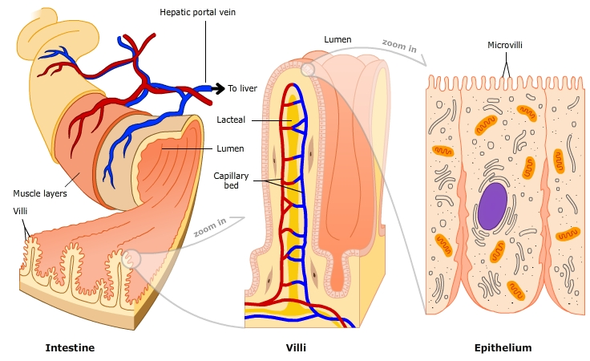
Villi and the Small intestine
The surface area of the small intestine is almost as big as a tennis court.
This is because of the villi in the small intestine.

Slide 18
The Large Intestine
When food leaves the small intestine, almost all of the nutrients have been taken out.
All that is left is water and indigestible substances like cellulose.
The large intestine’s job is to take in water from that mixture for the body to use.
If too little water is removed, you get diarrhea. If too much water is removed, you become constipated.

Slide 19
Connecting Backwards
How does the digestive system work to help cellular respiration?

