Slide 1
Phases of Matter and Energy
Mr. Mesiouris

Slide 2
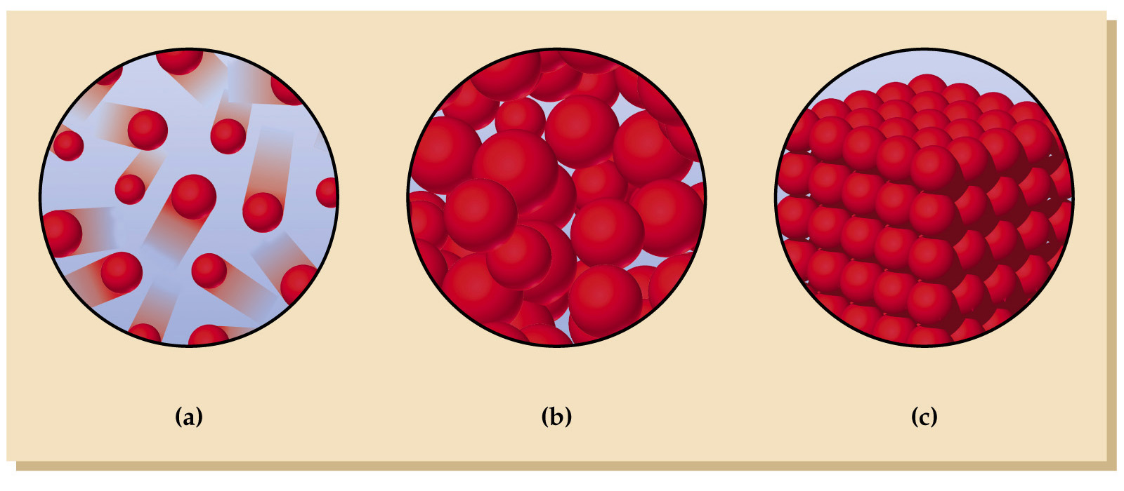
Solids
Liquids
Gases
  Definite volume
  Definite shape
  Particles are fixed in their place, and only vibrate slightly
Definite volume
No definite shape
Liquids take the shape of the container that they are in
The particles move freely past each other, they have no regular
pattern or arrangement
No definite shape
No definite volume
Gases fill the containers that they are in entirely, from wall to wall
The particles move in straight lines until they collide with another particle or a wall

Slide 3
Concept Check
REGENTS
QUESTION
In which sample are the particles arranged in a regular geometric pattern?
1.
2.
3.
4.
HCl_{(L)} NaCl_{(aq)} N_{2(g)} I_{2(s)}

Slide 4
Concept Check
REGENTS
QUESTION
In which sample are the particles arranged in a regular geometric pattern?
1.
2.
3.
4.
HCl_{(L)} NaCl_{(aq)} N_{2(g)} I_{2(s)}

Slide 5
Energy
Energy is the ability to do work
ENERGY IS NEVER CREATED OR DESTROYED, ONLY TRANSFORMED FROM ONE FORM TO ANOTHER
All chemical substances have potential energy.
Potential energy is stored energy; the energy of position or composition, waiting to be released or used in a reaction or change.

Slide 6
Kinetic Energy
Kinetic energy is the energy that a particle has due to motion. It is the direct opposite of potential energy.
Temperature is a measure of the average kinetic energy of a substance.
Something with a high temperature has a high kinetic energy
Something with a low temperature has a low kinetic energy
All molecular motion stops at absolute zero (-273 ºC)

Slide 7
Energy, changes, and reactions
There are two types of changes in chemistry that deal with energy:
Endothermic reaction: energy is absorbed from the environment, products become less stable
Exothermic reaction: energy is released into the environment, products become more stable
We’re going to start to talk about these reactions in terms of phase changes, to ease us into the concept.

Slide 8
Changing between phases of matter
Solids have the highest potential energy of the three phases of matter.
Going from a solid to a liquid is called melting
The particles in the solid break their hold on each other and begin to move around freely, losing their definite shape.
Endothermic process or exothermic process?

Slide 9
Changing between phases of matter
Gasses have the lowest amount of potential energy of the stages of matter
Going from a liquid to a gas is called evaporation
The particles in the liquid spread apart from each other, losing their definite volume and expanding to fill up the entire container.
Endothermic process or exothermic process?

Slide 10
Changing between phases of matter
Take it back now y’all
Going from a gas to a liquid is called condensation
The particles in the gas come closer together, gaining a definite volume and taking the shape of the container that holds them
Endothermic process or exothermic process?

Slide 11
Changing between phases of matter
Going from a liquid to a solid is called freezing or fusion
The particles in the liquid come closer and closer together, joining together in a structured way, becoming a solid with definite shape and volume.
Endothermic process or exothermic process?

Slide 12
Changing between phases of matter
Two hops this time
Sometimes a solid will skip the liquid phase and become a gas. This is called sublimation.
Endothermic process or exothermic process?
A gas can sometimes skip liquid and become a solid, this is called deposition.
Endothermic process or exothermic process?

Slide 13
Concept Check
REGENTS
QUESTION
Which change results in a release of energy?
1.
2.
3.
4.
H₂O_{(s)}→H₂O_{(g)} CO_{2(s)}→CO_{2(l)} H₂S_{(g)}→H₂S_{(l)} NH_{3(l)}→NH_{3(g)}

Slide 14
Concept Check
REGENTS
QUESTION
Which change results in a release of energy?
1.
2.
3.
4.
H₂O_{(s)}→H₂O_{(g)} CO_{2(s)}→CO_{2(l)} H₂S_{(g)}→H₂S_{(l)} NH_{3(l)}→NH_{3(g)}

Slide 15


Concept Check
A substance with low potential energy has _______ kinetic energy
High
Low

Slide 16
Concept Check
A substance with low potential energy has _______ kinetic energy
High
Low

Slide 17
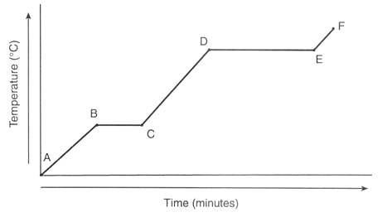
Heating / Cooling Curves

Slide 18
Curve Calculations
Q = m C ΔT Used for calculating heat needed to increase the temperature of a substance (slants)
Q = m H_{f} Used for calculating heat needed to go from solid to liquid (first plateau)
Q = m H_{v} Used for calculating heat needed to go from liquid to gas (second plateau)

Slide 19

How much energy is needed to increase the temperature of 50 g of water by 30 ºC ?
How much energy is needed to melt 400 g of copper if the heat of fusion is 0.5 J/g ?
How much energy is needed to change the temperature of 50 g of iron from 10 to 80 ºC ? (the specific heat of iron is 2 J/gºC)

Slide 20
Concept Check
REGENTS
QUESTION
The heat of fusion of a substance is the energy measured during a
1.
2.
3.
4.
phase change temp change chemical change pressure change

Slide 21
Concept Check
REGENTS
QUESTION
The heat of fusion of a substance is the energy measured during a
1.
2.
3.
4.
phase change temp change chemical change pressure change

Slide 22
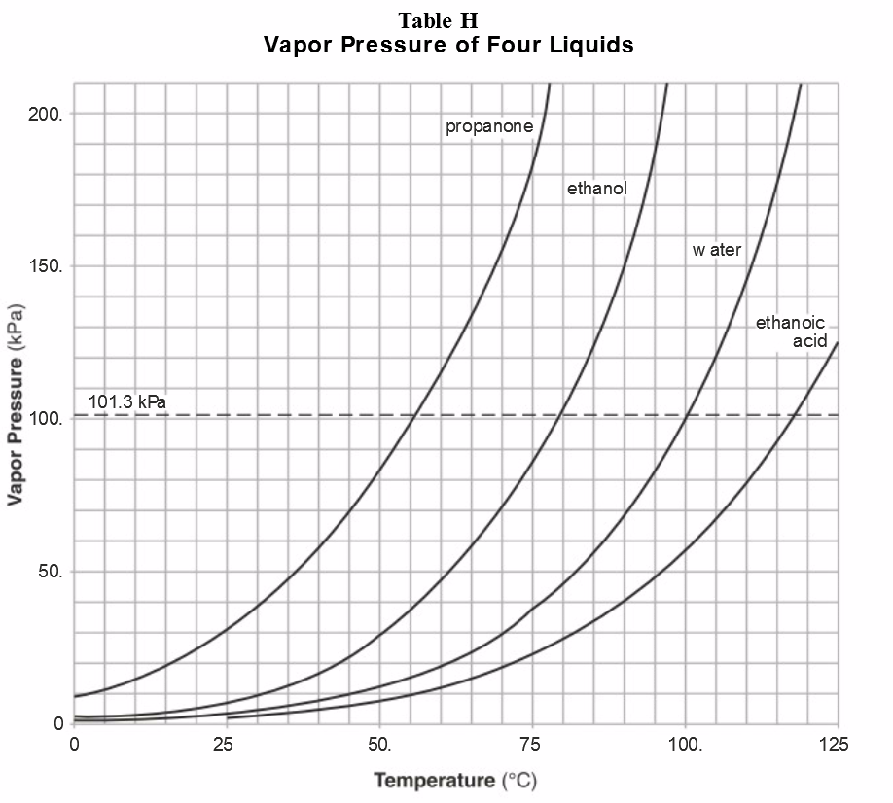
Table H
Liquids are constantly evaporating, slowly becoming gases (also vice versa, we’ll get there)
As these liquids become gas, the gas exerts pressure on the sides of the container (and the air above the surface of the liquid)
The boiling point of the liquid is when the vapor pressure = atmospheric pressure

Slide 23
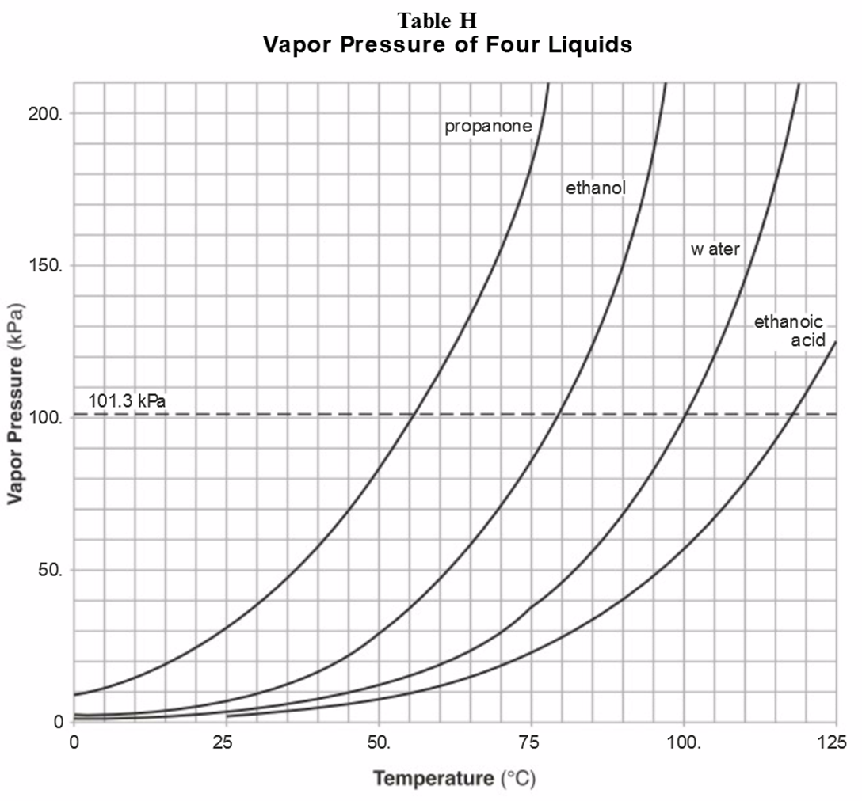
Concept Check
REGENTS
QUESTION
If the pressure on the surface of propanone in the liquid state is 90 kPa, the liquid will boil at about
1.
2.
3.
4.
0ºC 55ºC 80ºC 100ºC

Slide 24
Concept Check
REGENTS
QUESTION
If the pressure on the surface of propanone in the liquid state is 90 kPa, the liquid will boil at about
1.
2.
3.
4.
0ºC 55ºC 80ºC 100ºC

Slide 25
Concept Check
REGENTS
QUESTION
Water will boil at a temperature of 70ºC when the pressure on its surface is
1.
2.
3.
4.
121 kPa 91 kPa 31 kPa 61 kPa

Slide 26
Concept Check
REGENTS
QUESTION
Water will boil at a temperature of 70ºC when the pressure on its surface is
1.
2.
3.
4.
121 kPa 91 kPa 31 kPa 61 kPa

Slide 27
Heat Flow
When two objects are in direct contact with each other, and no heat can escape, heat will equalize.
What does this look like?
70 ºC
30 ºC

Slide 28
Concept Check
60 ºC
40 ºC
1.
2.
3.
40
50
60

Slide 29
Concept Check
60 ºC
40 ºC
1.
2.
3.
40
50
60

Slide 30
Concept Check
90 ºC
50 ºC
1.
2.
3.
50
70
90

Slide 31
Concept Check
90 ºC
50 ºC
1.
2.
3.
50
70
90

Slide 32
Concept Check
10 ºC
80 ºC
1.
2.
3.
40
45
60

Slide 33
Concept Check
10 ºC
80 ºC
1.
2.
3.
40
45
60

Slide 34
Concept Check
REGENTS
QUESTION
Solid X is placed in contact with solid Y. Heat will flow spontaneously from X to Y when
1.
2.
3.
4.
X is 20ºC and Y is 20ºC X is 10ºC and Y is 5ºC X is -25ºC and Y is -10ºC X is 25ºC and Y is 30ºC

Slide 35
Concept Check
REGENTS
QUESTION
Solid X is placed in contact with solid Y. Heat will flow spontaneously from X to Y when
1.
2.
3.
4.
X is 20ºC and Y is 20ºC X is 10ºC and Y is 5ºC X is -25ºC and Y is -10ºC X is 25ºC and Y is 30ºC

