Slide 1
Human Transport
Mr. Mesiouris

Slide 2
The Circulatory System
The human circulatory system moves nutrients and oxygen to cells around the body, and takes waste from those cells to get rid of it.
The important parts of the circulatory system are:
The heart, the blood vessels, and the blood itself.

Slide 3
The Heart
The heart is the main thing that moves blood throughout our body. The pumping of the heart forces the blood through its path.
The heart has four parts. A left atrium, a right atrium, a left ventricle and a right ventricle.
The atria receive the blood, and ventricles pump the blood out of the heart.

Slide 4
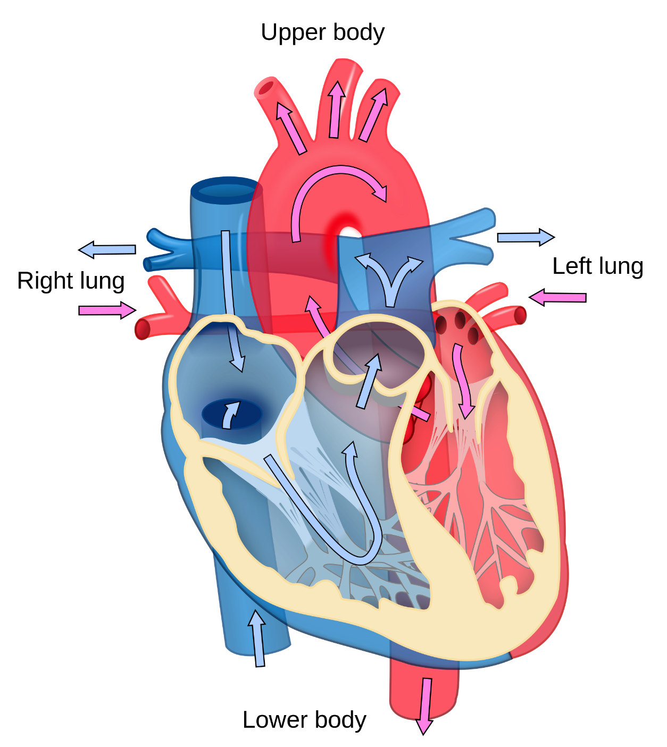
The Heart
The left side of the heart takes in blood that received oxygen from the lungs and pumps it through your body in the arteries.
The right side of the heart takes in blood without oxygen, from your body, and sends it to the lungs in the veins.
The left and right halves of the heart DO NOT share their blood. They are separated by a wall of tissue

Slide 5
Blood Vessels
There are three types of blood vessels in your body:
Arteries – these carry blood away from the heart, to the rest of your body. They have thick walls and almost always carry oxygen rich blood.
Veins – these carry blood towards your heart, from the rest of your body. They are full of one-way valves that let blood go towards the heart but not away.
Capillaries – these have very thin walls (only one cell thick). They allow the oxygen to diffuse into the body cells, and wastes to diffuse into the blood. They connect veins and arteries.

Slide 6
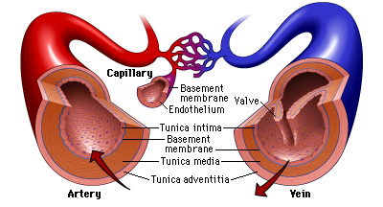

Slide 7
The Blood
There are four important things in the blood:
Red blood cells – contain hemoglobin, a protein that carries oxygen. They also take CO₂ and bring it to the lungs. Made in the bone marrow
White blood cells – Part of the immune system, fights off pathogens. Made in the lymph nodes
Platelets – clot the blood
Plasma – Carries everything else (nutrients, hormones, wastes, etc) but not O₂ or CO₂

Slide 8
Blood Types
Blood cells have antigens on them, which are little protein markers on the cell.
The plasma has antibodies, things made to attach to antigens and label them to be attacked by the immune system.

Slide 9
Fill in the Circulatory Map
Label: L atrium, R atrium, L ventricle, R ventricle, veins, arteries, lungs, body,
O₂ rich blood, O₂ poor blood, systemic & pulmonary circulation
Systemic Circulation – circulation to & from the body
Pulmonary Circulation – circulation to & from the lungs

Slide 10
Fill in the Circulatory Map
Label: L atrium, R atrium, L ventricle, R ventricle, veins, arteries, lungs, body,
O₂ rich blood, O₂ poor blood, systemic & pulmonary circulation
VEIN
V
VEIN
V
V
V
RA
LA
LUNGS
BODY
RV
LV
V
V
V
V
ARTERY
ARTERY

Slide 11
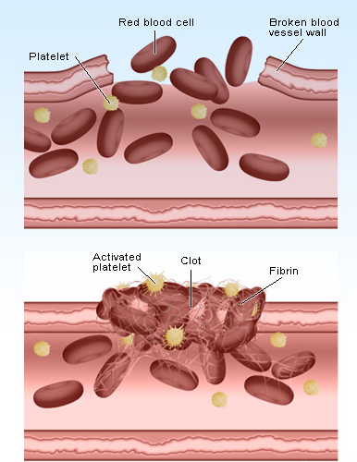
Circulatory Disorders
Platelet clotting – Platelets contain a special enzyme which makes platelets stick together and form the clots that stop you from bleeding.
Bad blood clots – cholesterol makes the platelets think there is a broken blood vessel, and cause the platelets to clot where they shouldn’t. This can lead to heart attacks and strokes.

Slide 12
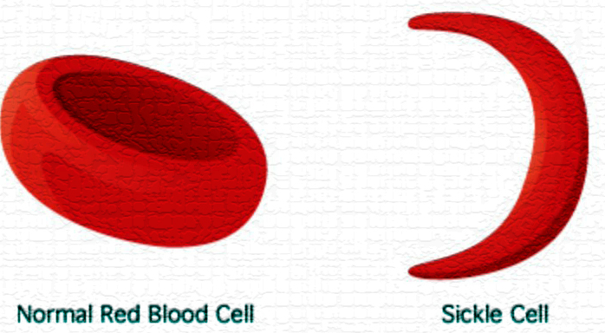
Circulatory Disorders
Sickle Cell Anemia – this is a disorder where a person’s red blood cells are misshapen, causing them not to be able to carry oxygen.
Sickle cell anemia is another example in the body of ‘shape determines function’

