Slide 1
The Periodic Table
Mr. Mesiouris

Slide 2
Gram Formula Mass
‘Gram formula mass’ or ‘molar mass’ is the phrase we use when talking about 1 mole of a substance
For elements, this number is the atomic mass directly off the periodic table. Usually, we round to the nearest whole number.
For compounds, it’s a little trickier to find the gram formula mass.

Slide 3
Concept Check
What is the gram formula mass of….
Mercury (Hg)
1.
2.
3.
80 g
201 g
206 g

Slide 4
Concept Check
What is the gram formula mass of….
Mercury (Hg)
1.
2.
3.
80 g
201 g
206 g

Slide 5
Concept Check
What is the gram formula mass of….
Chlorine (Cl)
1.
2.
3.
35.5 g
17 g
36 g

Slide 6
Concept Check
What is the gram formula mass of….
Chlorine (Cl)
1.
2.
3.
35.5 g
17 g
36 g

Slide 7
Concept Check
What is the gram formula mass of….
Krypton (Kr)
1.
2.
3.
84 g
36 g
83 g

Slide 8
Concept Check
What is the gram formula mass of….
Krypton (Kr)
1.
2.
3.
84 g
36 g
83 g

Slide 9
Calculating Gram Formula Mass
When we want to find the GFM of a compound, we need to add the respective mass of each element in the compound.
Lets look at carbon dioxide: CO₂.
It has one carbon atom and two oxygen atoms.
Carbon has a mass of 12 g, and oxygen has a mass of 16 g
Together, one carbon and two oxygen have a mass of 44 g

Slide 10
Calculating Gram Formula Mass
When we want to find the GFM of a compound that is written with parentheses we also need to add each element together.
BUT parentheses mean that the entire unit inside is taken twice or three times.
For example: Ca(OH)₂ or Fe₃(PO₄)₂
We’ll get into why later in the year.

Slide 11
Concept Check
What is the gram formula mass of….
Ammonia (NH₃)
1.
2.
3.
17 g
15 g
9 g

Slide 12
Concept Check
What is the gram formula mass of….
Ammonia (NH₃)
1.
2.
3.
17 g
15 g
9 g

Slide 13
Concept Check
What is the gram formula mass of….
Water (H₂O)
1.
2.
3.
9 g
10 g
18 g

Slide 14
Concept Check
What is the gram formula mass of….
Water (H₂O)
1.
2.
3.
9 g
10 g
18 g

Slide 15
Concept Check
What is the gram formula mass of….
Sodium Chloride (NaCl)
1.
2.
3.
58.5 g
59.5 g
28 g

Slide 16
Concept Check
What is the gram formula mass of….
Sodium Chloride (NaCl)
1.
2.
3.
58.5 g
59.5 g
28 g

Slide 17
Lets talk about moles again
So, since moles gave us trouble before I want to visit them again.
One mole of an element or compound has a mass equal to its GFM (what we’ve been calculating)
One mole of carbon has a mass of 12 g
One mole of water has a mass of 18 g
Etc.

Slide 18
Concept Check
What is the mass of….
3 moles of water (H₂O)
1.
2.
3.
18 g
6 g
54 g

Slide 19
Concept Check
What is the mass of….
3 moles of water (H₂O)
1.
2.
3.
18 g
6 g
54 g

Slide 20
Concept Check
What is the mass of….
½ a mole of carbon (C)
1.
2.
3.
6 g
12 g
24 g

Slide 21
Concept Check
What is the mass of….
½ a mole of carbon (C)
1.
2.
3.
6 g
12 g
24 g

Slide 22
Concept Check
What is the mass of….
12 moles of lithium (Li)
1.
2.
3.
84 g
70 g
36 g

Slide 23
Concept Check
What is the mass of….
12 moles of lithium (Li)
1.
2.
3.
84 g
70 g
36 g

Slide 24
Isotopes
We’ve already talked about isotopes, but let’s revisit them too.
What is an isotope?
When we write the element symbol for an atom, where do we put the mass number and the atomic number?

Slide 25
Ions
Atoms are neutrally charged by default. Their number of electrons is equal to their number of protons.
BUT atoms can gain or lose electrons through any number of ways, which turns them into ions.
This gives the atoms a ‘charge’, either positive or negative, depending on how many electrons were lost or gained.
We express the charge of an atom in the upper right hand corner.

Slide 26


Concept Check
An atom that has lost 3 electrons has a charge of …
+3
-3

Slide 27
Concept Check
An atom that has lost 3 electrons has a charge of …
+3
-3

Slide 28
Concept Check
An atom that has gained 4 electrons has a charge of …
+4
-4

Slide 29
Concept Check
An atom that has gained 4 electrons has a charge of …
+4
-4

Slide 30
Valence electrons
The electrons in the last shell of an atom are its valence electrons.
Every atom is looking to change their number of electrons until they have 8 or 0 in their outermost shell (except Helium and Hydrogen, which want 2 or 0).
For some atoms its easier for them to gain electrons to reach 8, while for others it is easier for them to lose electrons to get to 8
Look at sodium and chlorine….

Slide 31
Lewis Structures
A Lewis structure is a method of keeping track of these valence electrons, and will help us work to understand bonds as we move forward throughout the year.
To write a Lewis structure, we take the symbol of our element, and surround it with small dots to represent its valence electrons.
Two above, two below, and two to either side make 8 electrons.

Slide 32
Concept Check
Draw the Lewis dot structure for the first 18 elements of the periodic table
H |  |  |  |  |  |  |  | He
Li | Be |  | B | C | N | O | F | Ne
Na | Mg | … | Al | Si | P | S | Cl | Ar

Slide 33
Periodic Trends
Look at the Lewis dot structures you just made. What do you see?
H |  |  |  |  |  |  |  | He
Li | Be |  | B | C | N | O | F | Ne
Na | Mg | … | Al | Si | P | S | Cl | Ar

Slide 34
Ionization Energy
Ionization energy is the amount of energy needed to remove one valence electron from an atom.
The elements that want to lose electrons have low ionization energies, while elements that want to gain electrons have high ionization energies.
Looking at the periodic table, and keeping our Lewis dot structures in mind, what do you think this trend will look like on the periodic table?

Slide 35
The Four Corners
Li
F
1
7
Fr
Uuq
1
7

Slide 36
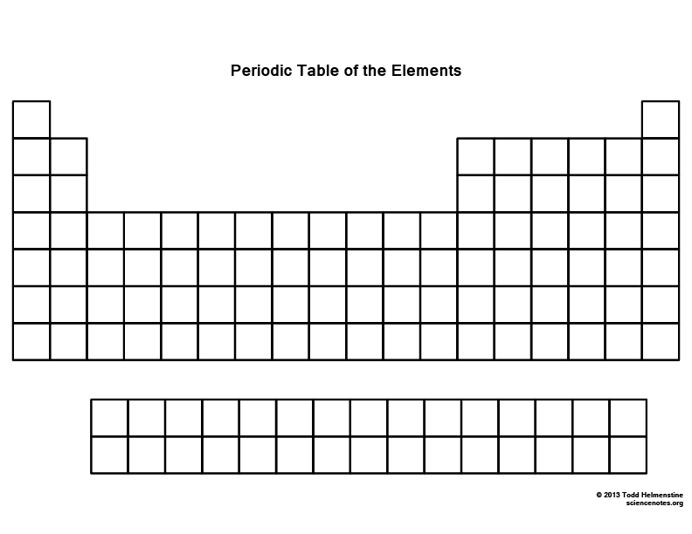
Ionization Energy

Slide 37
Electronegativity
Electronegativity is a measure of an element’s ability to attract electrons. It is measured on a scale of 0 to 4, with 4 being the highest. There is no actual measurement though, the entire scale is relative.
Elements that want to gain electrons have a higher electronegativity than the elements that want to lose electrons.
Looking at the periodic table, and keeping our Lewis dot structures in mind, what do you think this trend will look like on the periodic table?

Slide 38
The Four Corners
Li
F
1
7
Fr
Uuq
1
7

Slide 39
Electronegativity

Slide 40
Atomic Radius
The electrons around the nucleus are held where they are because the nucleus is positive and the electrons are negative.
The electrons are held at specific distances from the nucleus, in their shells.
As we add more and more shells to an atom, does it become easier or harder for the nucleus to hold on?
As we add more and more electrons to a shell, does it become easier or harder for the nucleus to hold on? What else do we add to the atom?
Nuclear charge – the number of protons in the nucleus

Slide 41
The Four Corners
Li
F
1
7
Fr
Uuq
1
7

Slide 42
Atomic Radius

Slide 43
Ionic Radius
Every atom wants to be like a noble gas.
When it gains or loses its electrons to become an ion, its radius will change too.
What happens to the radius of Li? F?
Li
F
2
1
2
7

Slide 44
Ionic Radius
Every atom wants to be like a noble gas.
When it gains or loses its electrons to become an ion, its radius will change too.
What happens to the radius of Li? F?
Li
F
2
1
2
7
Li⁺
F⁻
2
0
2
8

Slide 45
Ionic Radius
Every atom wants to be like a noble gas.
When it gains or loses its electrons to become an ion, its radius will change too.
What happens to the radius of Li? F?
Li
F
2
1
2
7
Li⁺
F⁻
A positive ion is smaller than its atom
A negative ion is bigger than its atom
2
8
2

Slide 46
Table S
Table S takes up two pages of your reference table
If you look on the left side of the table it tells you the values for each element in regards to each of the trends (atomic radius, electronegativity, ionization energy)
If you ever forget the trend and have to compare two or more elements, the information is all there on Table S for you to look at!
Table S has a lot of other information that makes it helpful as we move on in chemistry.

Slide 47
The Periodic Table
Contains ALL the elements that exist, arranged in increasing atomic number
Columns (called groups or families) have similar chemical properties
Rows (called periods) don’t always have similar chemical properties

Slide 48
The Types of Elements
Metals – good conductors of heat and electricity. Found on the left of the periodic table
Non-metals – bad conductors of heat and electricity. Found on the right of the periodic table
Metalloids – share characteristics of both metals and nonmetals. Found on the staircase

Slide 49
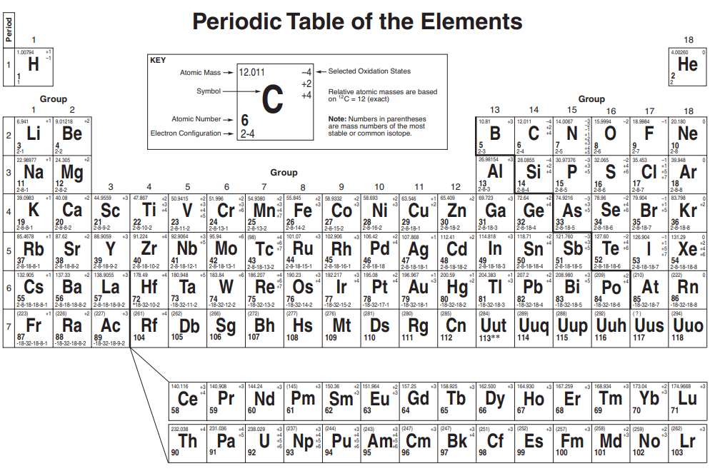

Slide 50
Properties of different elements
Metals
Hard
Lustrous
High melting and boiling points
Good conductors
Malleable, Ductile
Non-Metals
Brittle
Dull
Low melting and boiling points
Bad conductors

Slide 51
Concept Check
REGENTS
QUESTION
Which element in Group 15 would most likely have luster and good electrical conductivity?
1.
2.
3.
4.
N P As Bi

Slide 52
Concept Check
REGENTS
QUESTION
Which element in Group 15 would most likely have luster and good electrical conductivity?
1.
2.
3.
4.
N P As Bi

Slide 53
The Areas of the Periodic Table
Some of the families in the periodic table have specific names, so we can refer to them easier. (We’ve been talking about the noble gases this whole time, right?)
The 1st family is called the Alkali metals.
The 2nd family is called the alkaline earth metals
The 17th family is called the halogens
The 18th family is called the noble gases

Slide 54
Concept Check
REGENTS
QUESTION
Which two elements have the most similar chemical properties?
1.
2.
3.
4.
aluminum + barium nickel + phosphorus chlorine + sulfur sodium + potassium

Slide 55
Concept Check
REGENTS
QUESTION
Which two elements have the most similar chemical properties?
1.
2.
3.
4.
aluminum + barium nickel + phosphorus chlorine + sulfur sodium + potassium

Slide 56
Concept Check
As you move up a group the ionization energy of the atoms …
Increases
Decreases

Slide 57
Concept Check
As you move up a group the ionization energy of the atoms …
Increases
Decreases

Slide 58
Concept Check
As you move left along a period the electronegativity of the atoms …
Increases
Decreases

Slide 59
Concept Check
As you move left along a period the electronegativity of the atoms …
Increases
Decreases

Slide 60
Concept Check
As you move left along a period the atomic radius of the atoms …
Increases
Decreases

Slide 61
Concept Check
As you move left along a period the atomic radius of the atoms …
Increases
Decreases

Slide 62
Concept Check
As you move right along a period the ionization energy of the atoms …
Increases
Decreases

Slide 63
Concept Check
As you move right along a period the ionization energy of the atoms …
Increases
Decreases

Slide 64
Concept Check
As you move down a group the electronegativity of the atoms …
Increases
Decreases

Slide 65
Concept Check
As you move down a group the electronegativity of the atoms …
Increases
Decreases

Slide 66
Concept Check
As you move up a group the atomic radius of the atoms …
Increases
Decreases

Slide 67
Concept Check
As you move up a group the atomic radius of the atoms …
Increases
Decreases

