Slide 1
An Introduction to Chemistry
Mr. Mesiouris

Slide 2
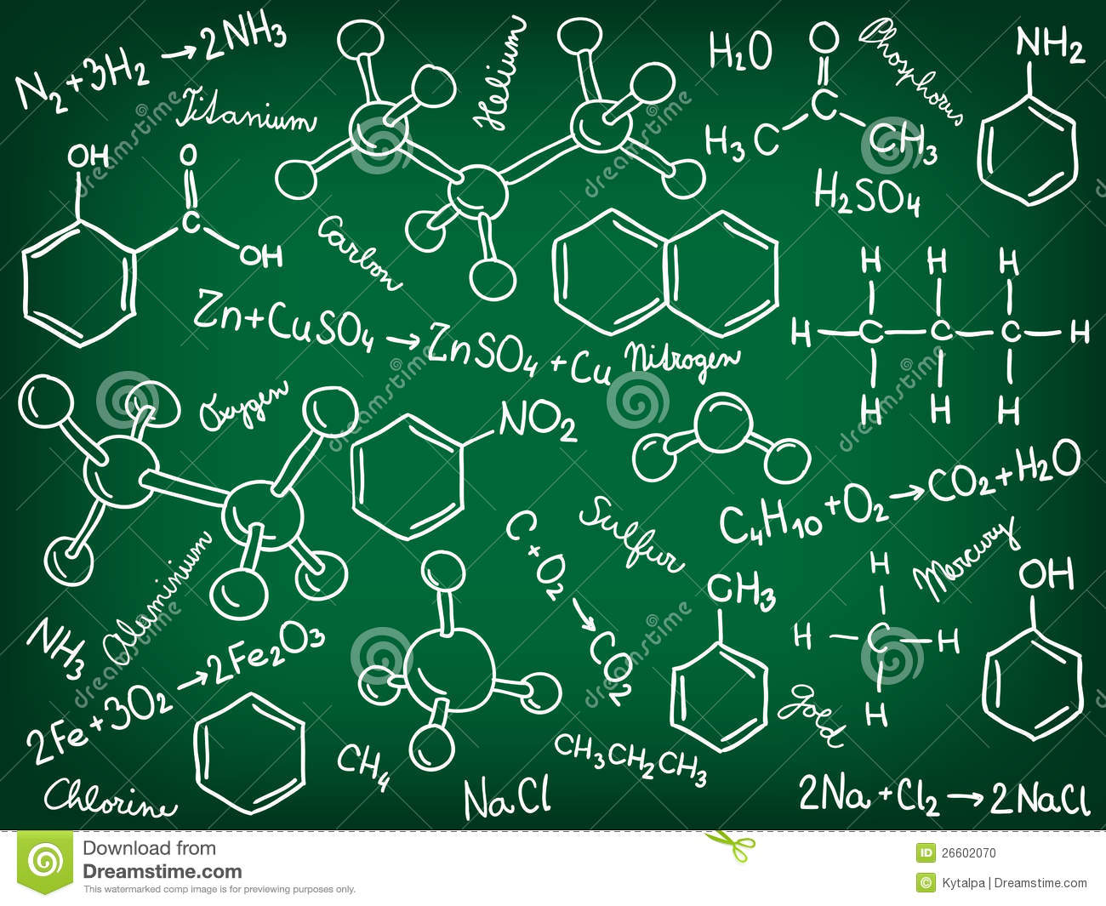
What is chemistry?
Chemistry is a physical science
It is the study of the composition, structure, and properties of matter, and the changes it undergoes
As a class we will be looking at all of these things over the course of the year, with labs and lectures.

Slide 3
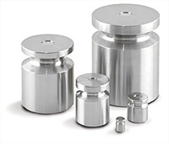
Well, what’s matter?
Nothing, what’s the matter with you?
Matter is anything that has mass and takes up space.
Volume is a measure of the amount of space an object occupies
Mass is a measure of the amount of matter, it is NOT the same as weight.

Slide 4
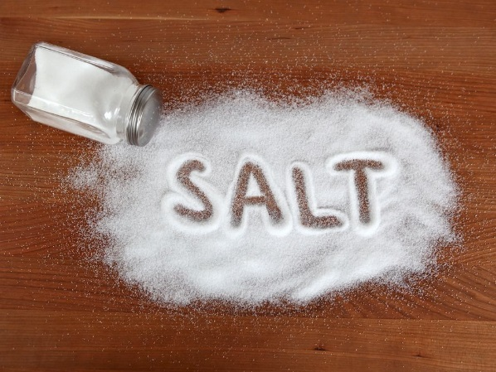
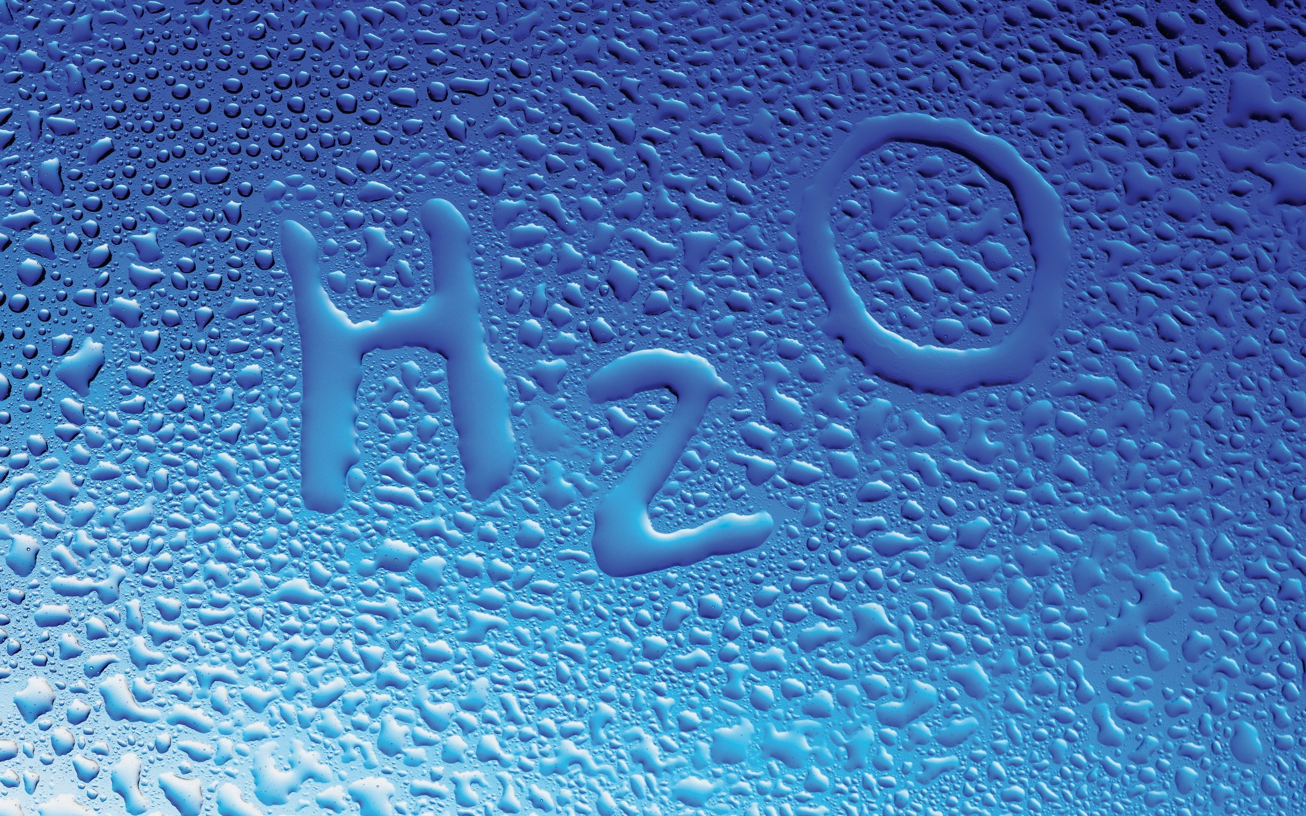
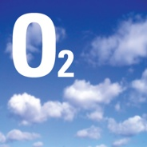
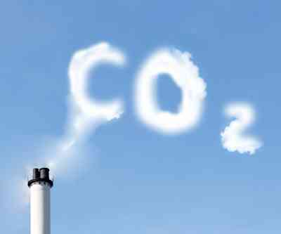
Chemicals
We interact with thousands of chemicals every day
A chemical is any substance that has a definite composition
They are divided into elements and compounds

Slide 5
Elements and Compounds
Element- a substance that cannot be broken down any further without destroying it. They make up the periodic table.
  Atom- the smallest unit of an element that maintains the properties of that element
Compound – a substance made from two or more different elements that are chemically bonded
  Molecule- the smallest unit of a compound that maintains the properties of that compound.
Molecules are made from two or more atoms

Slide 6

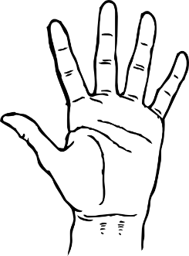
Concept Check
Is carbon dioxide, CO₂, an element or a compound?
Element
Compound

Slide 7
Concept Check
Is carbon dioxide, CO₂, an element or a compound?
Element
Compound

Slide 8
Concept Check
Is silver, Ag, an element or a compound?
Element
Compound

Slide 9
Concept Check
Is silver, Ag, an element or a compound?
Element
Compound

Slide 10
Concept Check
Is oxygen, O₂, an element or a compound?
Element
Compound

Slide 11
Concept Check
Is oxygen, O₂, an element or a compound?
Element
Compound

Slide 12
Concept Check
Is oxygen, O₂, an atom or a molecule?
Atom
Molecule

Slide 13
Concept Check
Is oxygen, O₂, an atom or a molecule?
Atom
Molecule

Slide 14
Diatomic Elements
Some elements exist in their most stable form as molecules of 2.
There are 7 of these elements, called the diatomic elements.
They are: Br₂ I₂ N₂ Cl₂ H₂ O₂ F₂
They can be easily remembered as ‘Brinclhof’

Slide 15
Concept Check
REGENTS
QUESTION
Which substance can not be decomposed into simpler substances?
1.
2.
3.
4.
ammonia aluminum methane methanol

Slide 16
Concept Check
REGENTS
QUESTION
Which substance can not be decomposed into simpler substances?
1.
2.
3.
4.
ammonia aluminum methane methanol

Slide 17
Concept Check
REGENTS
QUESTION
Which formula represents a binary compound?
1.
2.
3.
4.
NH₄NO₃ CH₄ CH₃COCH₃ CaCO₃

Slide 18
Concept Check
REGENTS
QUESTION
Which formula represents a binary compound?
1.
2.
3.
4.
NH₄NO₃ CH₄ CH₃COCH₃ CaCO₃

Slide 19
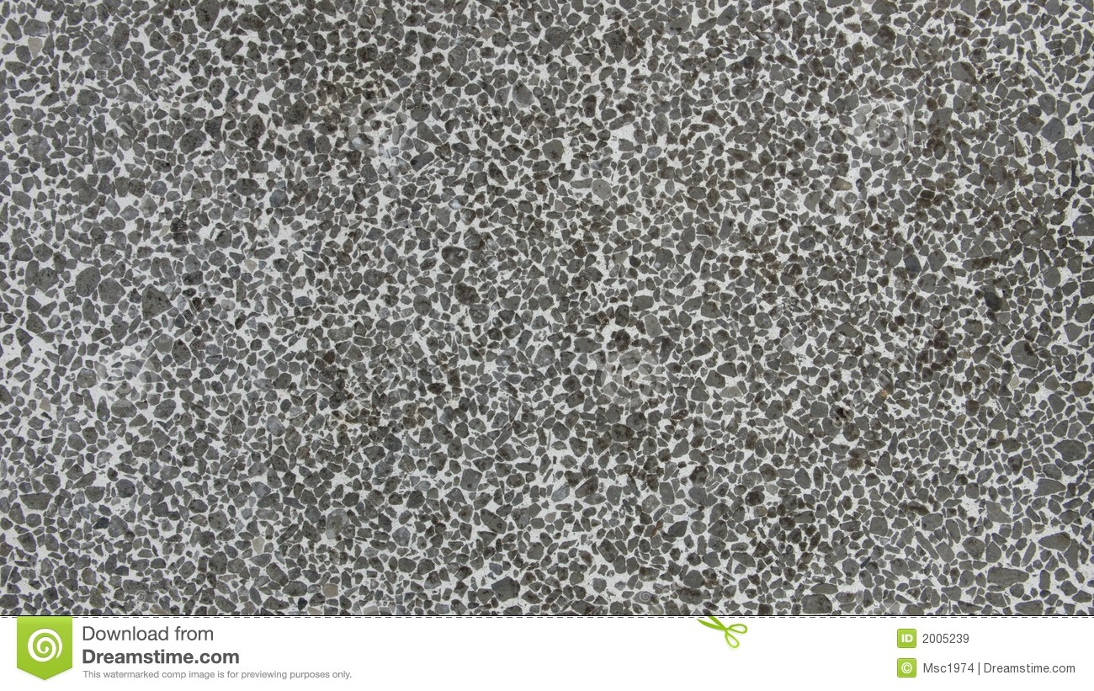
Pure Substances and Mixtures
A mixture is a blend of two or more kinds of matter, where each retains its properties.
There are two types of mixtures:
  Heterogeneous mixture – Non uniform (concrete, rocky road ice cream)
  Homogeneous mixture – Uniform (salt water, sugar water)
A pure substance is either an element or a compound, every sample of a pure substance has the same characteristics and composition

Slide 20
Concept Check
Is the air around us a pure substance, a homogeneous mixture, or a heterogeneous mixture?
Without accounting for pollution
1.
2.
3.
Pure Substance
Homogeneous Mixture
Heterogeneous Mixture

Slide 21
Concept Check
Is the air around us a pure substance, a homogeneous mixture, or a heterogeneous mixture?
Without accounting for pollution
1.
2.
3.
Pure Substance
Homogeneous Mixture
Heterogeneous Mixture

Slide 22
Concept Check
REGENTS
QUESTION
An example of a heterogeneous mixture is:
1.
2.
3.
4.
soil sugar carbon monoxide carbon dioxide

Slide 23
Concept Check
REGENTS
QUESTION
An example of a heterogeneous mixture is:
1.
2.
3.
4.
soil sugar carbon monoxide carbon dioxide

Slide 24
Separating Mixtures
Due to the fact that mixtures are not chemically combined, they can be separated back into the substances that make up the mixture.
Filtration: Separates mixtures by particle size
Distillation: separates a mixture of multiple liquids by boiling point
Some mixtures can also be separated using the properties of the substances that make it: using a magnet to pull iron out of sawdust, boiling away the water in salt water, etc

Slide 25
The Properties of Matter
Physical – can be observed without changing the identity of the substance (smell, melting point)
Chemical – relates to a substance’s ability to undergo changes that transform it into a different substance (stored energy)

Slide 26


Chemical and Physical Changes
Physical Change – a change to a substance without changing its identity
Chemical Change – a change to a substance that DOES change its identity
Chemical Changes are also known as chemical reactions

Slide 27
Concept Check
Ice melting
Physical
Chemical

Slide 28
Concept Check
Ice melting
Physical
Chemical

Slide 29
Concept Check
A lit burner on a gas stove
Physical
Chemical

Slide 30
Concept Check
A lit burner on a gas stove
Physical
Chemical

Slide 31
Concept Check
Salt dissolving in water / making a drink from powder
Physical
Chemical

Slide 32
Concept Check
Salt dissolving in water / making a drink from powder
Physical
Chemical

Slide 33
Concept Check
Frying an egg, grilling a burger
Physical
Chemical

Slide 34
Concept Check
Frying an egg, grilling a burger
Physical
Chemical

Slide 35
Chemical Reactions
Chemical reactions are written in a shorthand:
Carbon plus oxygen yields (or forms) carbon dioxide
Carbon + oxygen → carbon dioxide
C + O₂ → CO₂
Where do these symbols come from?

Slide 36
The Periodic Table
Contains ALL the elements that exist, arranged in increasing atomic number
Columns, called groups or families have similar chemical properties
Rows called periods don’t always have similar chemical properties

Slide 37
The Types of Elements
Metals – good conductors of heat and electricity. Found on the left of the periodic table
Non-metals – bad conductors of heat and electricity. Found on the right of the periodic table
Metalloids – share characteristics of both metals and nonmetals. Found on the staircase
Noble Gases – The right-most group on the periodic table. Incredibly unreactive

Slide 38
Concept Check
Os (76)
Al (13)
H (1)
F (9)
Sb (51)
1.
2.
3.
Metal
Metalloid
Nonmetal

Slide 39
Concept Check
Os (76)
Al (13)
H (1)
F (9)
Sb (51)
Metal
Metalloid
Nonmetal
Nonmetal
Metalloid
1.
2.
3.
Metal
Metalloid
Nonmetal

Slide 40
Rules for Scientific Notation
Making a big number into scientific notation makes the exponent positive
Making a small number into scientific notation makes the exponent negative
The leading number should be between 1 and 10
1.03 x 10⁻¹¹ 10.3 x 10⁻¹²
^{Good} ^{Bad}
Don’t round a number in scientific notation unless its SN form is past the thousands place
Scientific notation is just moving the decimal point to ‘condense’ a number like an accordion

Slide 41
Measurements in Chemistry
Chemists use the metric system, it is better and easier than the American system
Everything is measured in multiples of ten, so when you convert all you do is move the decimal
Milligram = .001 grams
Gram = 1
decagram = 10 grams
Kilogram = 1,000 grams

Slide 42
The Metric Prefixes and Scientific notation
Pico--- = 0.000000000001 (1 x 10⁻¹²)
Nano--- = 0.000000001 --- (1 x 10⁻⁹)
Micro--- = 0.000001 --- (1 x 10⁻⁶)
Milli--- = .001 --- (1 x 10⁻³)
Centi--- = .01 --- (1 x 10⁻²)
---
Deca--- = 10 --- (1 x 10¹)
Kilo--- = 1,000 --- (1 x 10³)
Mega--- = 1,000,000 --- (1 x 10⁶)
Giga --- = 1,000,000,000 --- (1 x 10⁹)
PSSSSSSST ….. The important prefixes and conversions are on
Table C !

Slide 43
Concept Check
Put this number in scientific notation:
1,470,000,000,000
1.
2.
3.
1.47 x 10¹²
14.7 x 10⁹
147 x 10¹⁰

Slide 44
Concept Check
Put this number in scientific notation:
1,470,000,000,000
1.
2.
3.
1.47 x 10¹²
14.7 x 10⁹
147 x 10¹⁰

Slide 45
Concept Check
170 grams is equal to how many kilograms?
1.
2.
3.
1.7
0.17
170,000

Slide 46
Concept Check
170 grams is equal to how many kilograms?
1.
2.
3.
1.7
0.17
170,000

Slide 47
Concept Check
Put this number in scientific notation:
.0000000003
1.
2.
3.
3 x 10¹⁰
30 x 10⁻¹¹
3 x 10⁻¹⁰

Slide 48
Concept Check
Put this number in scientific notation:
.0000000003
1.
2.
3.
3 x 10¹⁰
30 x 10⁻¹¹
3 x 10⁻¹⁰

Slide 49
Concept Check
REGENTS
QUESTION
How many joules are equivalent to 35 kilojoules?
1.
2.
3.
4.
0.035 joule 0.35 joule 3,500 joule 35,000 joule

Slide 50
Concept Check
REGENTS
QUESTION
How many joules are equivalent to 35 kilojoules?
1.
2.
3.
4.
0.035 joule 0.35 joule 3,500 joule 35,000 joule

Slide 51
Significant Figures
Numbers in science have a lot of importance. The difference between 12.4 and 12.5 can be incredibly important.
Scientists express numbers according to a group of rules that govern which numbers in any given value are ‘significant’
You can’t use a piece of measuring equipment and make it more precise than it already is. A meter stick cant measure the width of a hair.
You can estimate one decimal place past what an instrument tells you. No further.

Slide 52
Zeros and Significant Figures
There are three types of zeros in this world…..
Leading zeros: 0.00012 (never significant)
Captive zeros: 2003 (always significant)
Trailing zeros: 1200 (sometimes significant)
What is the difference between 1200 and 1200. ?

Slide 53
Concept Check
How many significant figures are in:
1720.00
1.
2.
3.
3
4
6

Slide 54
Concept Check
How many significant figures are in:
1720.00
1.
2.
3.
3
4
6

Slide 55
Concept Check
How many significant figures are in:
.002003
1.
2.
3.
2
4
6

Slide 56
Concept Check
How many significant figures are in:
.002003
1.
2.
3.
2
4
6

Slide 57
Concept Check
How many significant figures are in:
32,001
1.
2.
3.
3
4
5

Slide 58
Concept Check
How many significant figures are in:
32,001
1.
2.
3.
3
4
5

Slide 59
Concept Check
How many significant figures are in:
132,030
1.
2.
3.
4
5
6

Slide 60
Concept Check
How many significant figures are in:
132,030
1.
2.
3.
4
5
6

Slide 61
Concept Check
How many significant figures are in:
132,000,000,000,000,000,000,000,000,000,000,000,000,000,000
1.
2.
3.
3
7
A lot

Slide 62
Concept Check
How many significant figures are in:
132,000,000,000,000,000,000,000,000,000,000,000,000,000,000
1.
2.
3.
3
7
A lot

Slide 63
Math functions with Sig. Figs
When you add or subtract or divide or multiply measurements, you need to make sure that you keep the proper amount of significant figures.
The rule for adding and subtracting: Keep the number of significant figures of the value with fewest significant digits to the right of the decimal point.
The rule for dividing and multiplying: Keep the number of significant figures of the number with the fewest significant figures.

Slide 64
Precision and Accuracy
When scientists make measurements, they want to know two things:
First, how close is the measured value to the “true” value?
ACCURACY
Secondly, how reproducible is the measurement?
PRECISION

Slide 65
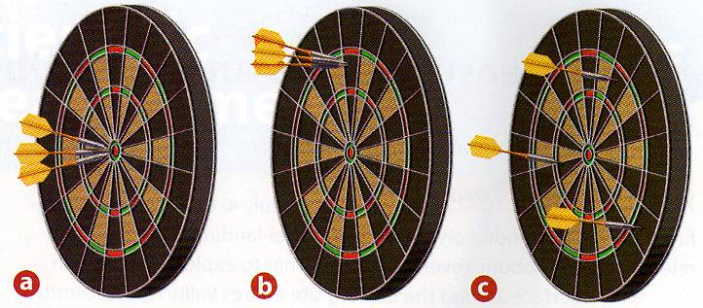
Precision and Accuracy (Visually)

Slide 66
Precision and Accuracy (Visually)
BOTH PRECISE NEITHER

Slide 67
Dimensional Analysis
Sounds fancy and complicated right? Well its not so bad.
Different teachers will call this process different things, depending on how they learned it.
At its core, dimensional analysis is a way to convert numbers from one form to another to help us solve problems.

Slide 68
Dimensional Analysis
Dimensional analysis works by multiplying numbers by ‘conversion factors’
1 meter = 100 centimeters becomes a conversion factor →
We express these factors as fractions, but they are equalities. Each one of these fractions is equal to 1, so we never change the value of the numbers that we convert.
Remember: the conversion factor is what you WANT over what you HAVE
___1 meter___
100 centimeters

Slide 69
Dimensional Analysis Example
1 cow is worth 4 pigs
2 pigs can be traded for 1 horse
3 horses are worth 12 sheep
2 sheep are worth 5 ducks
How many ducks can I get for 6 cows?
How many pigs can I get for 24 sheep?

Slide 70
Concept Check
There are:
2 igdals in 1 ondonk and
6 ondonks in 4 falkiers
if you have 3 igdals how many falkiers is that?
1.
2.
3.
1
3
4

Slide 71
Concept Check
There are:
2 igdals in 1 ondonk and
6 ondonks in 4 falkiers
if you have 3 igdals how many falkiers is that?
1.
2.
3.
1
3
4

Slide 72
Concept Check
I want to binge on doughnuts, so I buy 4 dozen doughnuts. If I want to use dimensional analysis to find out how many single doughnuts that is, which is the correct conversion factor?
1.
2.
3.
_12 doughnuts_
1 dozen
___1 dozen___
12 doughnuts
__1 doughnut__
12 dozen

Slide 73
Concept Check
I want to binge on doughnuts, so I buy 4 dozen doughnuts. If I want to use dimensional analysis to find out how many single doughnuts that is, which is the correct conversion factor?
1.
2.
3.
_12 doughnuts_
1 dozen
___1 dozen___
12 doughnuts
__1 doughnut__
12 dozen

Slide 74
Density
Density is a measure of how much mass is packed into a certain volume. It is different for each type of matter.
Substances with a high density, like steel, have molecules that are packed together tightly.
Substances with a low density, like cork, have fewer molecules packed into the same amount of space.

Slide 75
How to Find Density
Density is found by dividing the mass of something by its volume
As long as a substance is pure, the size or shape of the sample doesn’t matter. The density will always be the same.
This means that a steel paper clip has the same density as a steel girder used to build a bridge.
Density = Mass ÷ Volume
_m_
V
D=
The formula is on Table T for you

Slide 76
Concept Check
Which is denser, a pound of rocks or a pound of feathers?
rocks
feathers

Slide 77
Concept Check
Which is denser, a pound of rocks or a pound of feathers?
rocks
feathers

Slide 78
Practice
A 10.0 cm³ sample of copper has a mass of 89.6 g. What is the density of copper?
A block of iron has the dimensions of 2 cm x 3 cm x 2 cm. If the mass of this rectangular-shaped object is 94 g, what is the density of iron?

Slide 79
Practice
Mercury metal is poured into a graduated cylinder that holds exactly 22.5 mL. The mercury used to fill the cylinder weighs 306.0 g. From this information, calculate the density of mercury.
Calculate the density of sulfuric acid if 35.4 mL of the acid weighs 65.14 g.
What volume of silver metal will weigh exactly 2500.0 g. The density of silver is 10.5 g/cm3.

Slide 80
Concept Check
Which is denser, a steel paperclip or a steel girder?
1.
2.
3.
Paperclip
They have Equal Densities
Girder

Slide 81
Concept Check
Which is denser, a steel paperclip or a steel girder?
1.
2.
3.
Paperclip
They have Equal Densities
Girder

Slide 82
Practice
A 13.0 cm³ sample of nickel has a mass of 12.5 g. What is the density of nickel?
A block of brass has the dimensions of 2 cm x 3 cm x 4 cm. If the mass of this rectangular-shaped object is 86 g, what is the density of brass?

