Slide 1
Ions in Solution
Mr. Mesiouris

Slide 2
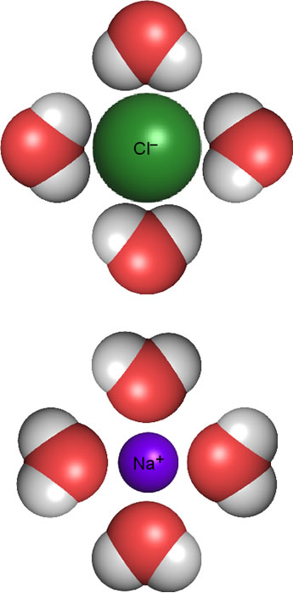
Dissolving / Hydrating
When you put certain things in water, they will ‘disappear’
This is because of the water molecules surrounding the other molecules and dispersing them throughout the water.
A molecule or ion that is surrounded by water molecules is ‘hydrated’ and chemists describe this using the subscript (aq) much like (s) , (l) , and (g)

Slide 3
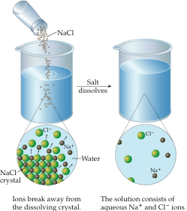
Dissociation of Ionic Compounds
When an ionic solid dissolves, its lattice comes apart to yield ions in solution
This breakdown of the lattice is called dissociation
Ex: NaCl_{(s)} → Na⁺_{(aq)} + Cl⁻_{(aq)}
This is not the same with covalent compounds. For example, when sucrose (C₁₂H₂₂O₁₁) dissolves in water, you get intact, dissolved molecules (C₁₂H₂₂O_{11 (aq)}) and no ions are produced

Slide 4
Concentration of Ionic Compounds
If we want to find the concentration of the ions in a solution, we need to consider the dissociated ionic molecule and not the solid ionic molecule
Ex:
If we put 1 mole of NaCl into a glass of water, what will the total concentration of the ions be?
If NaCl_{(s)} → Na⁺_{(aq)} + Cl⁻_{(aq)} then, 1 NaCl_{(s)} → 1 Na⁺_{(aq)} + 1 Cl⁻_{(aq)}
Which adds up to 2 moles of ions.

Slide 5
Concept Check
If we put 4 moles of NaCl into a glass of water, what will the total concentration of the ions be?
1.
2.
3.
2 moles of ions
4 moles of ions
8 moles of ions

Slide 6
Concept Check
If we put 4 moles of NaCl into a glass of water, what will the total concentration of the ions be?
1.
2.
3.
2 moles of ions
4 moles of ions
8 moles of ions

Slide 7
Concept Check
If we put 2 moles of CaCl₂ into a glass of water, what will the total concentration of the ions be?
1.
2.
3.
3 moles of ions
6 moles of ions
7 moles of ions

Slide 8
Concept Check
If we put 2 moles of CaCl₂ into a glass of water, what will the total concentration of the ions be?
1.
2.
3.
3 moles of ions
6 moles of ions
7 moles of ions

Slide 9
Concept Check
If we put 1 mole of Al₂(SO₄)₃ into a glass of water, what will the total concentration of the ions be?
1.
2.
3.
4 moles of ions
5 moles of ions
9 moles of ions

Slide 10
Concept Check
If we put 1 mole of Al₂(SO₄)₃ into a glass of water, what will the total concentration of the ions be?
1.
2.
3.
4 moles of ions
5 moles of ions
9 moles of ions

Slide 11
Ionization
Some covalent compounds do form ions in solution, but only if the water is strong enough to break the bond within the compound
This is what happens to many acids, like HCl and Acetic acid
HCl (in water)→ H⁺_{(aq)} + Cl⁻_{(aq)}

Slide 12
Electrolytes
An electrolyte is a substance that yields ions and conducts an electric current in solution
The strength of an electrolyte is based entirely on its ability to create ions in solution

Slide 13
Concept Check
Which would be a better electrolyte?
1.
2.
NaCl
CaCl₂

Slide 14
Concept Check
Which would be a better electrolyte?
1.
2.
NaCl
CaCl₂

Slide 15
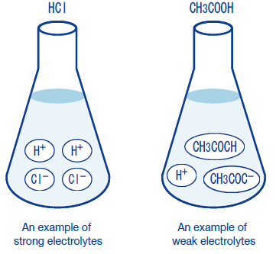
Strong Electrolytes
Dissociate 100% in water
They stay dissociated, they do not revert back to their molecular form
Ex: NaCl_{(s)} → Na⁺_{(aq)} + Cl⁻_{(aq)}
A stronger electrolyte produces more ions than a weaker electrolyte

Slide 16
Weak Electrolytes
Do not dissociate 100% in water
They do not stay dissociated, they revert back to their molecular form
Ex: CH₃COOH_{(s)} H⁺_{(aq)} + CH₃COO⁻_{(aq)}

Slide 17
Concept Check
Which would be a better electrolyte?
1.
2.
CH₃COOH
CaCl₂

Slide 18
Concept Check
Which would be a better electrolyte?
1.
2.
CH₃COOH
CaCl₂

Slide 19
Precipitation Reactions
Occasionally when two solutions are mixed, the force between their ions will be strong enough to overcome the hydration
The ions will form an insoluble compound and ‘fall out’ of solution as solids
This is called a precipitation reaction.

Slide 20


Concept Check
Is AgCl soluble?
No
Yes

Slide 21
Concept Check
Is AgCl soluble?
No
Yes

Slide 22
Concept Check
Is Li₂SO₄ soluble?
No
Yes

Slide 23
Concept Check
Is Li₂SO₄ soluble?
No
Yes

Slide 24
Double Replacement Practice
KOH + H₂SO₄ --->
FeS + HCl --->
NaCl + H₂SO₄ --->
AgNO₃ + NaCl ---> Ca(OH)₂ + HCl --->
Al(NO₃)₃ + H₂SO₄ --->
Pb(NO₃)₂ + K₂S --->
Pb(NO₃)₂ + CuSO₄ --->

Slide 25
Double Replacement Practice
2 KOH + H₂SO₄ ---> K₂SO₄ + 2 H₂O
FeS + 2 HCl ---> FeCl₂ + H₂S
2 NaCl + H₂SO₄ ---> Na₂SO₄ + 2 HCl
AgNO₃ + NaCl ---> AgCl + NaNO₃ Ca(OH)₂ + 2 HCl ---> CaCl₂ + 2 H₂O
2 Al(NO₃)₃ + 3 H₂SO₄ ---> Al₂(SO₄)₃ + 6 HNO₃
Pb(NO₃)₂ + K₂S ---> PbS + 2 KNO₃
Pb(NO₃)₂ + CuSO₄ ---> PbSO₄ + Cu(NO₃)₂

Slide 26
Net Ionic Equations
When we have precipitation reactions, all of the ions that are present do not always react.
Sometimes the ions ‘spectate’ and just watch the reaction that happens around them.
Justly, we call them ‘spectator ions’
Complete Equation: Cd(NO₃)₂ + (NH₄)₂S → CdS + 2 NH₄NO₃
Expanded Equation: Cd⁺² + 2 NO₃⁻ + 2 NH₄⁺ + S⁻² → CdS + 2 NO₃⁻ + 2 NH₄⁺
Spectator Ions: ?

Slide 27
Net Ionic Equations
  Expanded Equation: Cd⁺² + 2 NO₃⁻ + 2 NH₄⁺ + S⁻² → CdS + 2 NO₃⁻ + 2 NH₄⁺
  Spectator Ions: 2 NO₃⁻ + 2 NH₄⁺
  We can take the spectator ions out of the equation, and write a new equation, the net Ionic equation:
  Net Ionic Equation: Cd⁺² + S⁻² → CdS
What is the equation missing? (aq) and (s)

Slide 28
Net Ionic Equations
  Expanded Equation: Cd⁺² + 2 NO₃⁻ + 2 NH₄⁺ + S⁻² → CdS + 2 NO₃⁻ + 2 NH₄⁺
  Spectator Ions: 2 NO₃⁻ + 2 NH₄⁺
  We can take the spectator ions out of the equation, and write a new equation, the net Ionic equation:
  Net Ionic Equation: Cd⁺²_{(aq)} + S⁻²_{(aq)} → CdS_{(s)}
What is the equation missing? (aq) and (s)

Slide 29
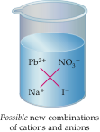
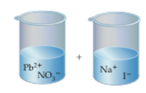

Net Ionic Equations (Pictorally)
How would we write the net ionic equation for this picture?

Slide 30
Concept Check
Is this the net ionic equation?
Ba⁺² + SO₄⁻² + Na⁺ → BaSO₄ + Na⁺
No
Yes

Slide 31
Concept Check
Is this the net ionic equation?
Ba⁺² + SO₄⁻² + Na⁺ → BaSO₄ + Na⁺
No
Yes

Slide 32
Concept Check
Is this the net ionic equation?
Zn⁺² + S⁻² → ZnS
No
Yes

Slide 33
Concept Check
Is this the net ionic equation?
Zn⁺² + S⁻² → ZnS
No
Yes

Slide 34
Concept Check
Is this the net ionic equation?
Pb²⁺_{(aq)} + 2 NO₃⁻_{(aq)} + 2 Na⁺_{(aq)} + 2 I⁻_{(aq)} → PbI_{2(s)} + 2 Na⁺_{(aq)} + 2 NO₃⁻_{(aq)}
No
Yes

Slide 35
Concept Check
Is this the net ionic equation?
Pb²⁺_{(aq)} + 2 NO₃⁻_{(aq)} + 2 Na⁺_{(aq)} + 2 I⁻_{(aq)} → PbI_{2(s)} + 2 Na⁺_{(aq)} + 2 NO₃⁻_{(aq)}
No
Yes

Slide 36
Colligative Properties
When we add electrolytes to water, we change the properties of the water
The interactions between the electrolytes and the water cause this
There are three properties that change:
  Boiling Point
  Freezing Point
  Vapor Pressure
  Do you think that the values increase or decrease for each of these properties?

Slide 37
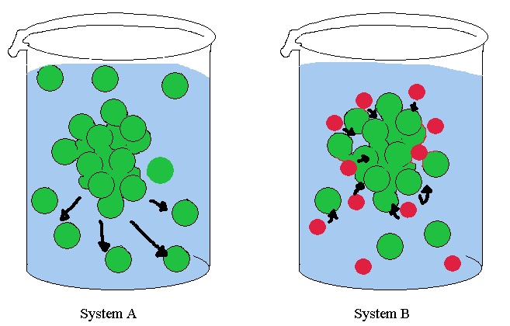
Freezing Point Depression
When a solute is added to a solution, the freezing point always decreases.
The solute prevents the molecules of the liquid from coming close together, delaying freezing.

Slide 38
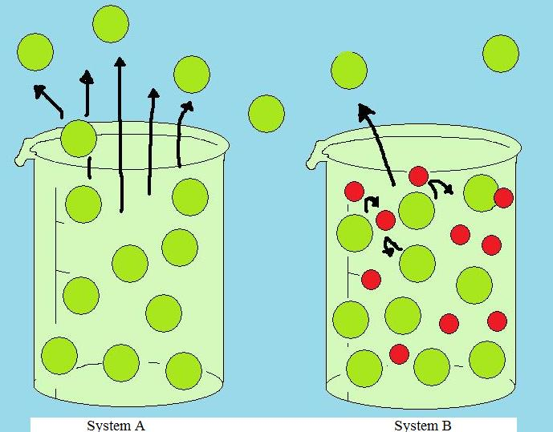
Boiling Point Elevation
When a solute is added to a solution, the boiling point always increases.
The solute prevents the molecules of the liquid from escaping from the surface, delaying boiling.

Slide 39
Concept Check
REGENTS
QUESTION
A 0.100 M aqueous solution of which compound has the lowest freezing point?
1.
2.
3.
4.
C₆H₁₂O₆ CH₃OH C₁₂H₂₂O₁₁ NaOH

Slide 40
Concept Check
REGENTS
QUESTION
A 0.100 M aqueous solution of which compound has the lowest freezing point?
1.
2.
3.
4.
C₆H₁₂O₆ CH₃OH C₁₂H₂₂O₁₁ NaOH

Slide 41
Concept Check
Why do we use salt to keep ice off of the sidewalks instead of sugar?

